Slide 1
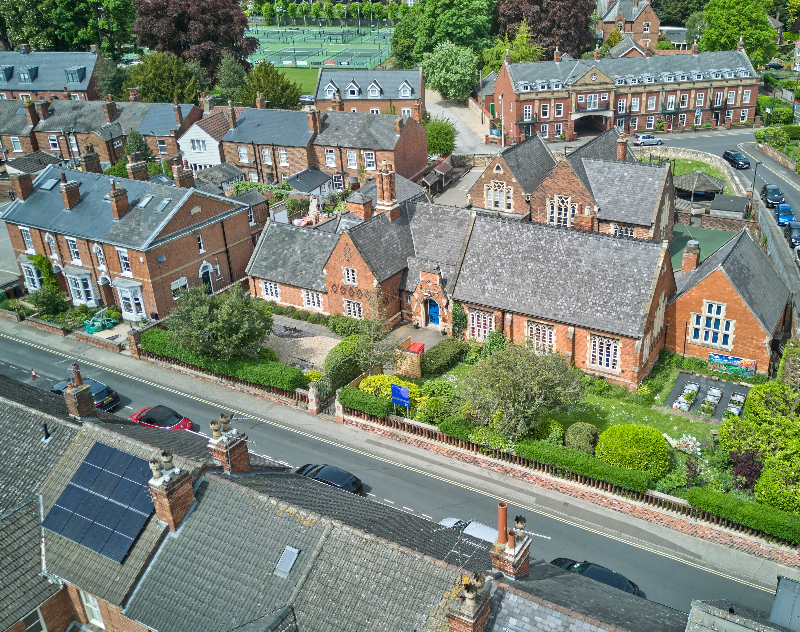
Welcome St Peter in Eastgate C of E Infant School

Slide 2
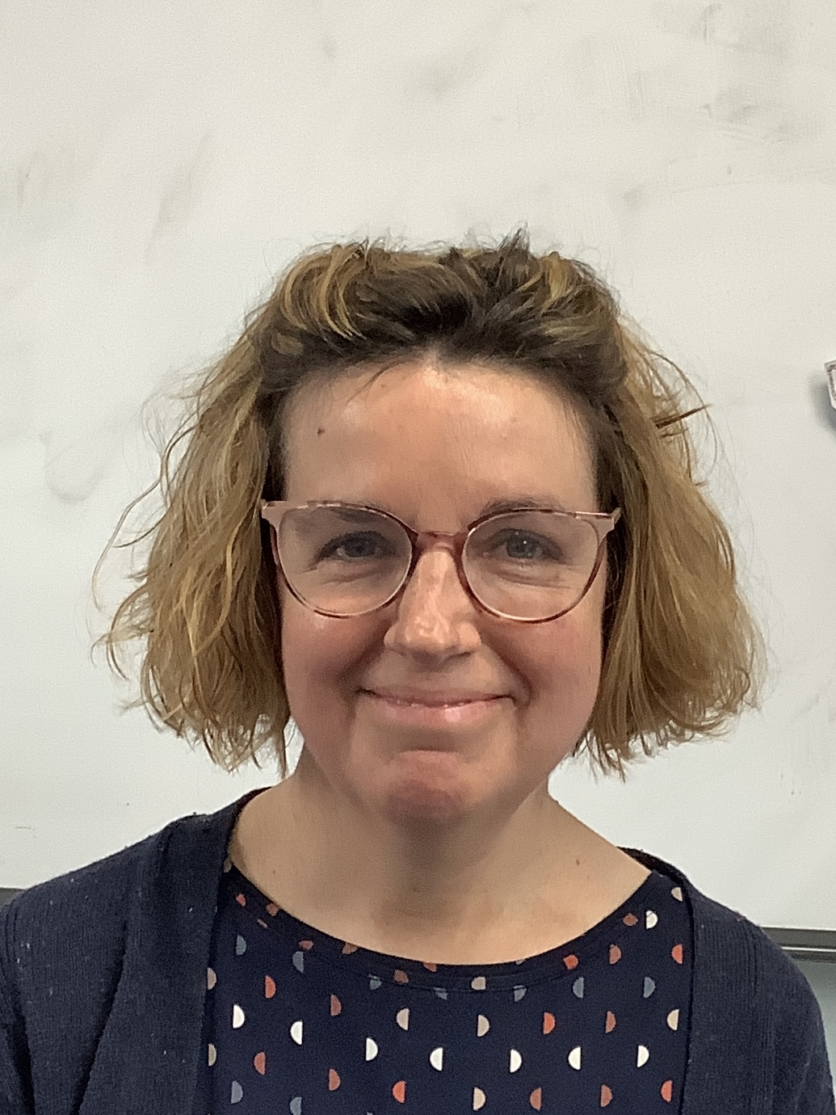
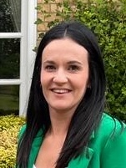
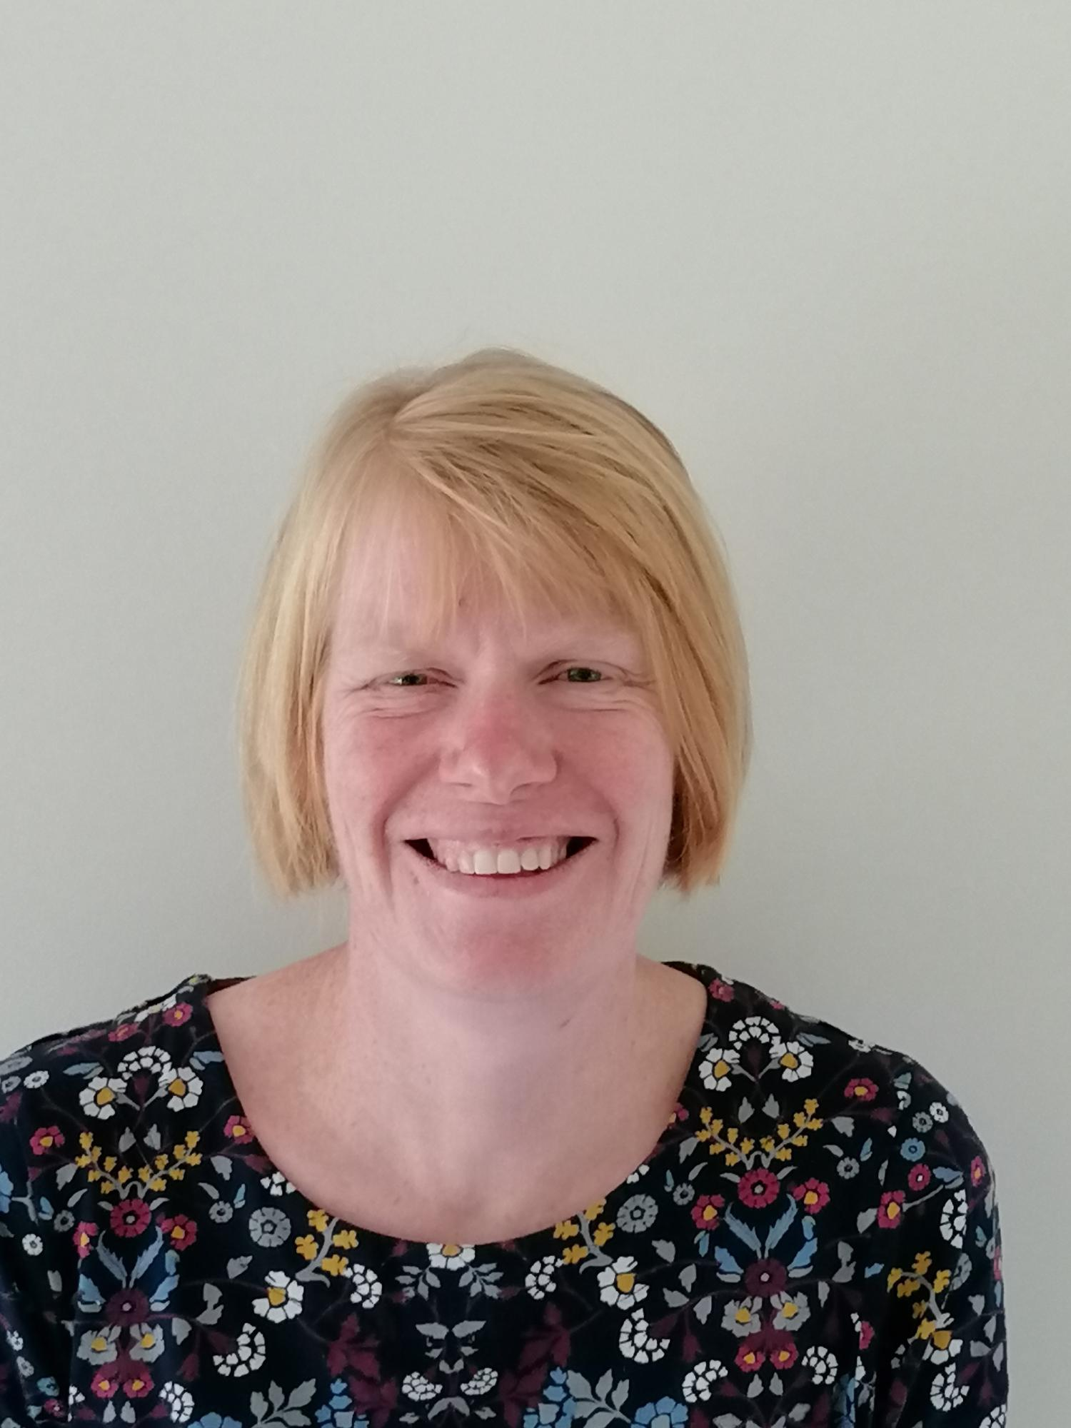
Reception staff team
Mrs Chenh Miss White
Class teacher Teaching assistant
Mrs Marshall
Headteacher

Slide 3





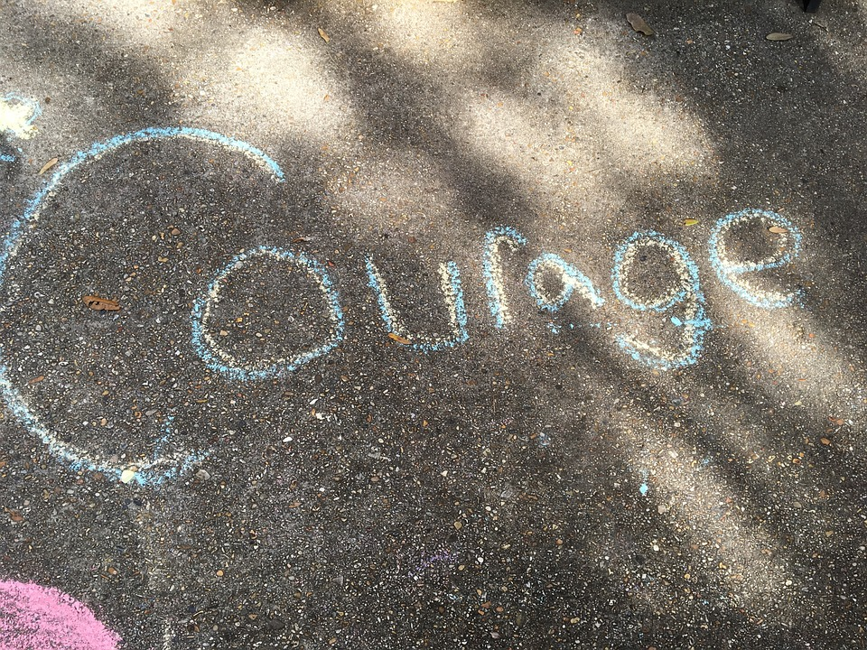
Vision
Our vision is to encourage and support all to develop their talents, knowledge and skills in a secure and happy environment, following Jesus’ example to walk in the way of love.
‘Live a life of love, just as Christ loved us’
Ephesians 5:2a
This Photo by Unknown Author is licensed under CC BY-SA

Slide 4
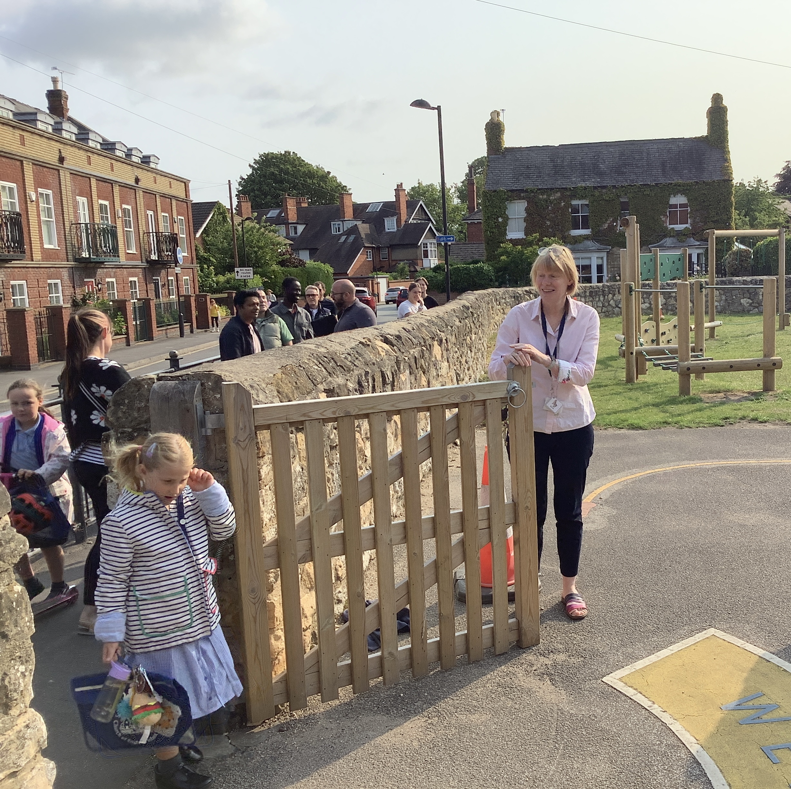
Start and end of the day
The school gates are at the back of school they open at 8.35am. School starts at 8.50am.
We finish school at 3.15pm. The back gate opens at 3.05pm.

Slide 5
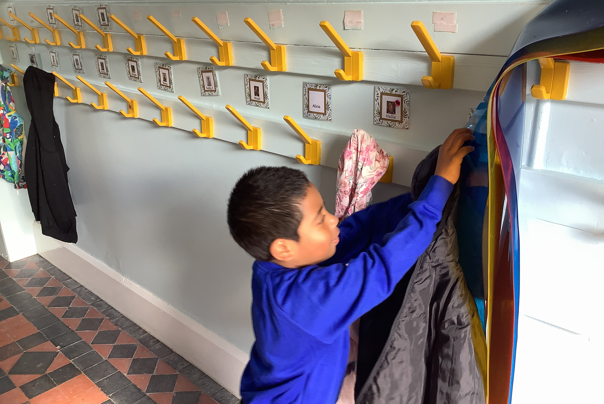
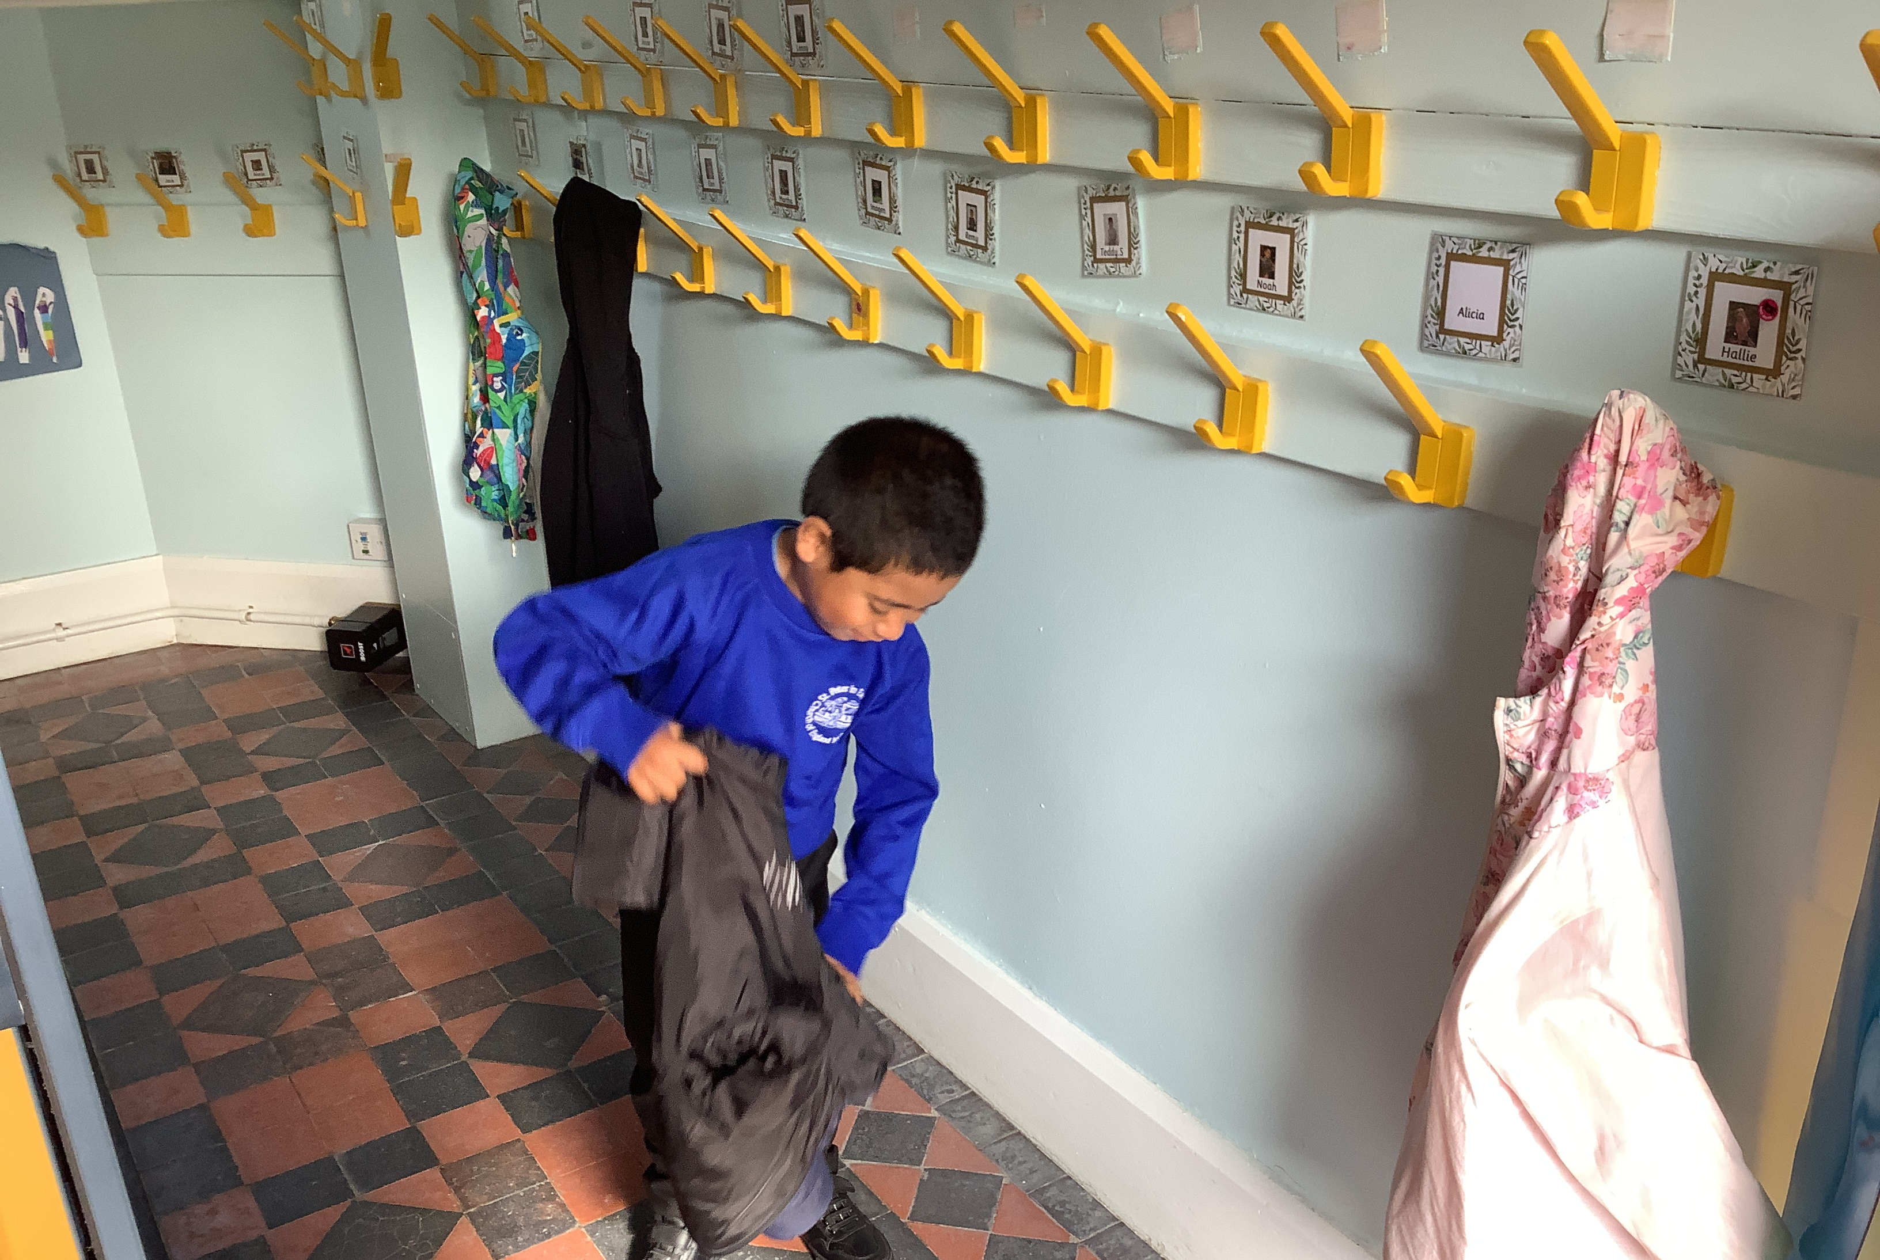
Coming into the classroom

Slide 6
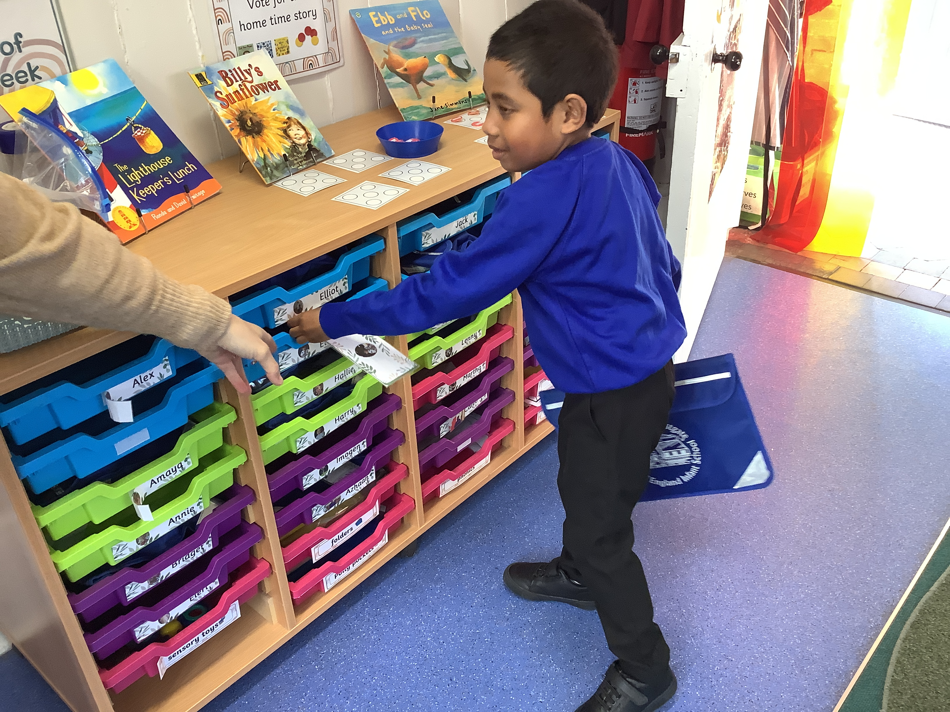
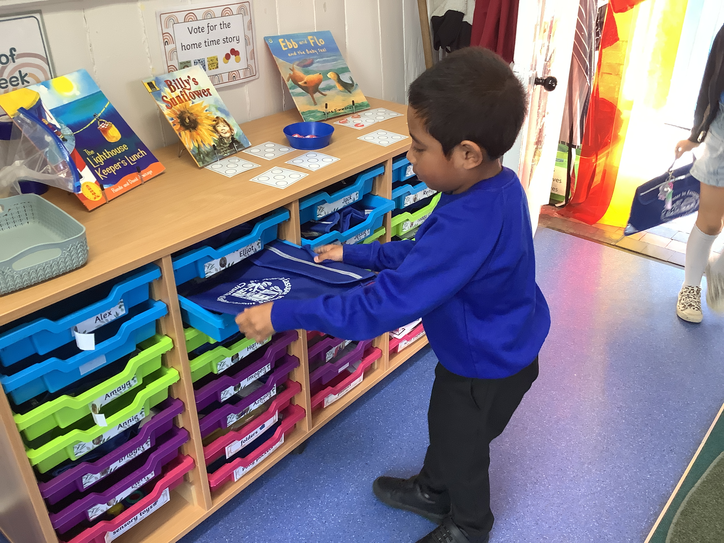
Name cards and book bags

Slide 7
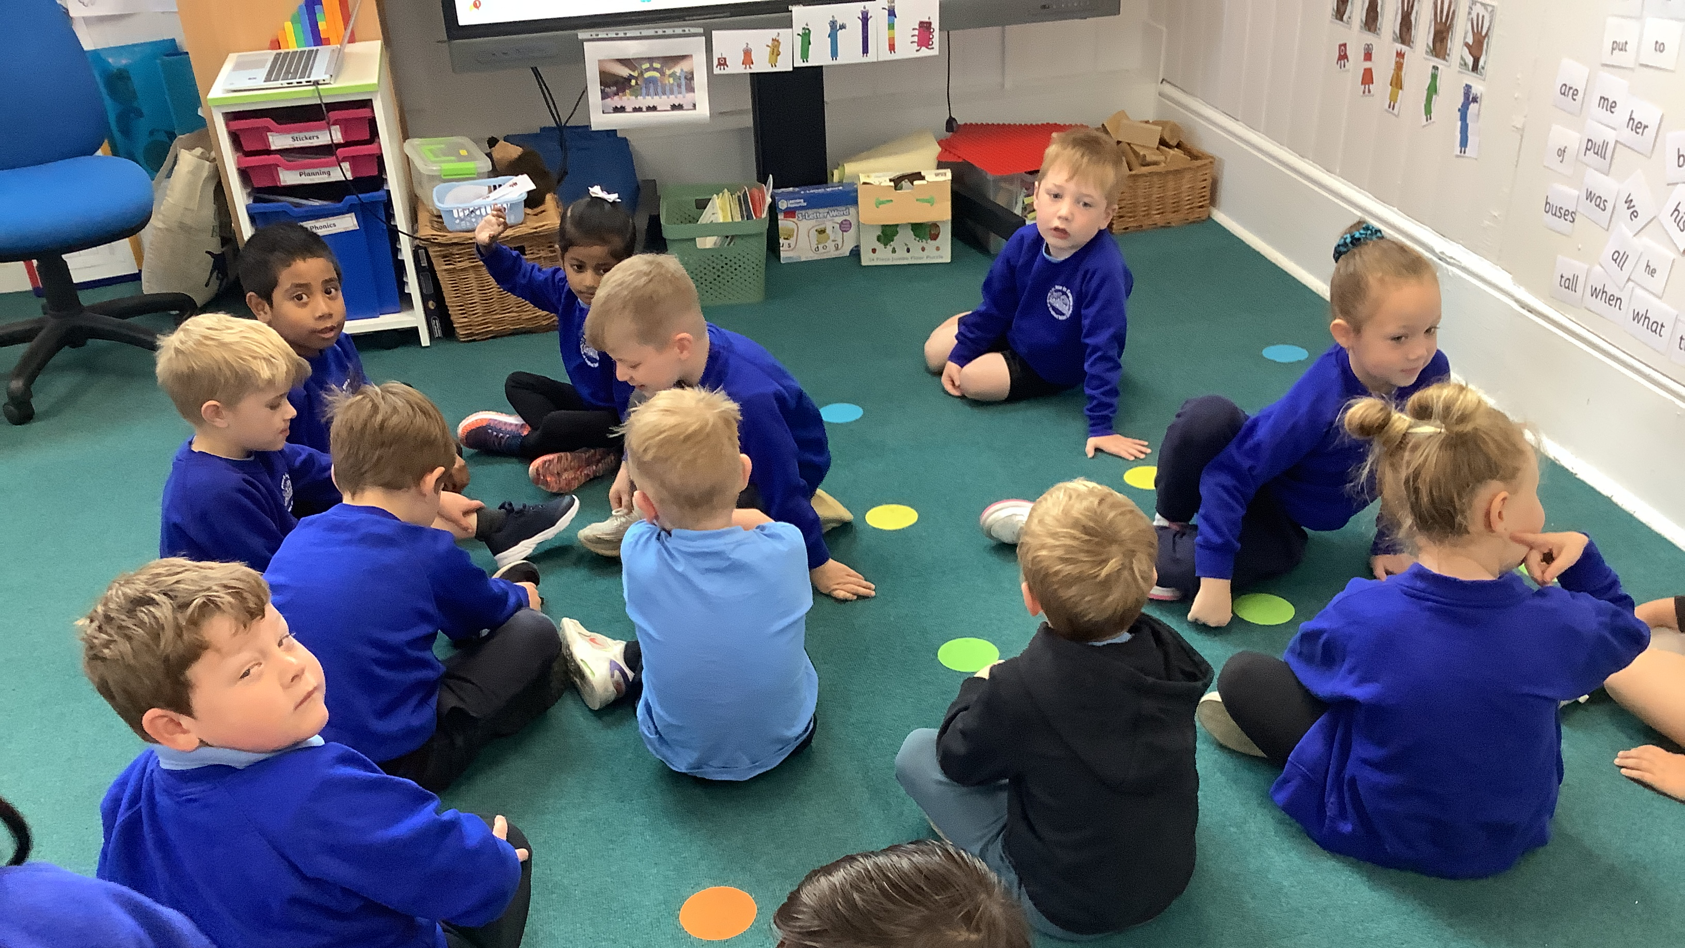
Find carpet spot

Slide 8
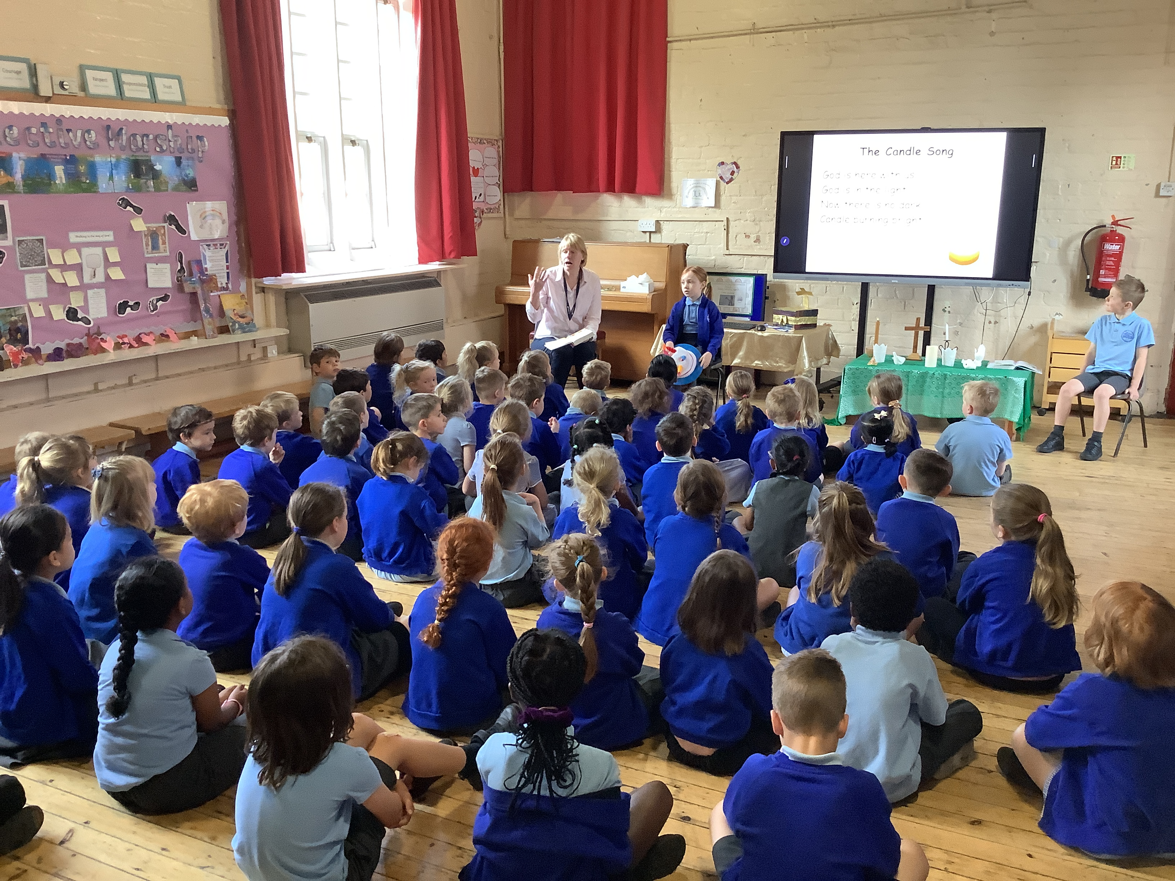
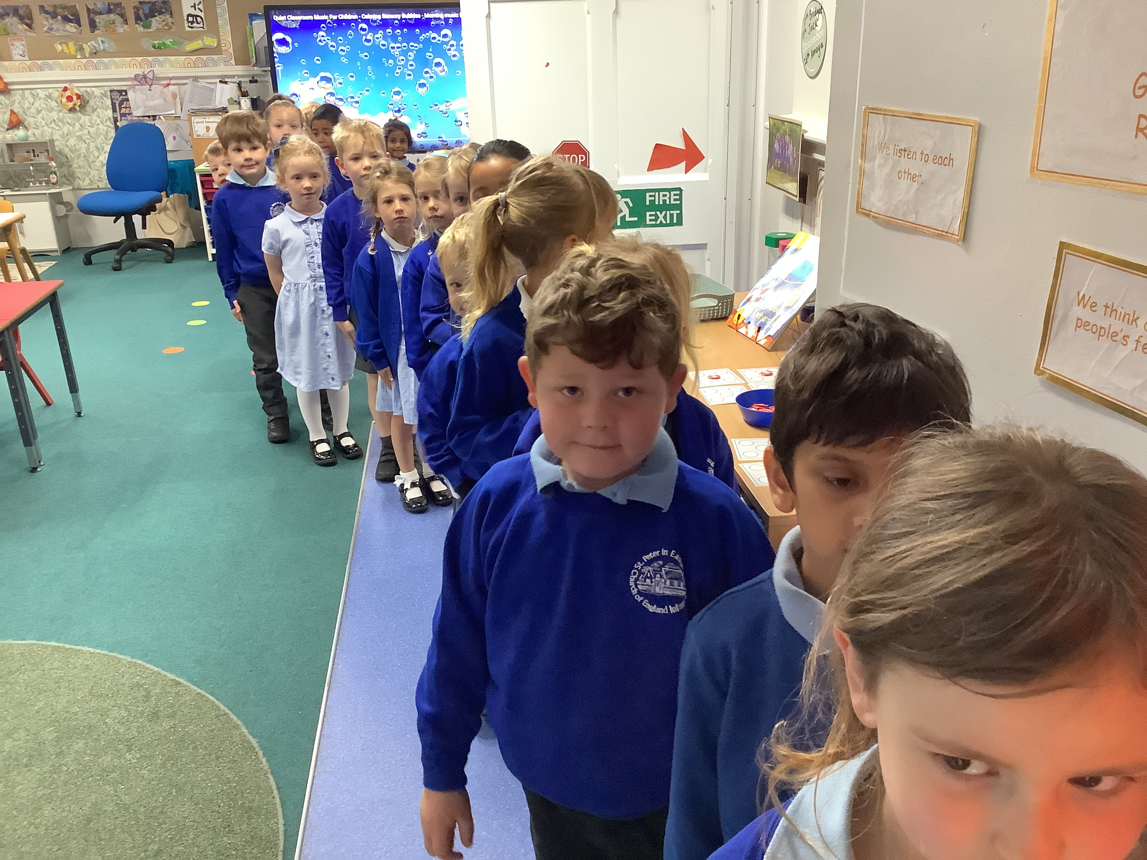
Collective Worship, line up

Slide 9
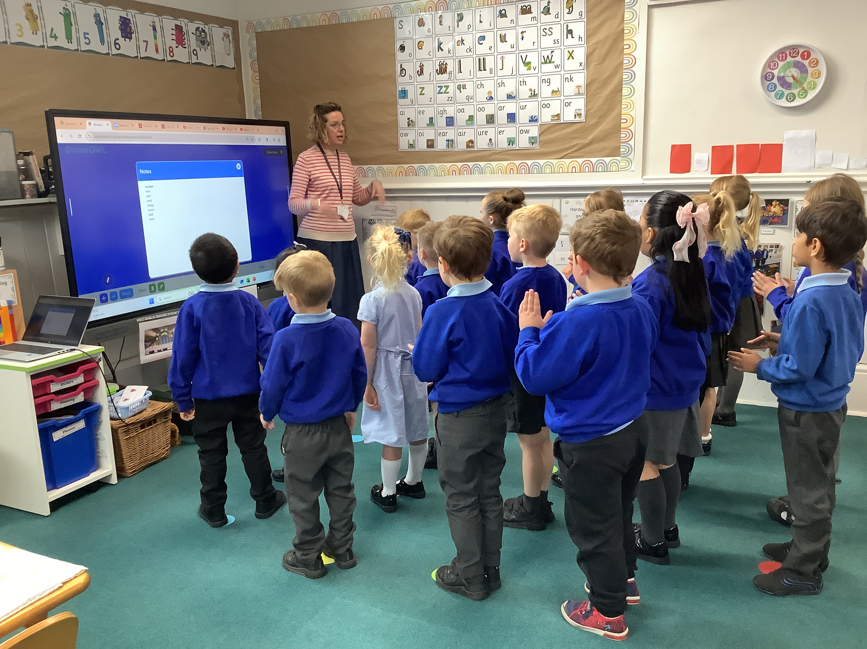
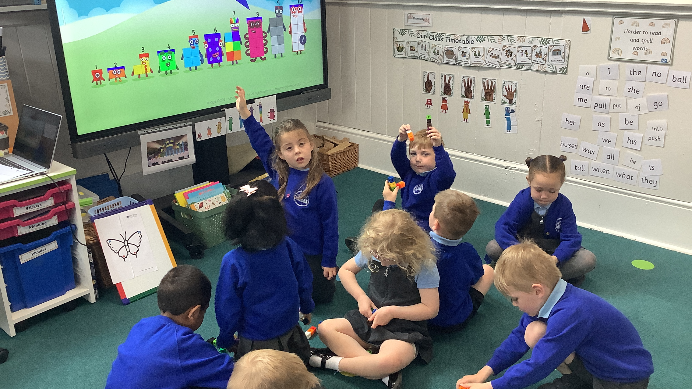
Phonics/maths

Slide 10
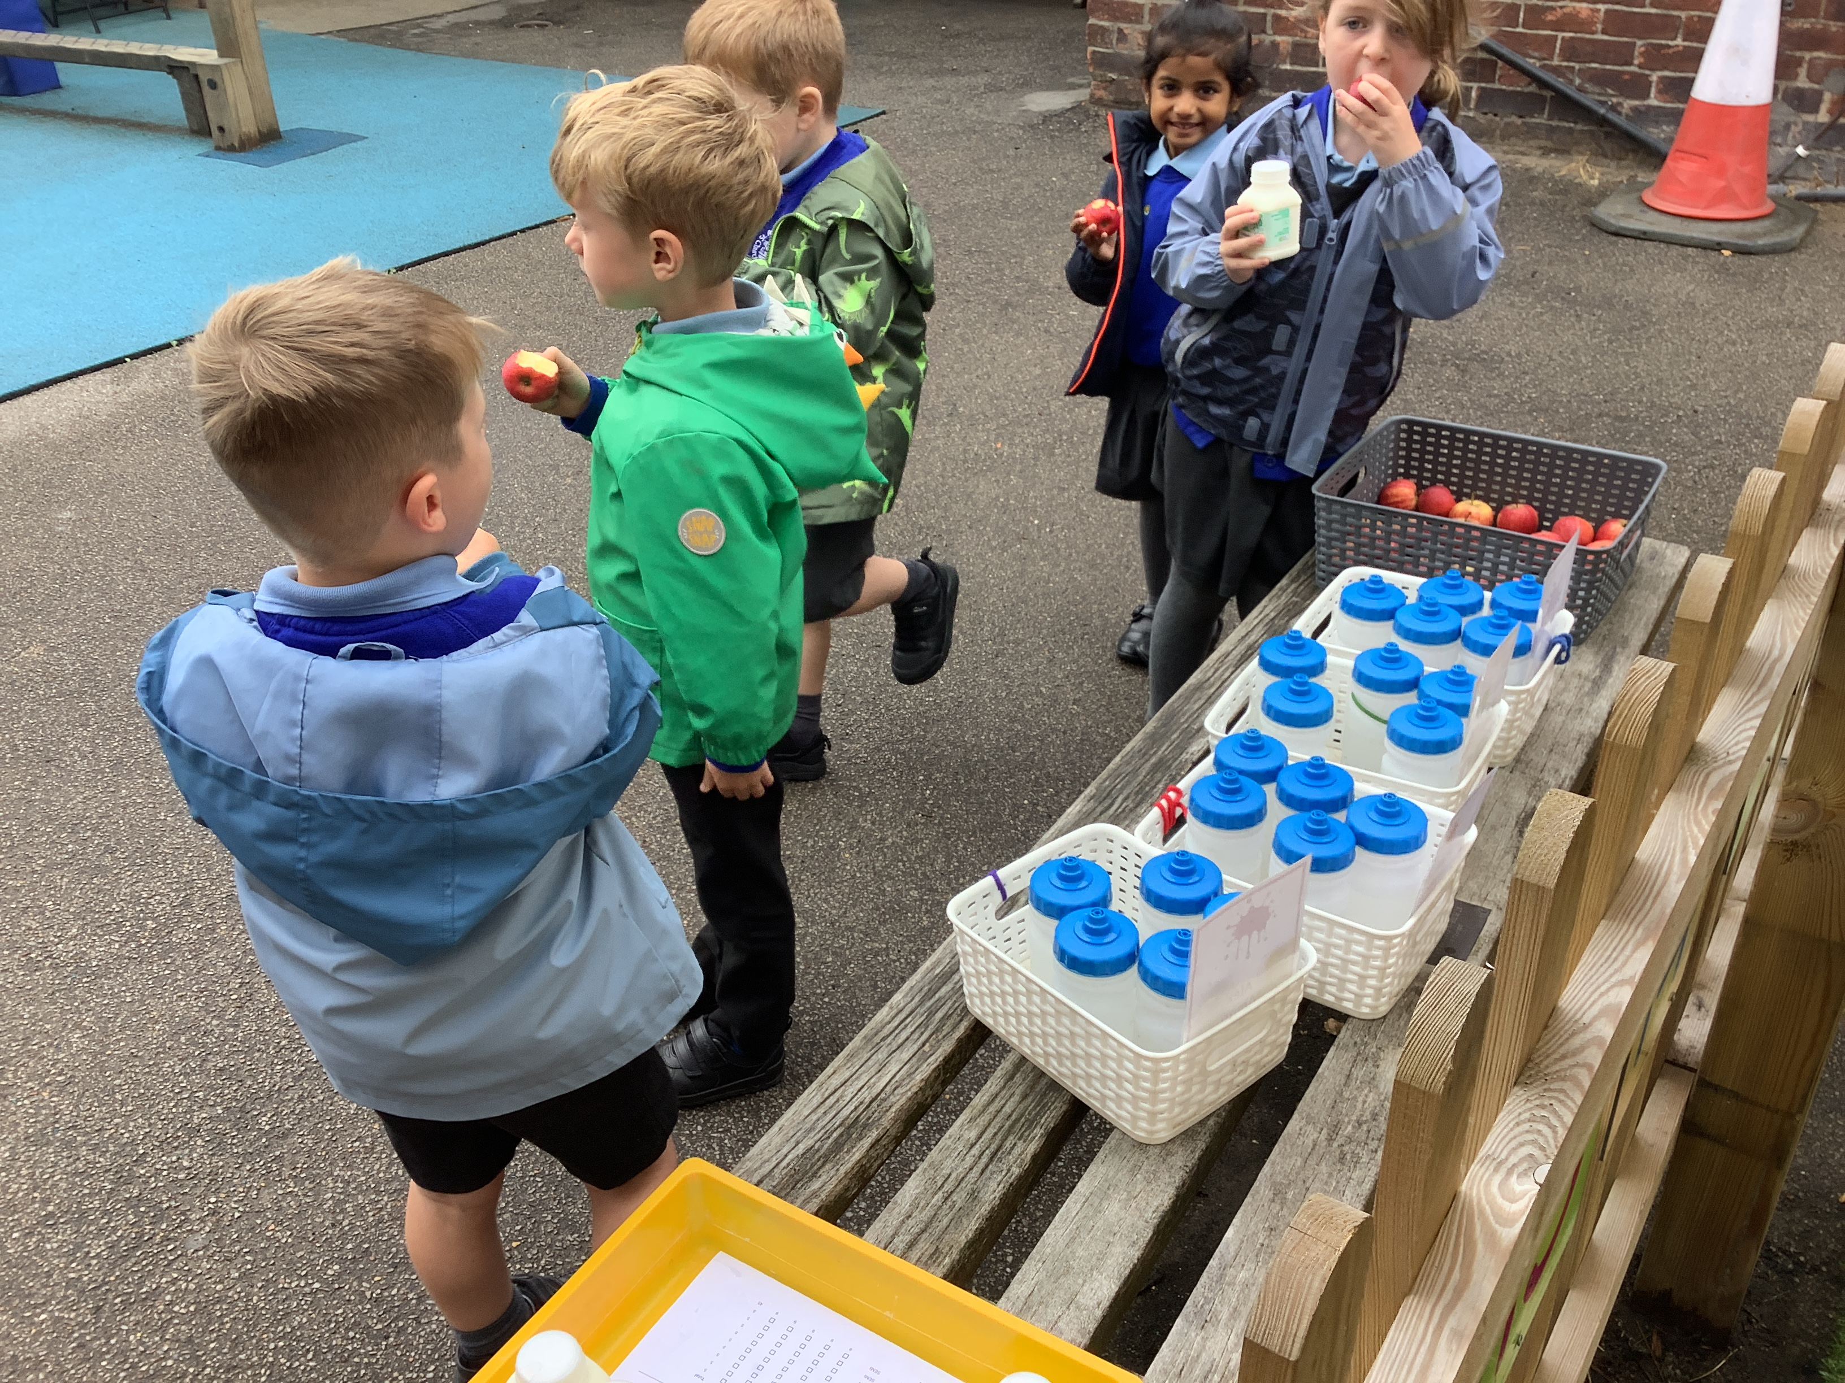
Playtime – fruit and milk

Slide 11
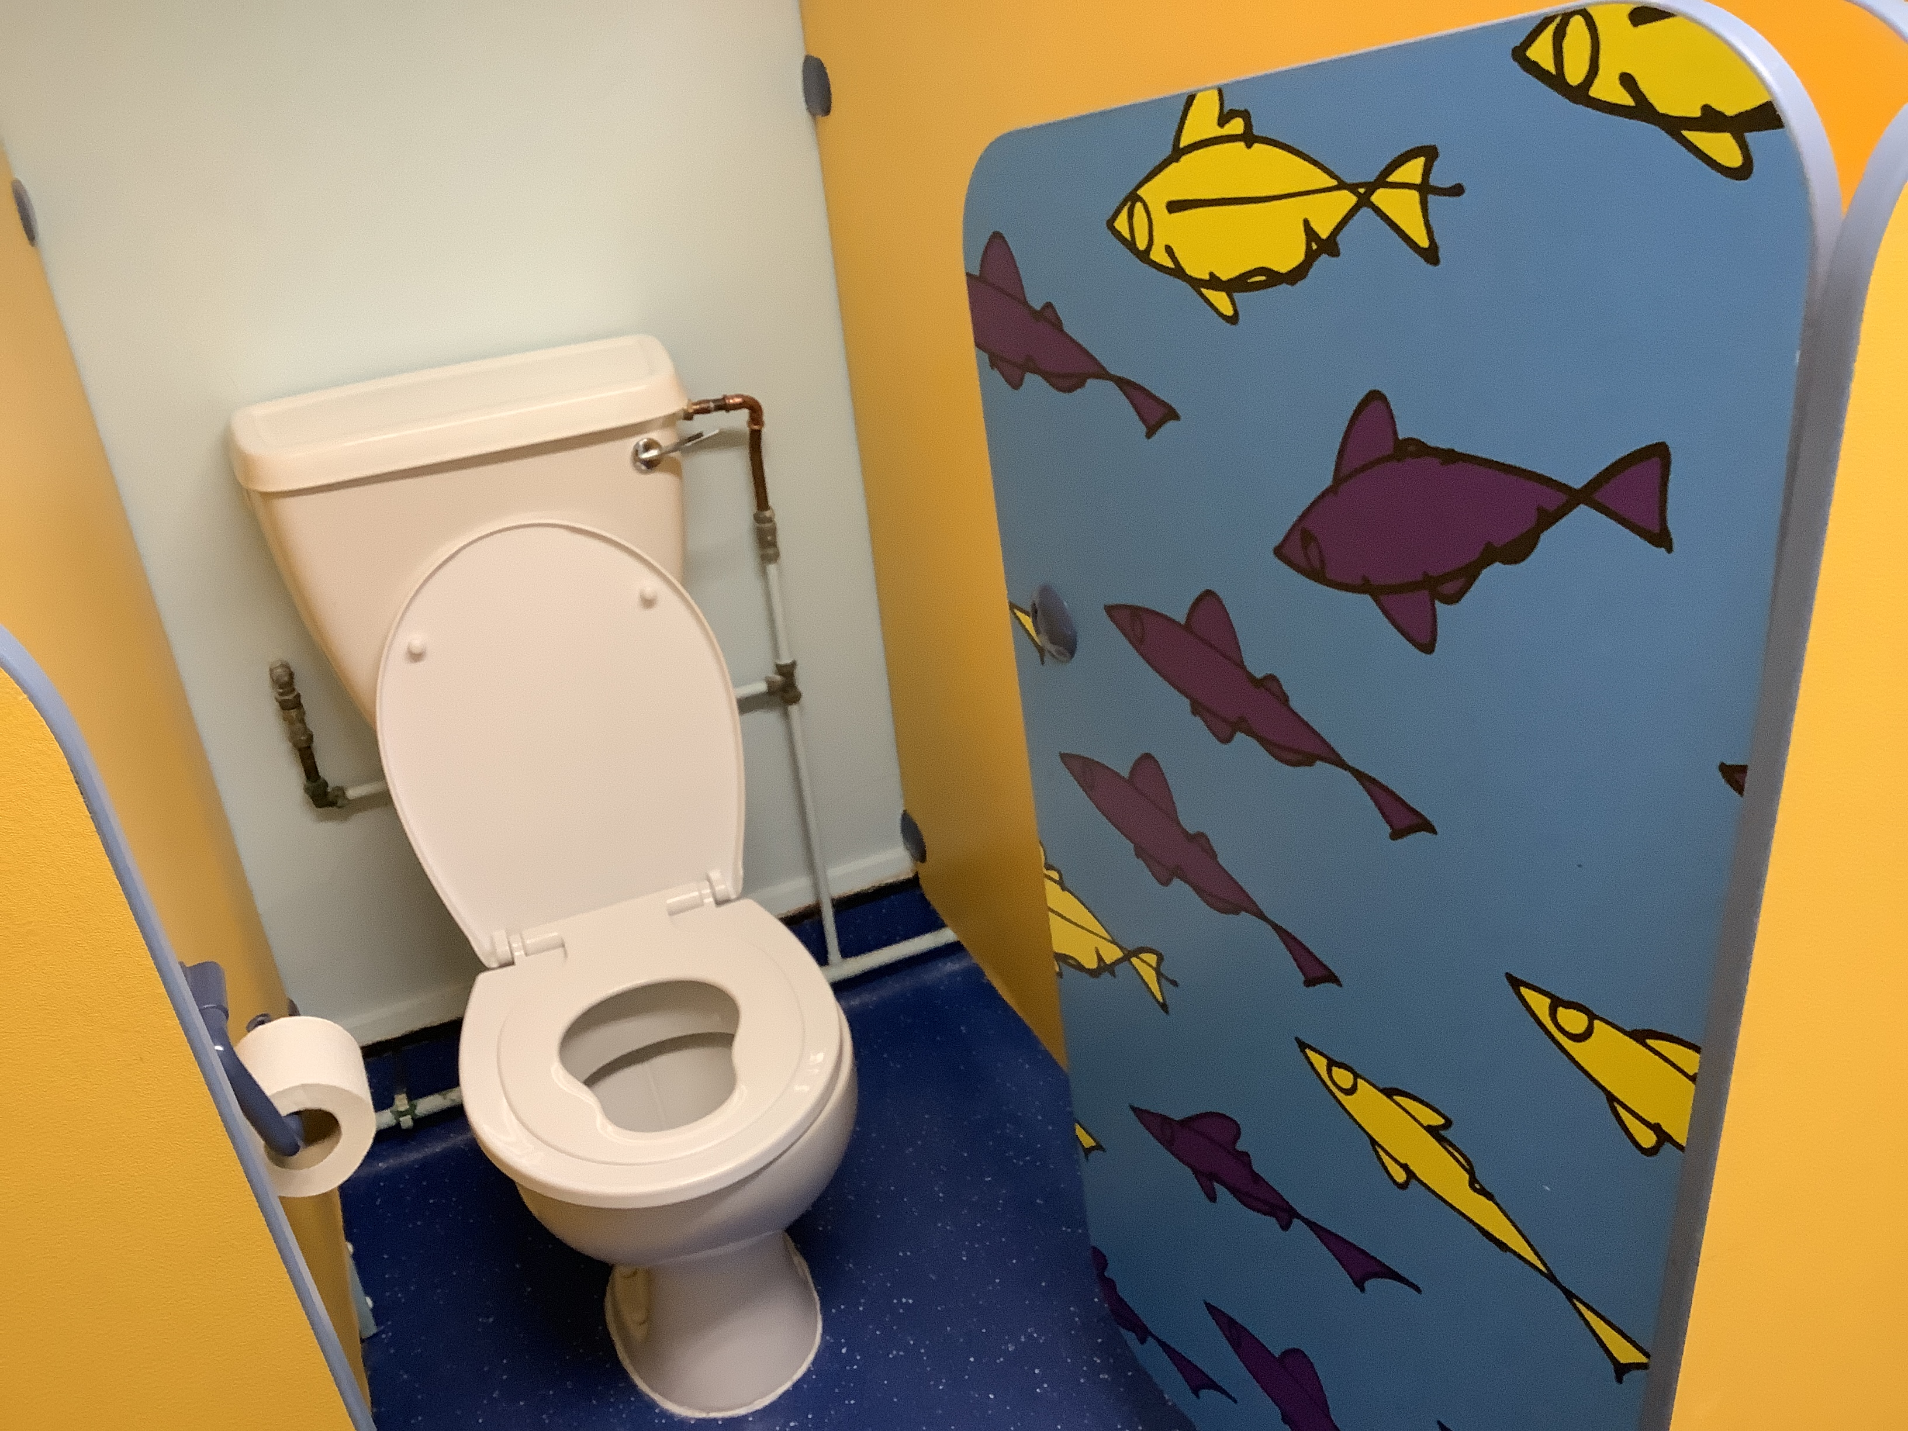
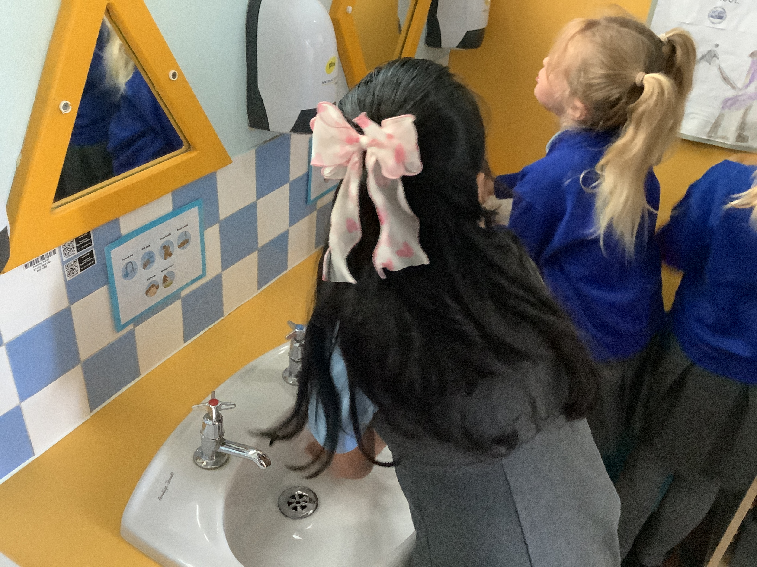
Toilet

Slide 12
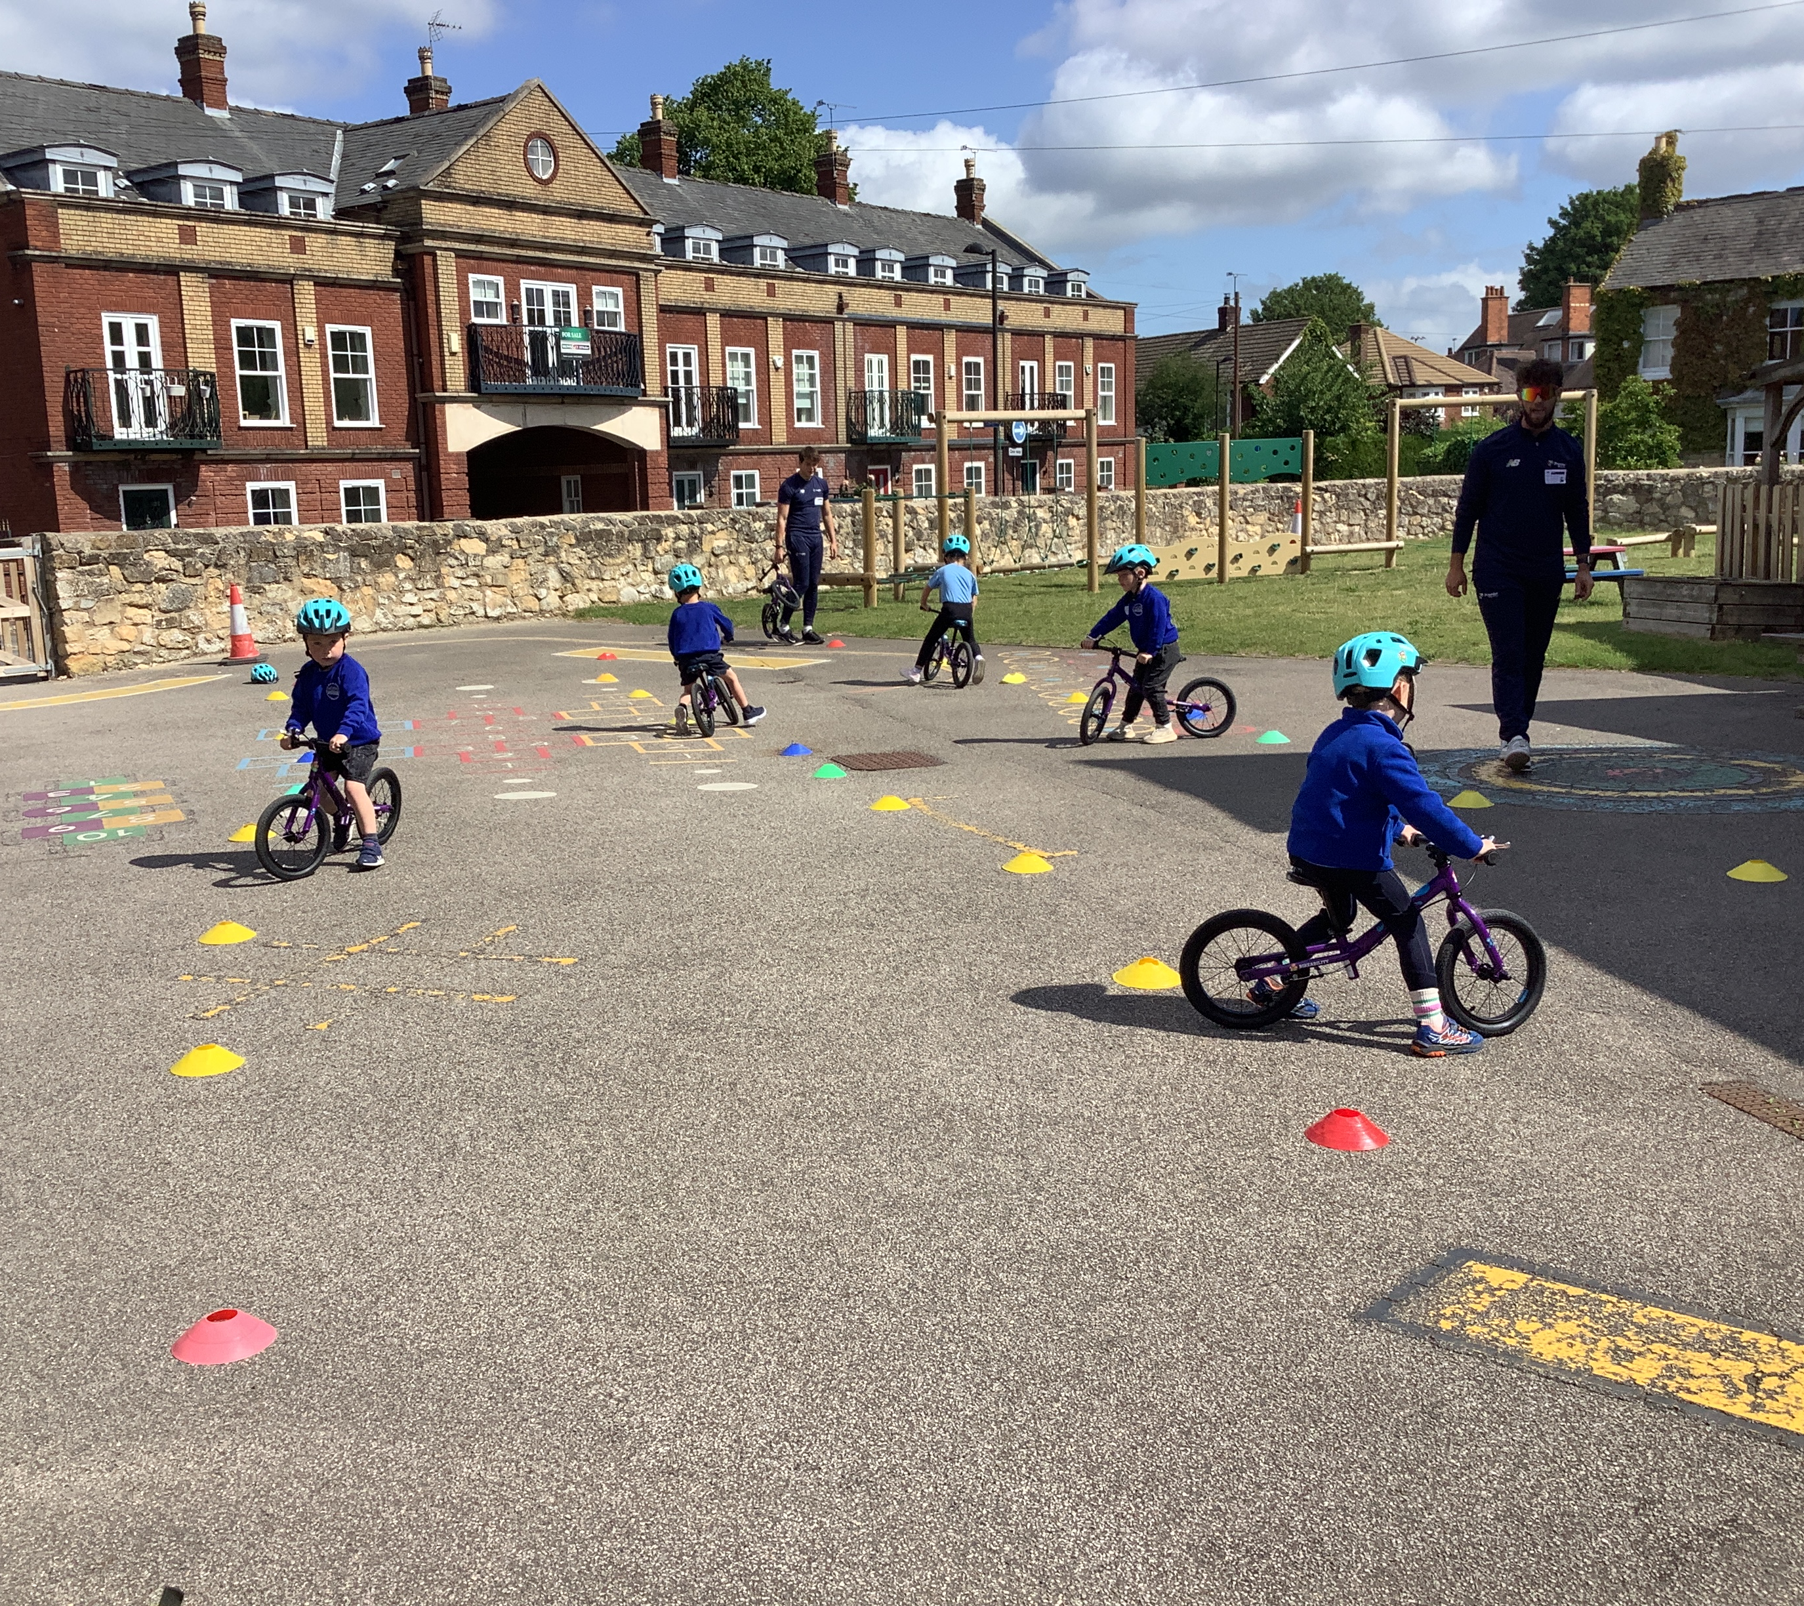
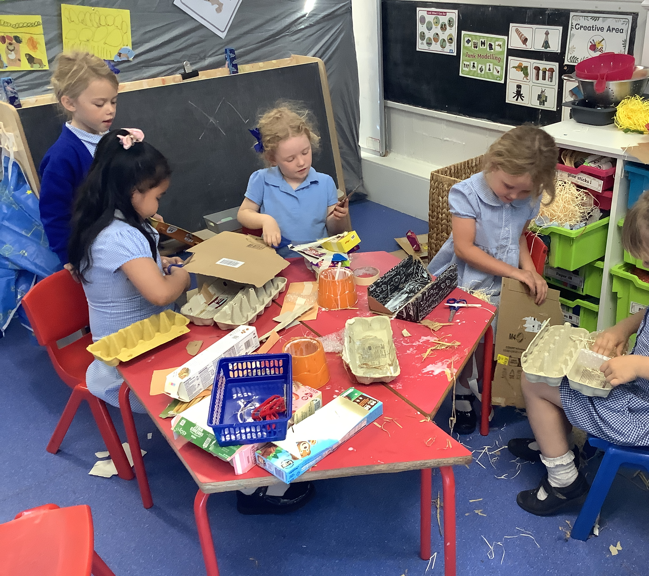
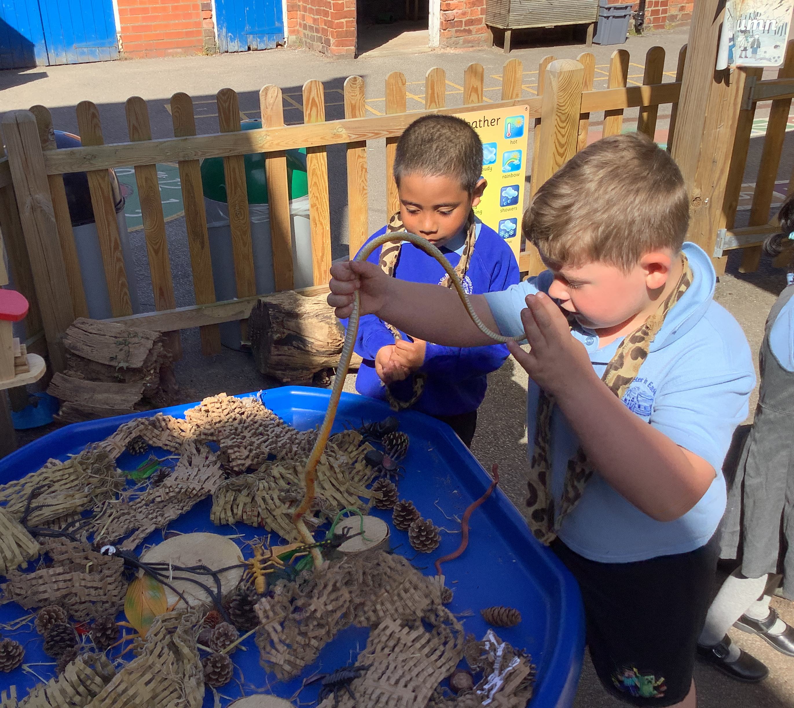
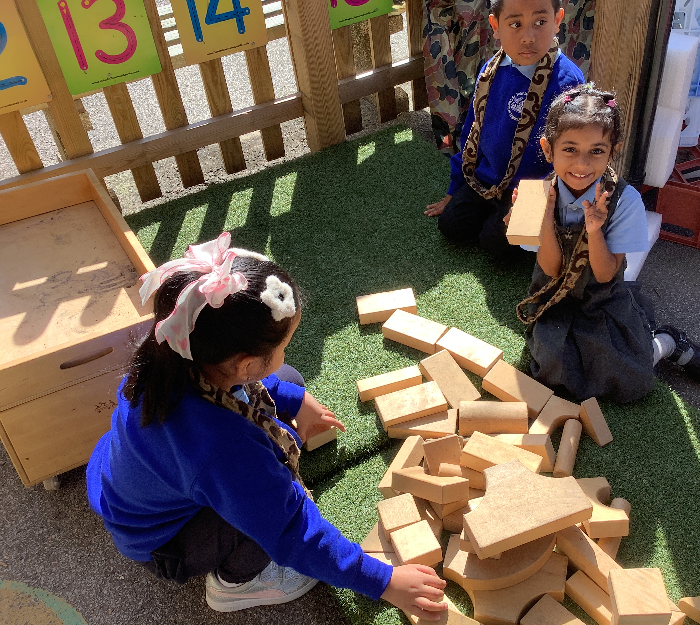
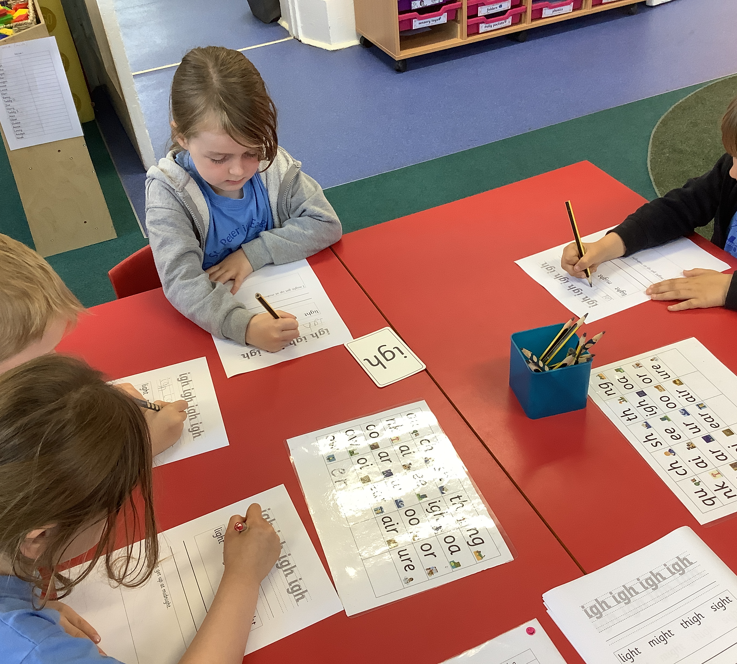
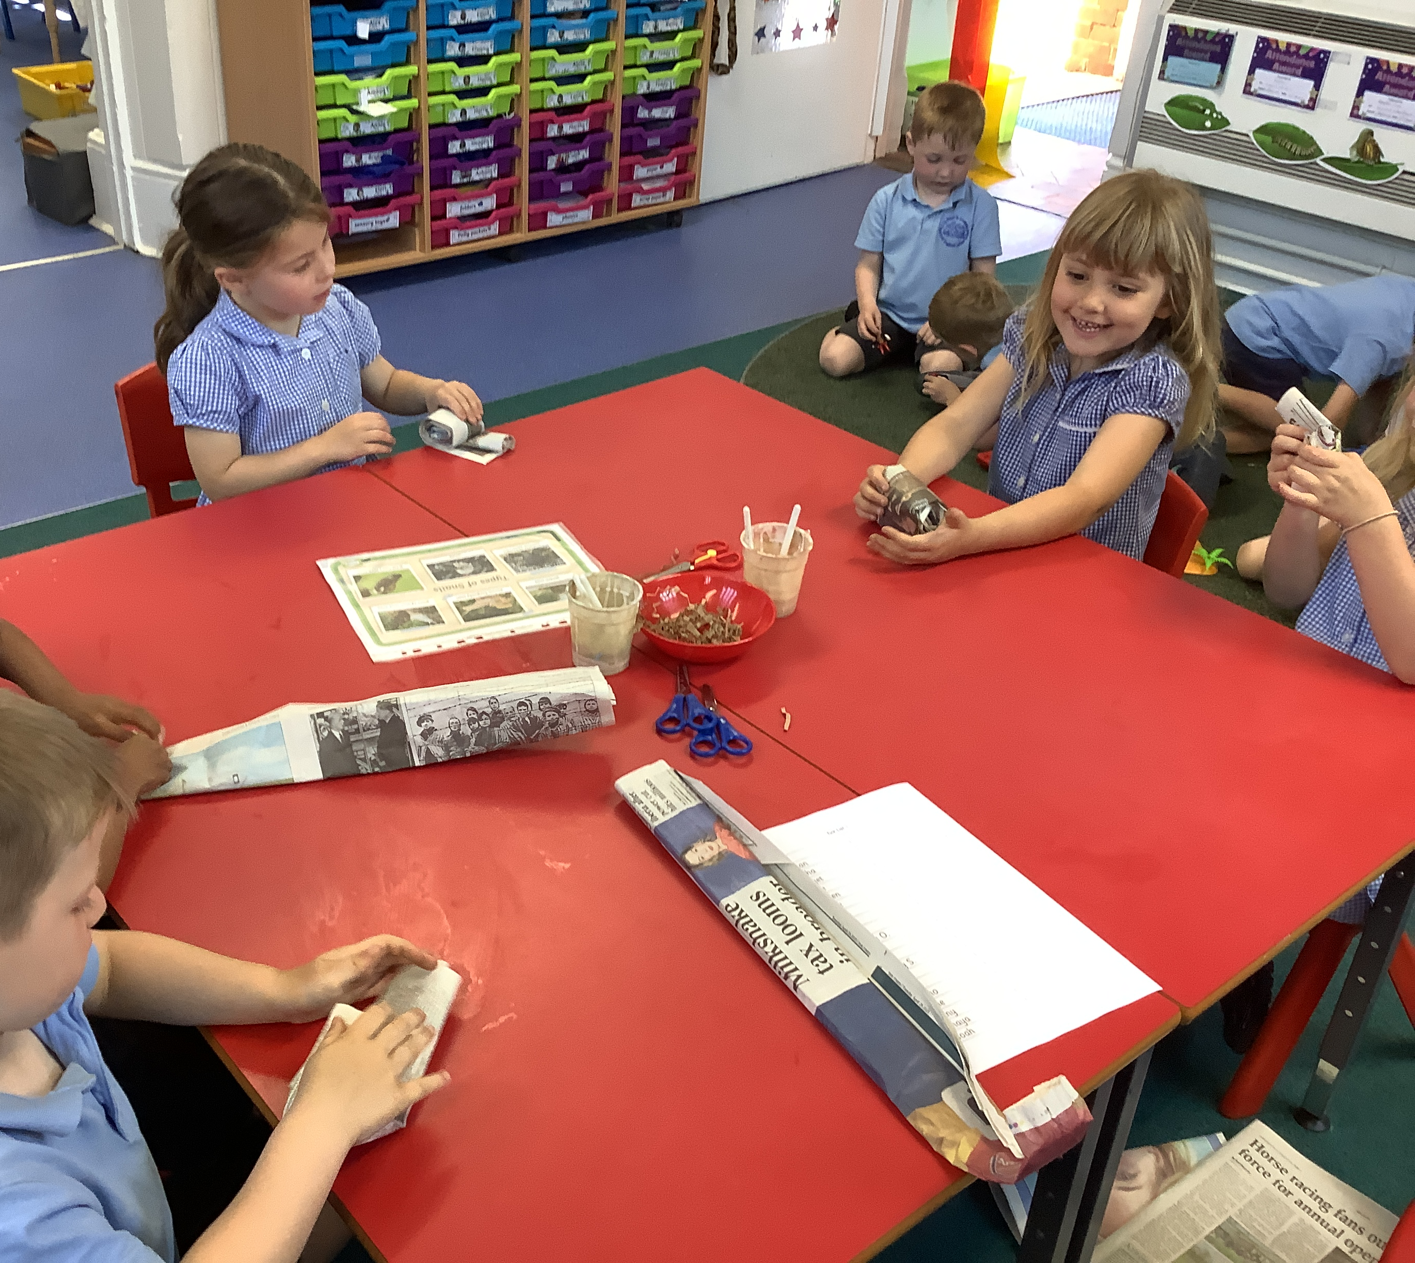
Exploring the classroom

Slide 13
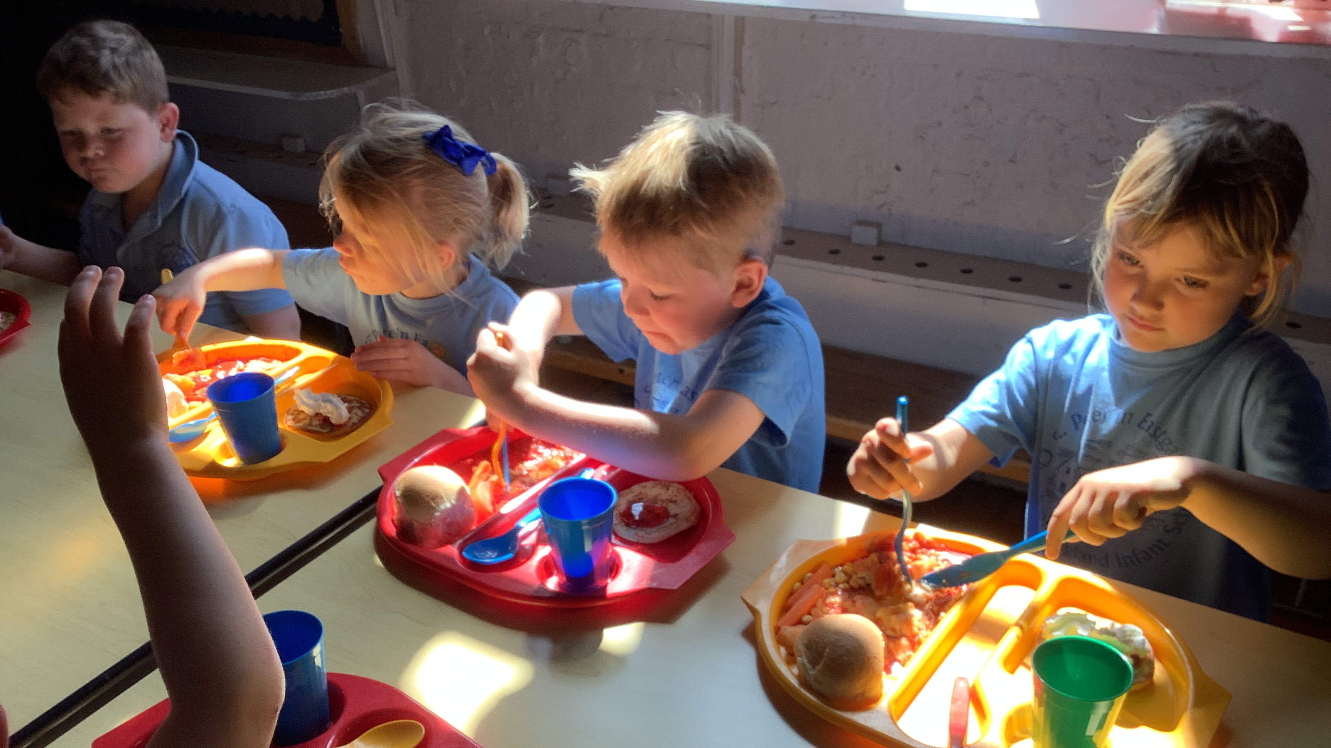
Lunchtime

Slide 14
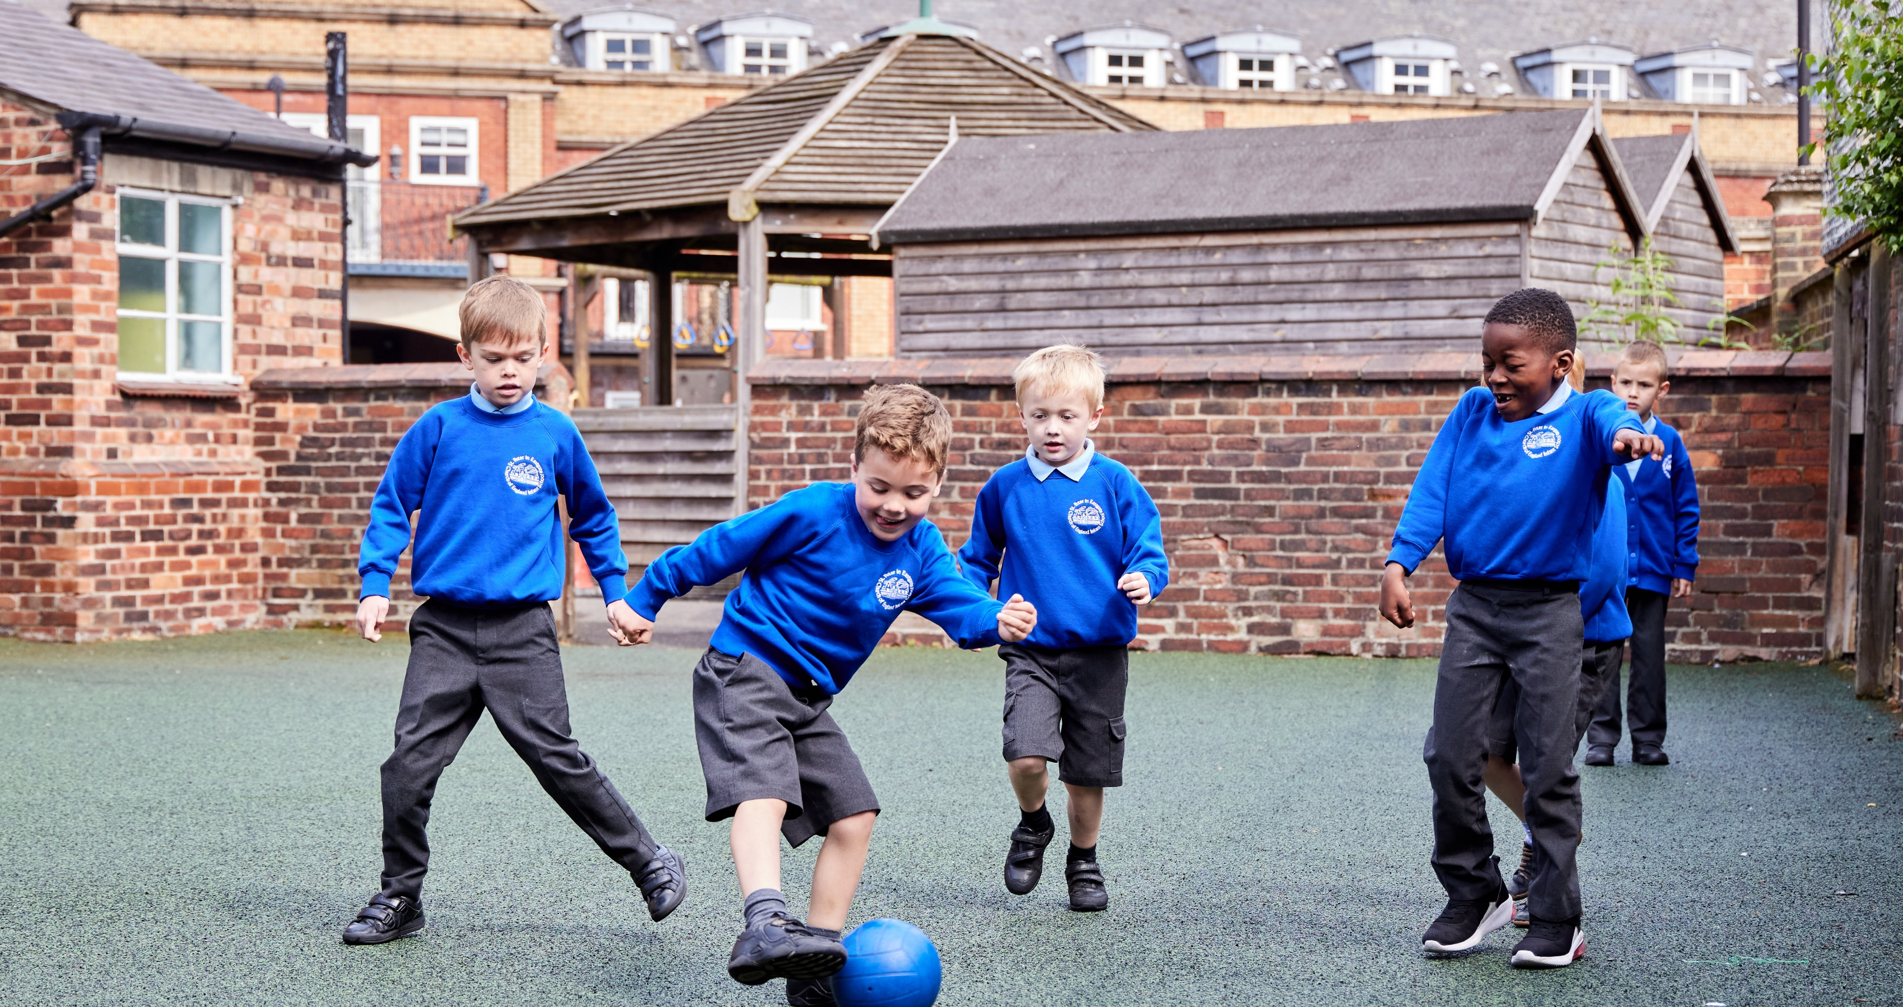
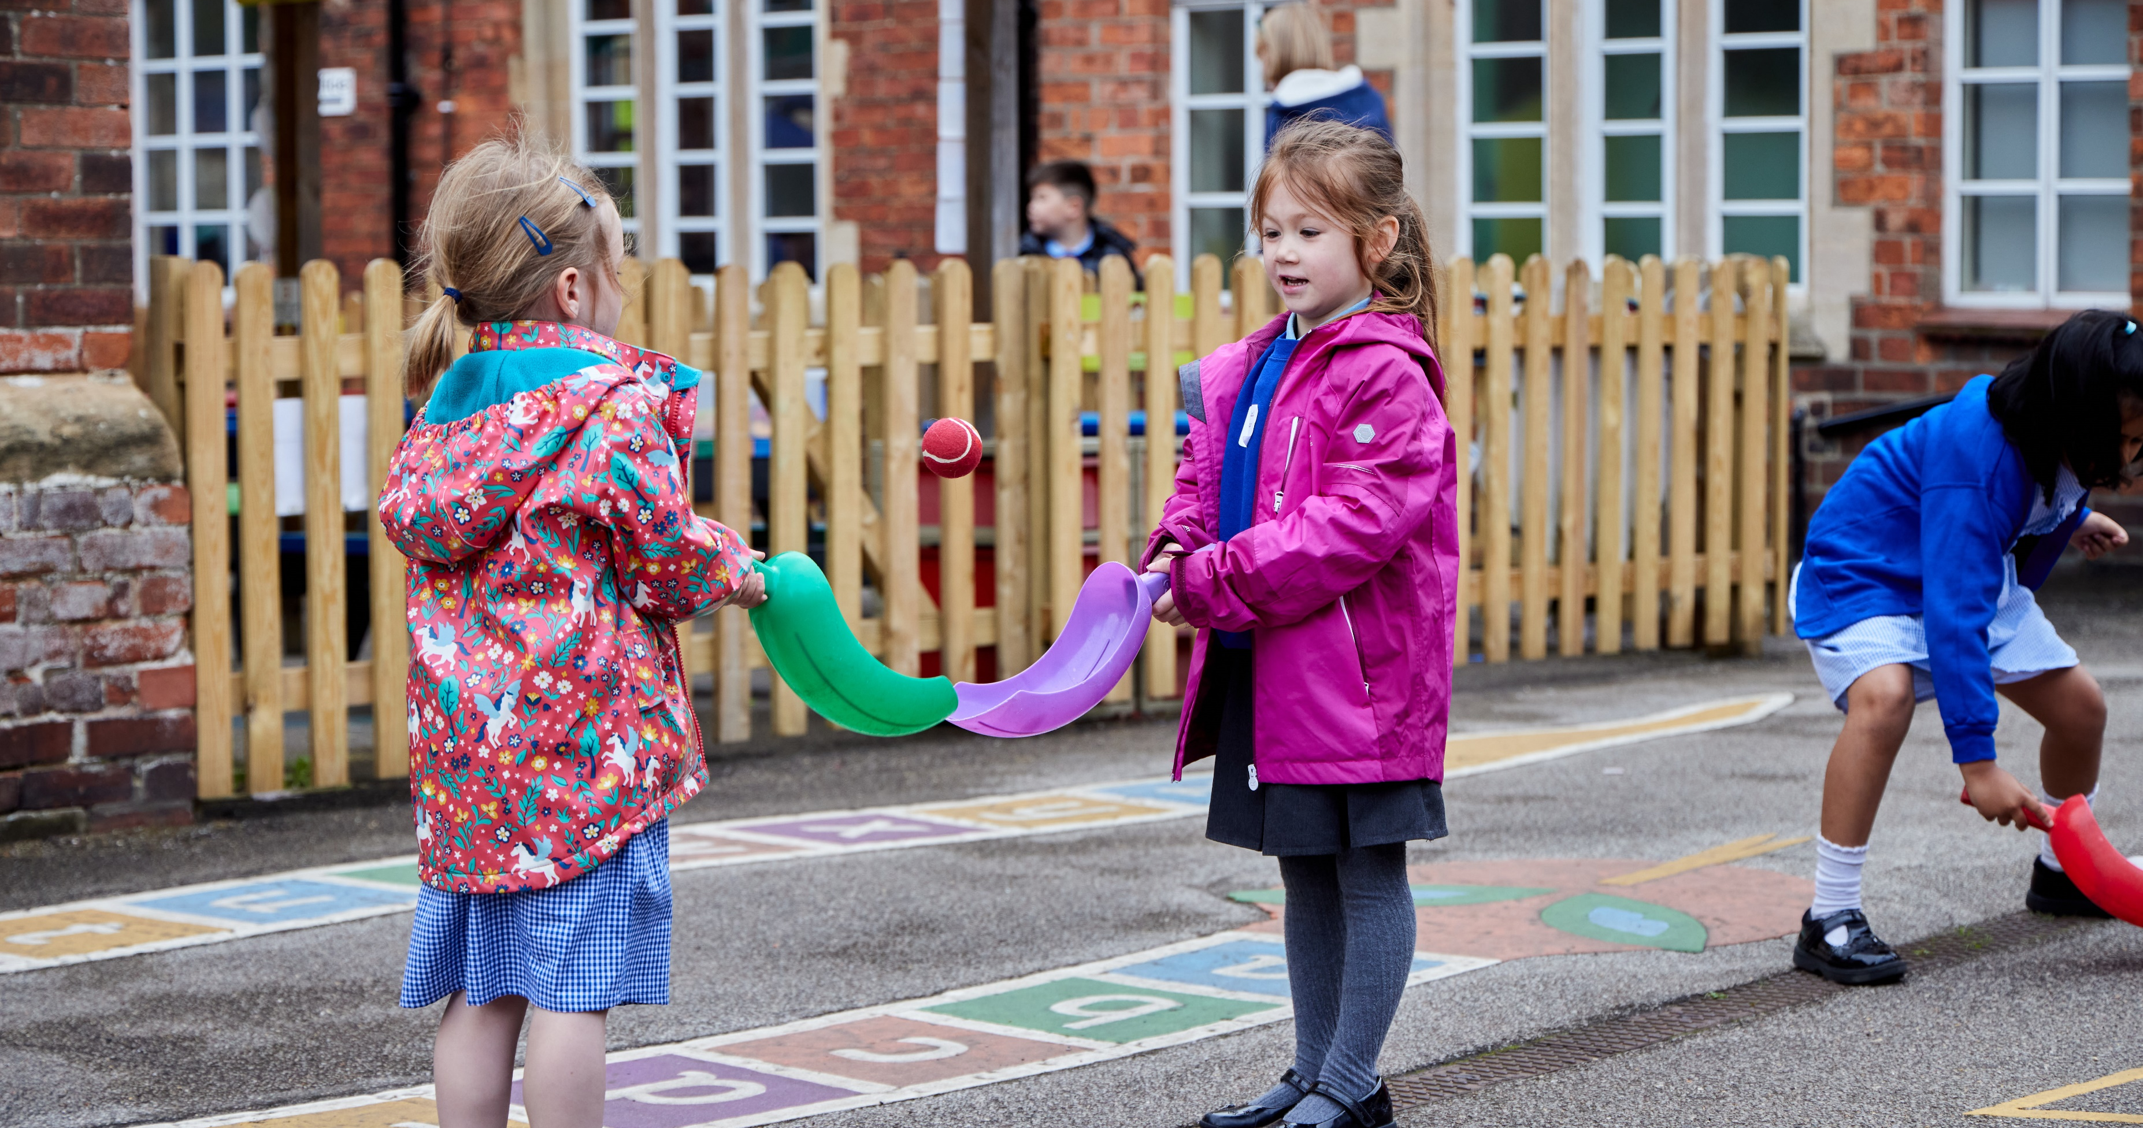
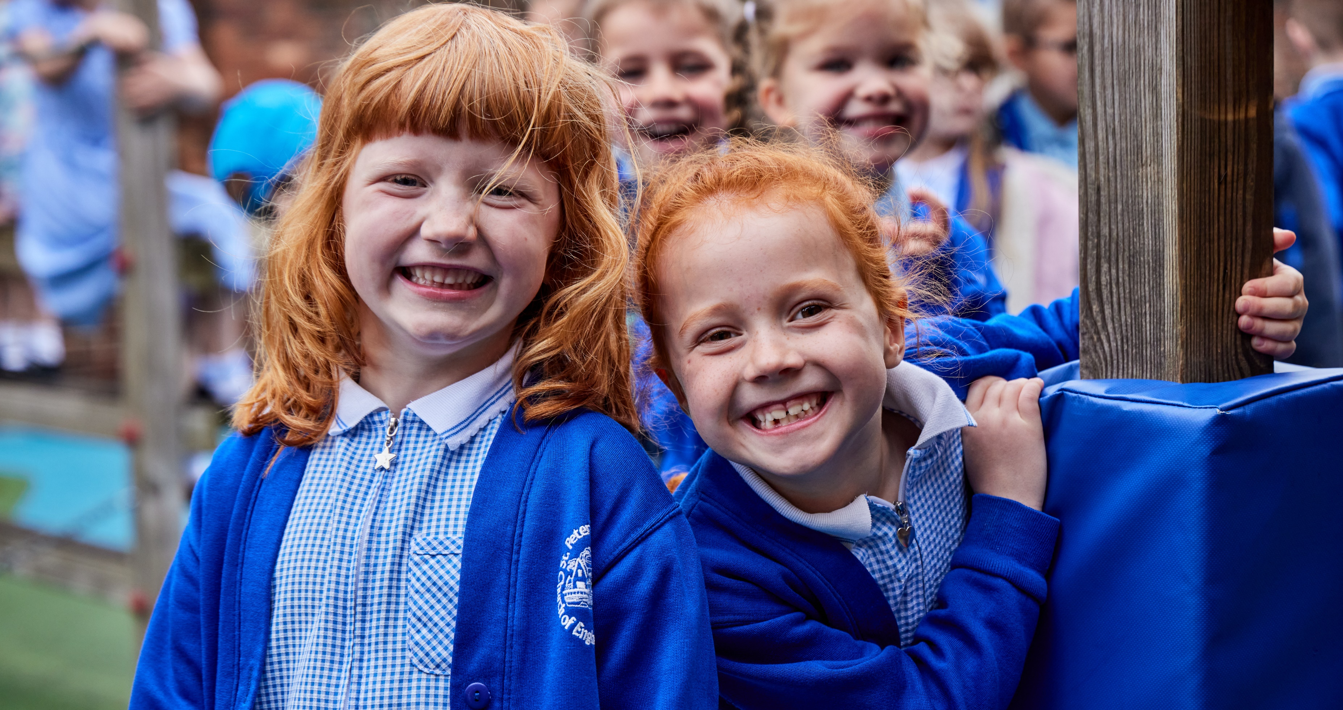
Playtime

Slide 15
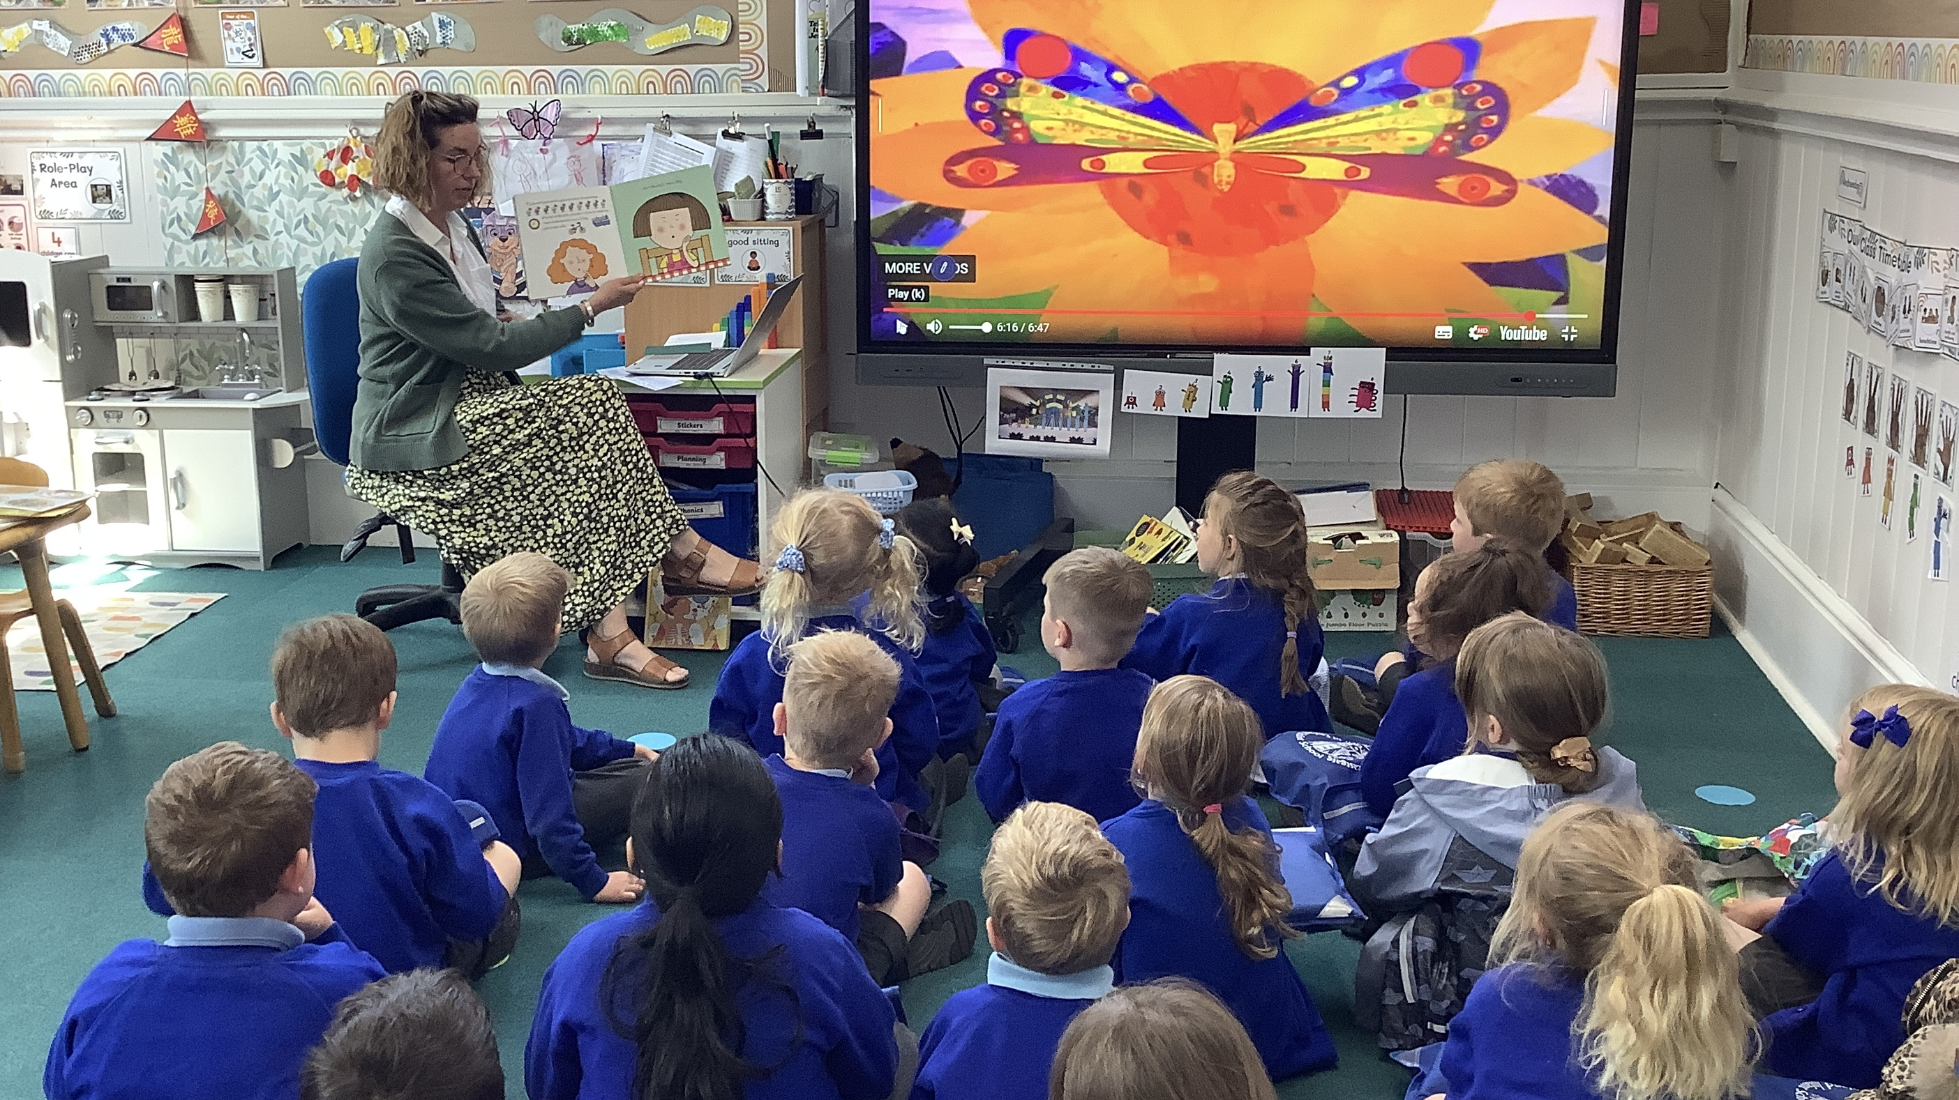
Storytime

Slide 16
Early Years Foundation Stage

Slide 17

Getting ready for school How can I help?

Slide 18


Slide 19
School readiness – Tiny happy people
BBC link - https://www.bbc.co.uk/tiny-happy-people

Slide 20


Invite to summer fayre

