Slide 1

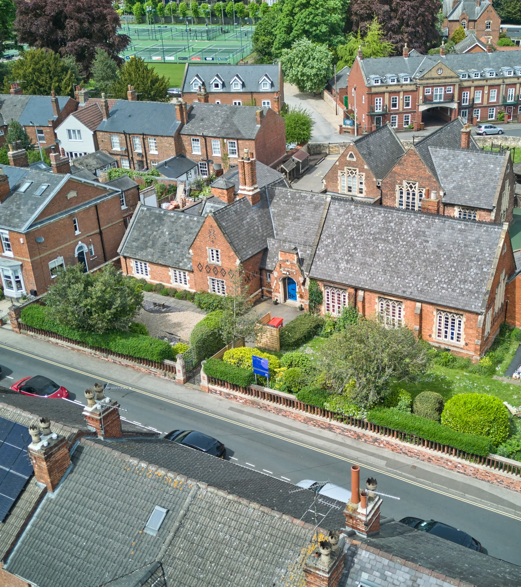
Welcome to
St Peter in Eastgate C of E Infant Academy.

Slide 2
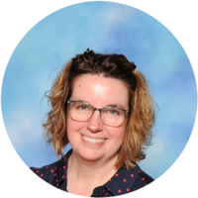
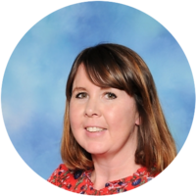
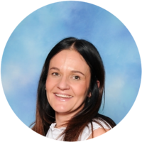
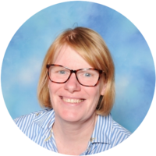
Reception Staff
Mrs Chenh Mrs Watkinson Miss White
Class teacher Class teacher (Thursdays) Teaching assistant
Mrs Marshall
Headteacher

Slide 3





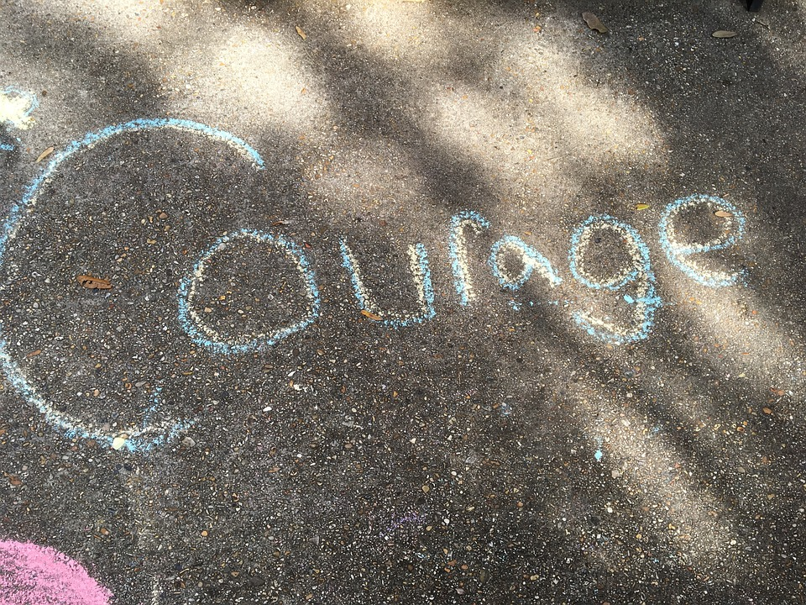
Vision
Our vision is to encourage and support all to develop their talents, knowledge and skills in a secure and happy environment, following Jesus’ example to walk in the way of love.
‘Live a life of love, just as Christ loved us’
Ephesians 5:2a
This Photo by Unknown Author is licensed under CC BY-SA

Slide 4
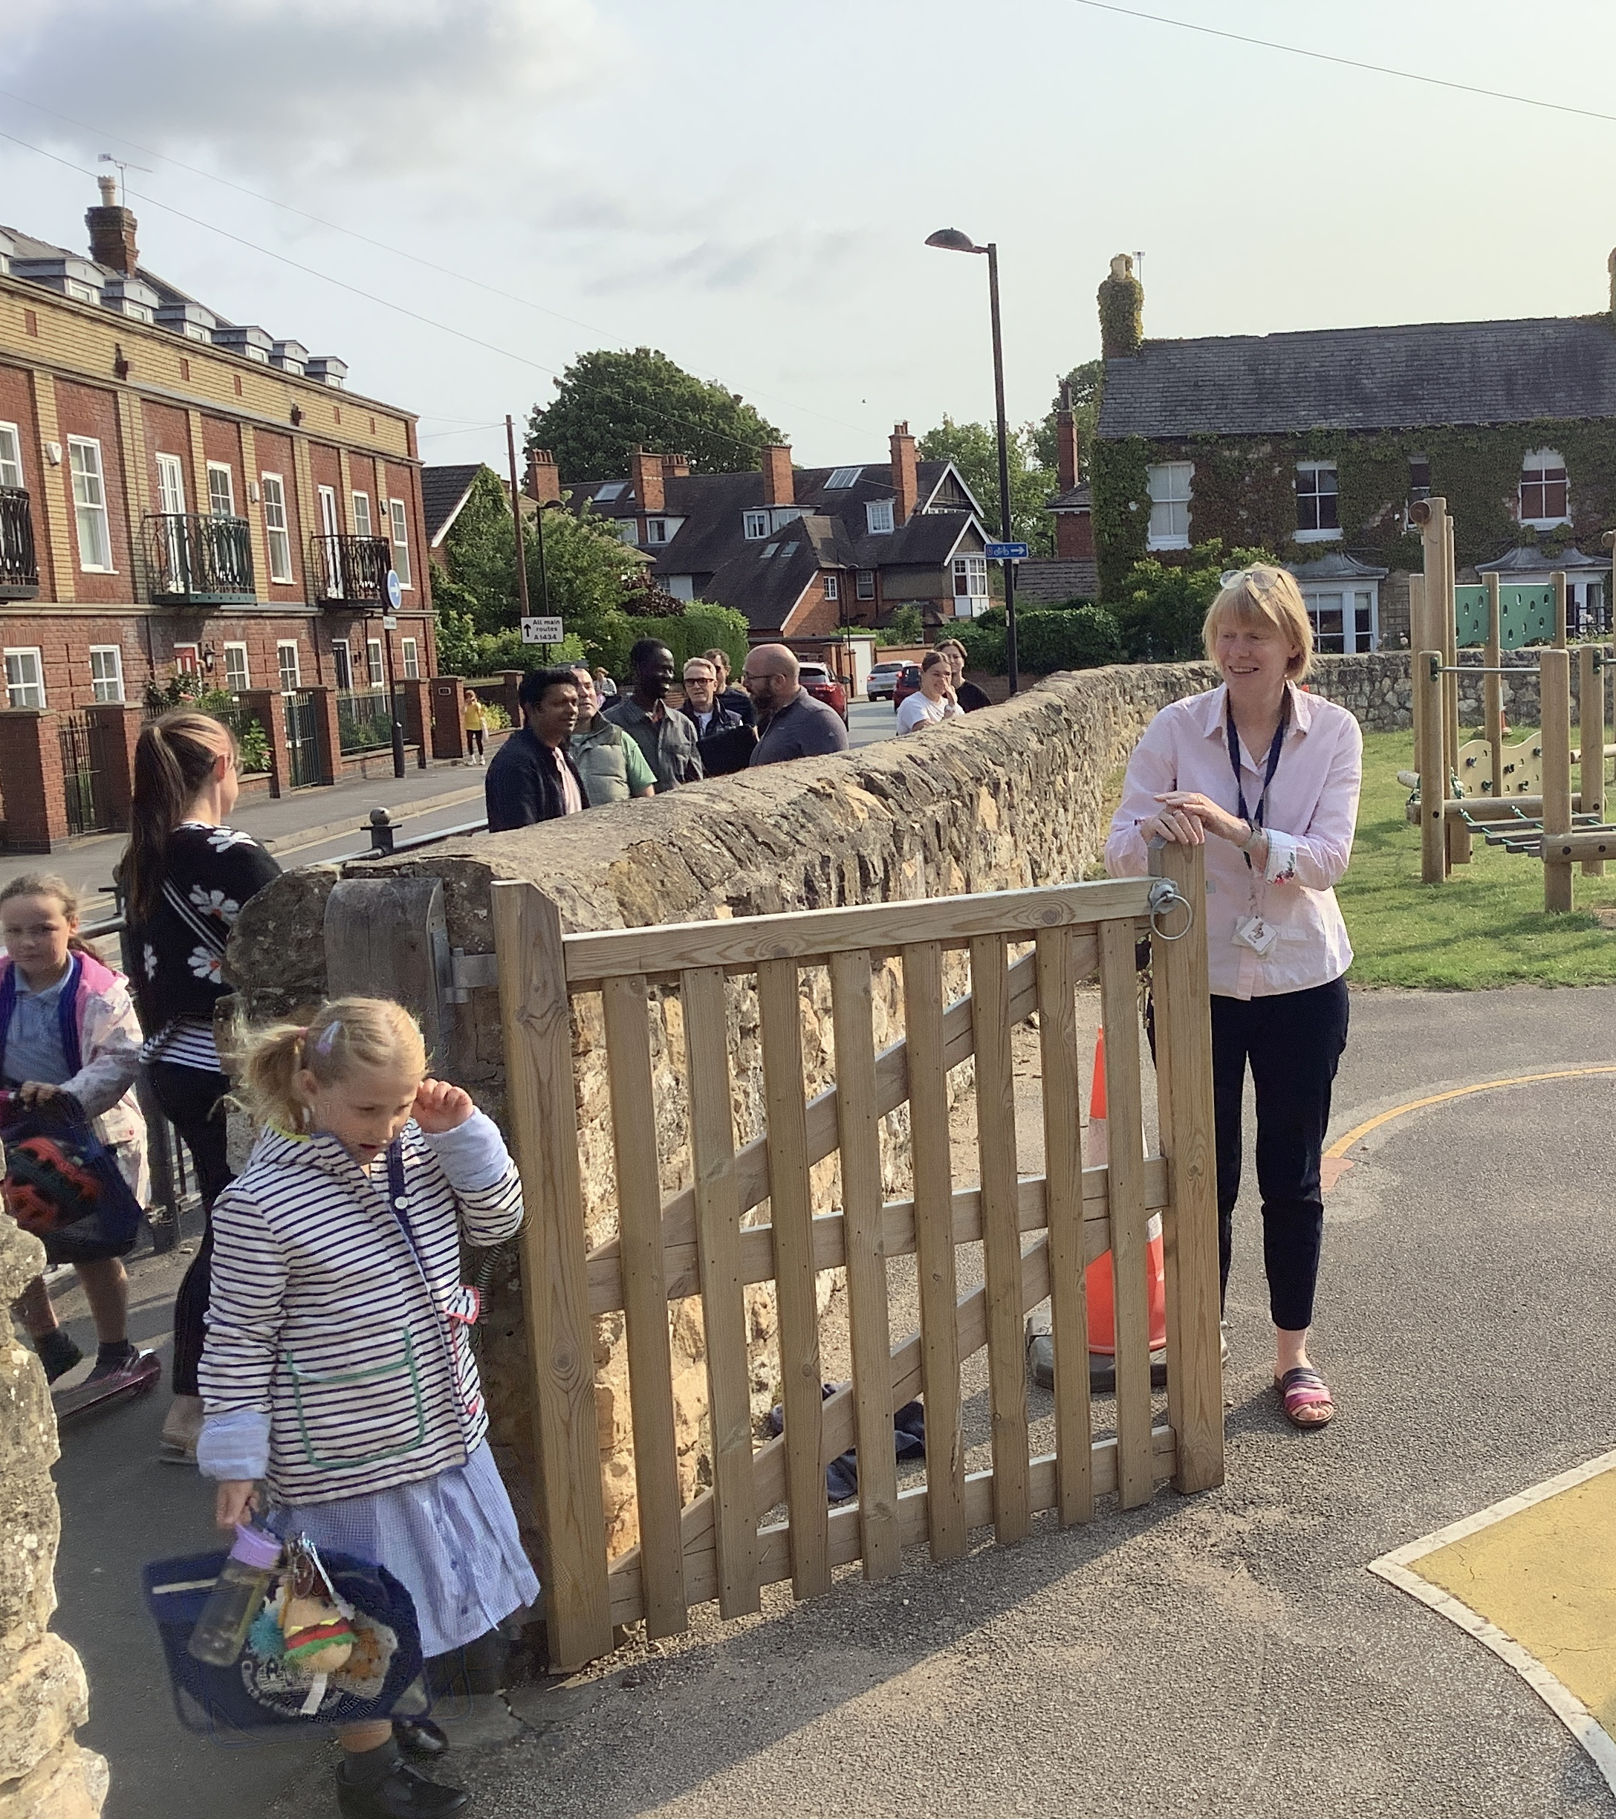
Start and end of the day
The school gates are at the back of school they open at 8.35am. School starts at 8.50am.
We finish school at 3.15pm. The back gate opens at 3.05pm.

Slide 5
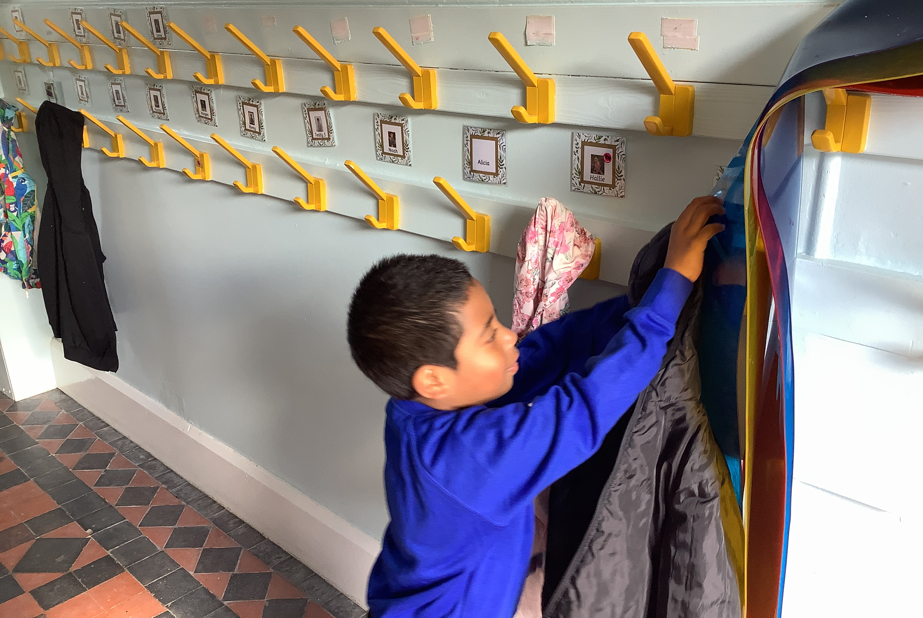
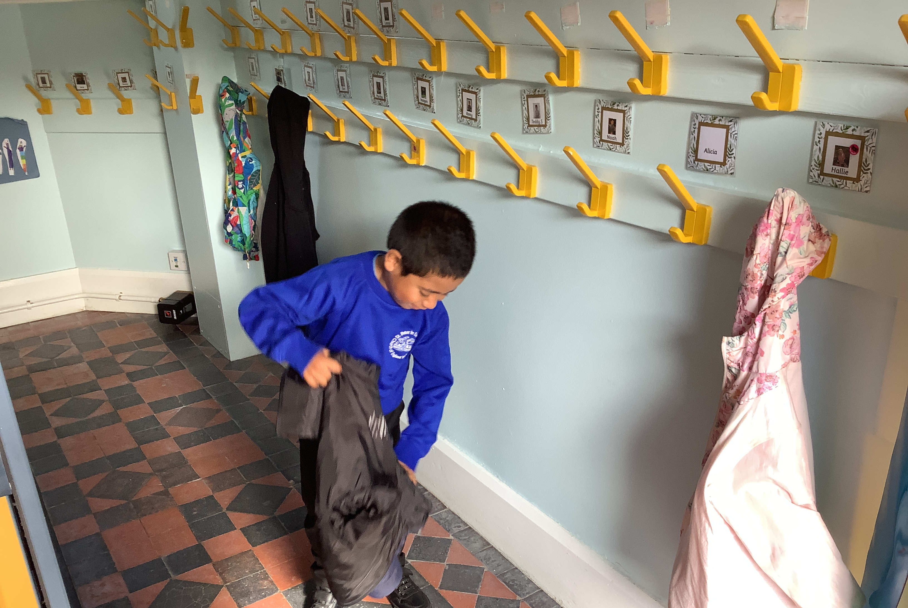
Coming into the classroom

Slide 6
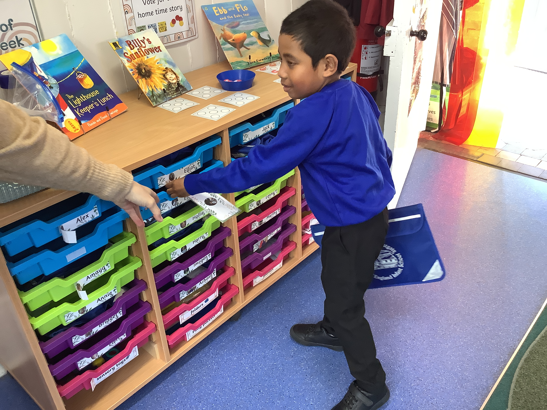
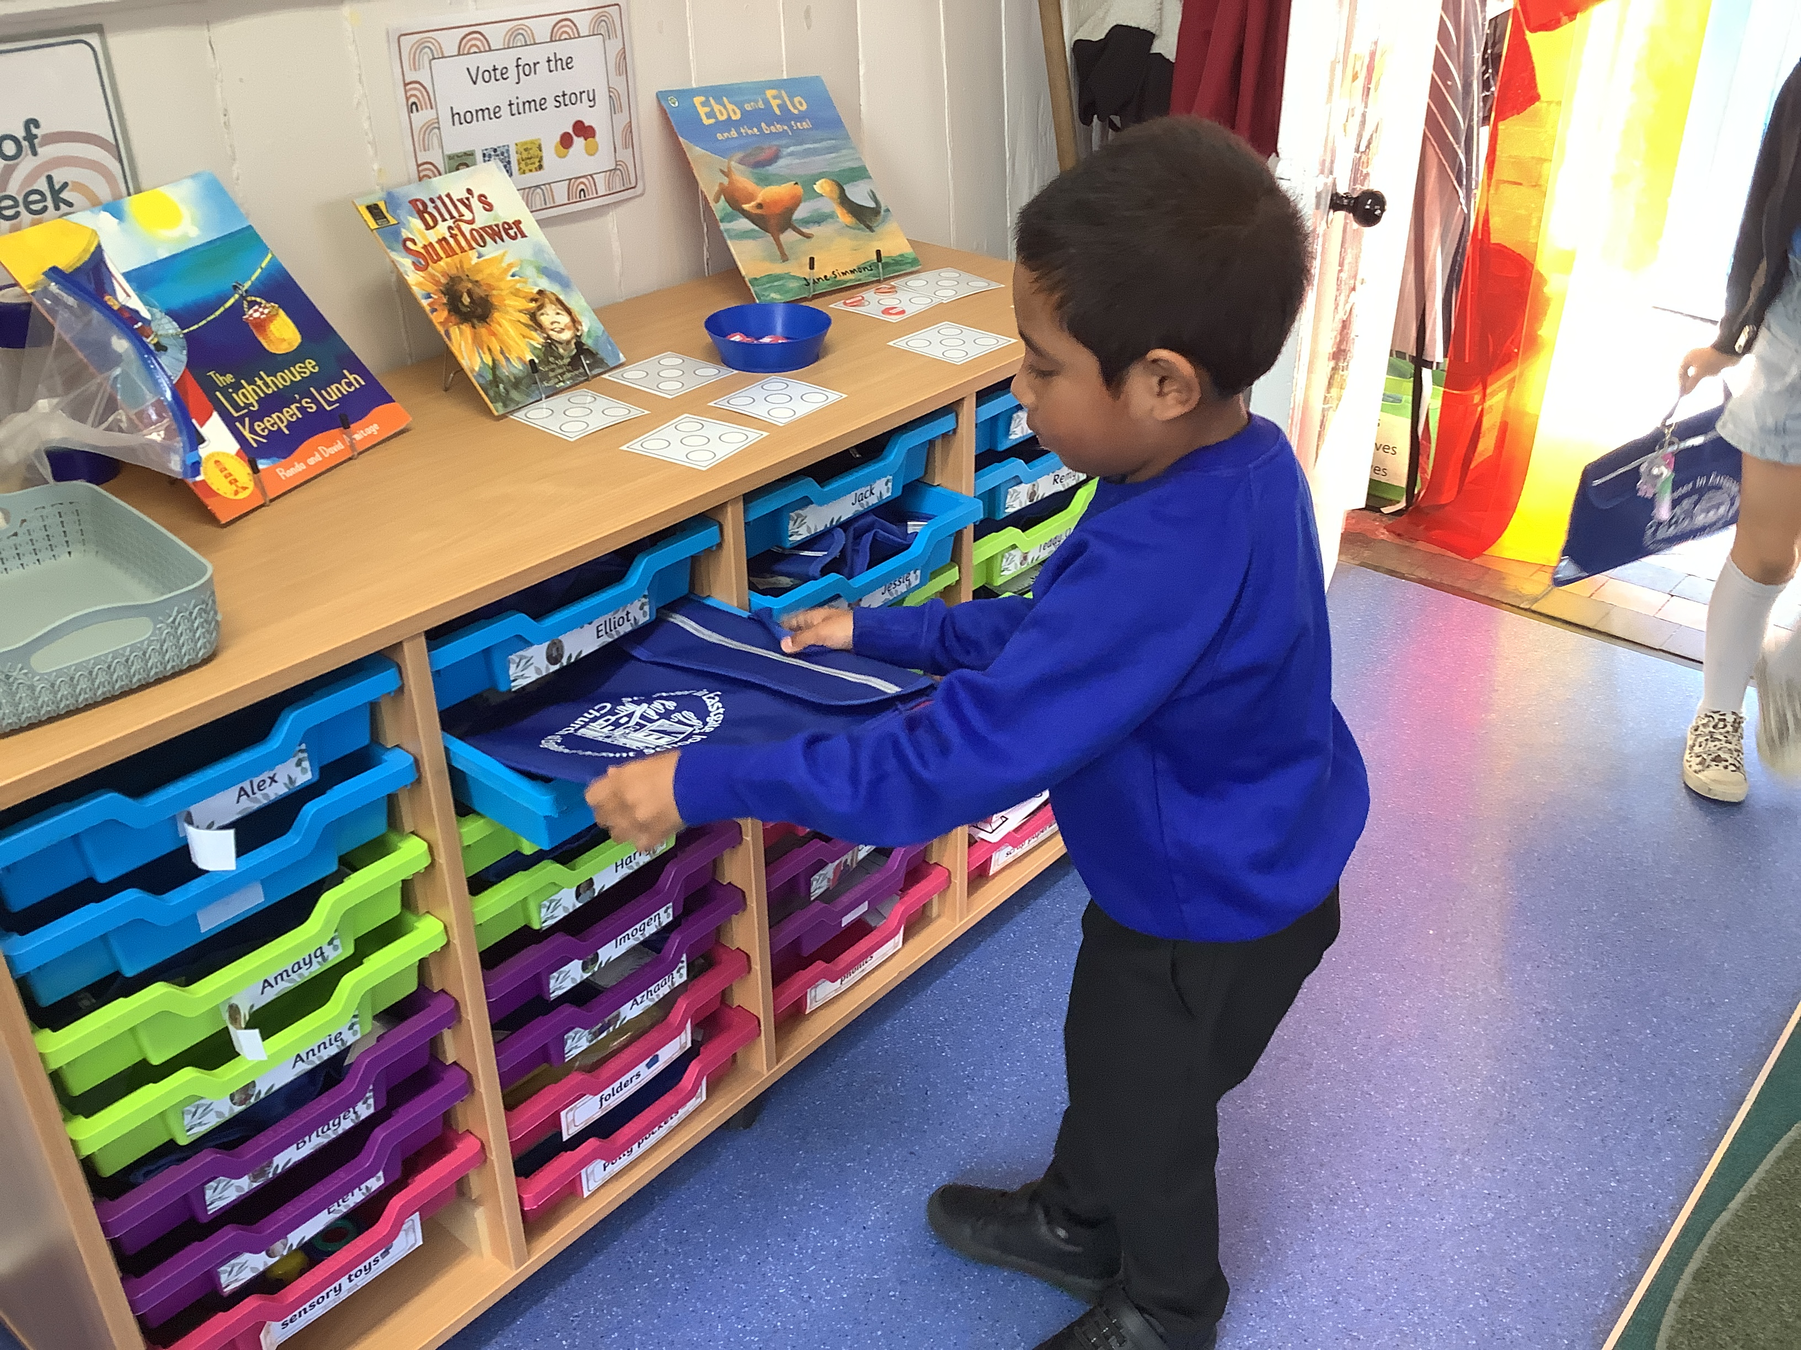
Name cards and book bags

Slide 7
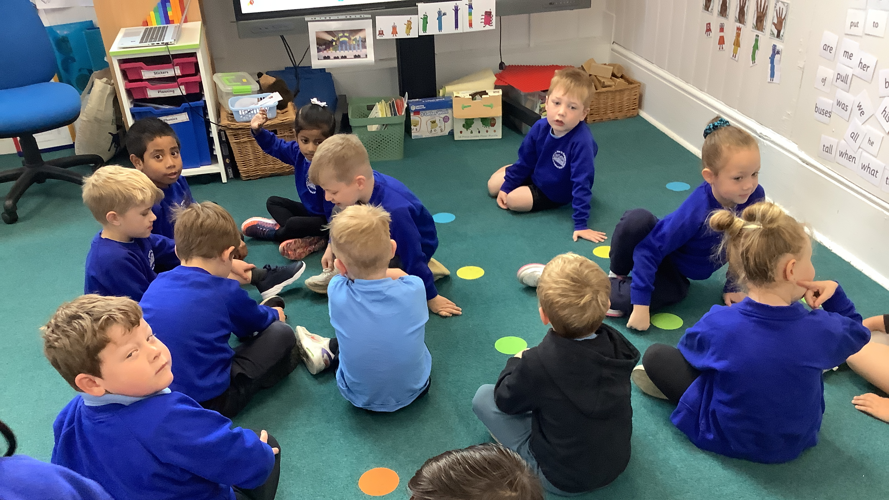
Find carpet spot

Slide 8
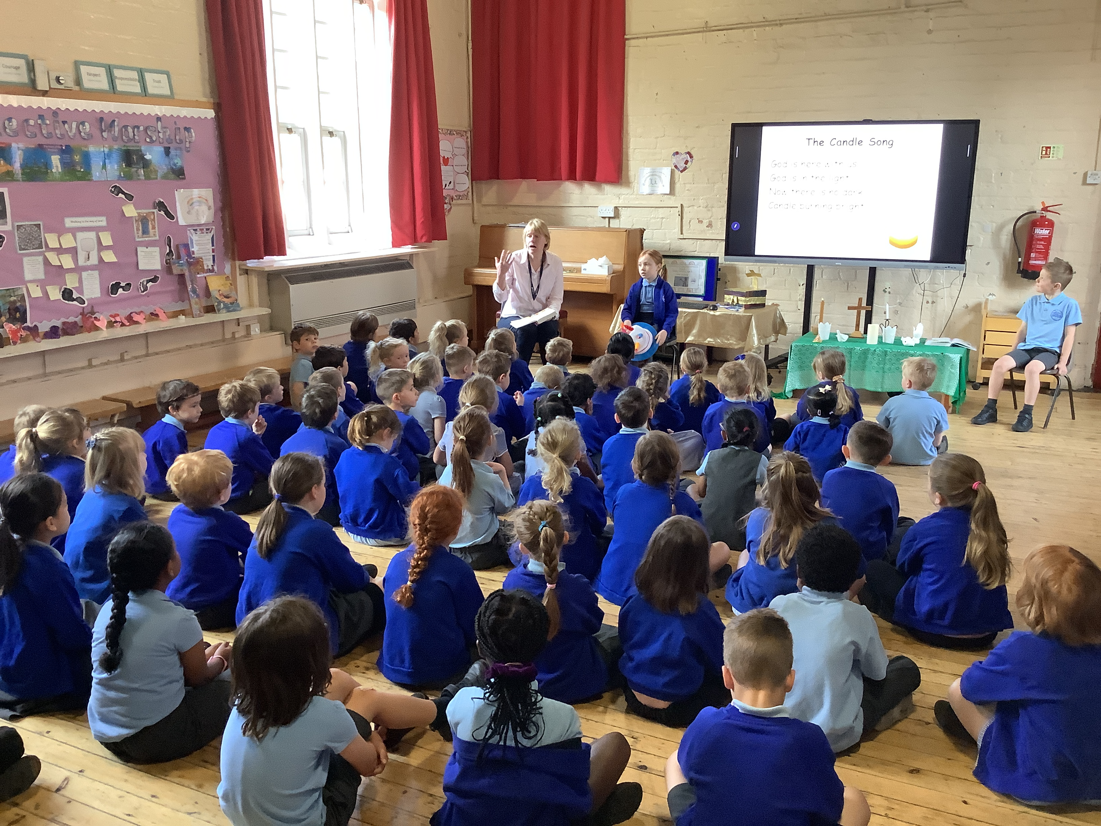
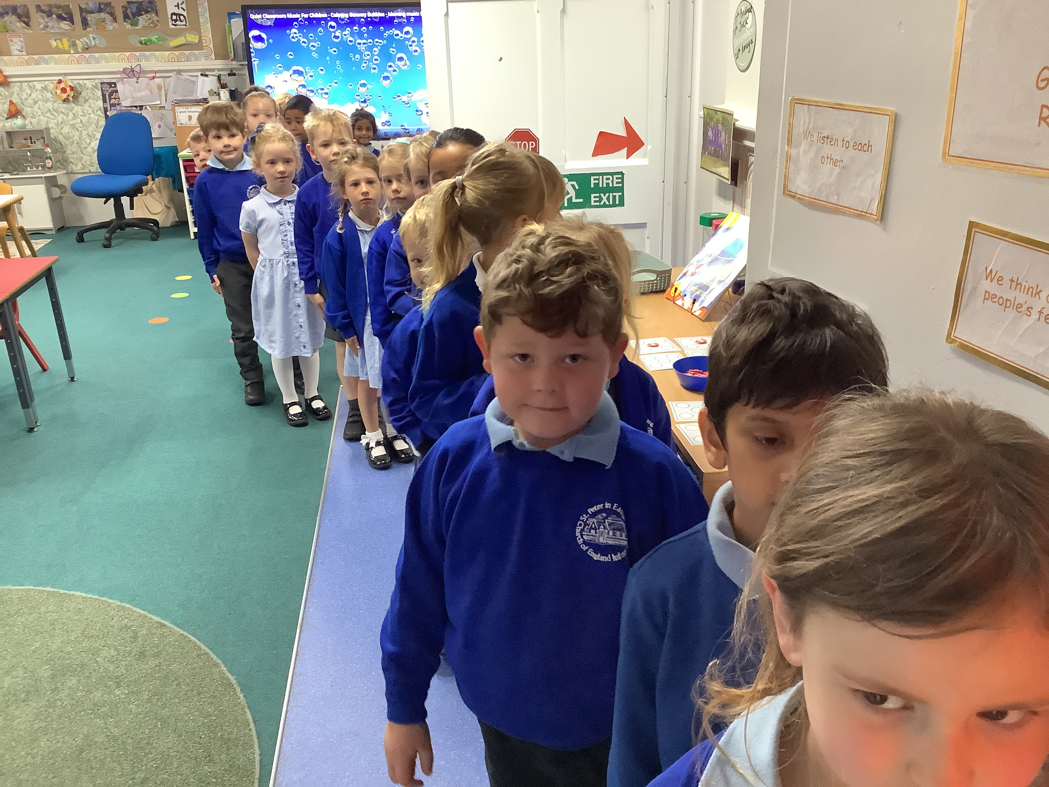
Collective Worship, line up

Slide 9
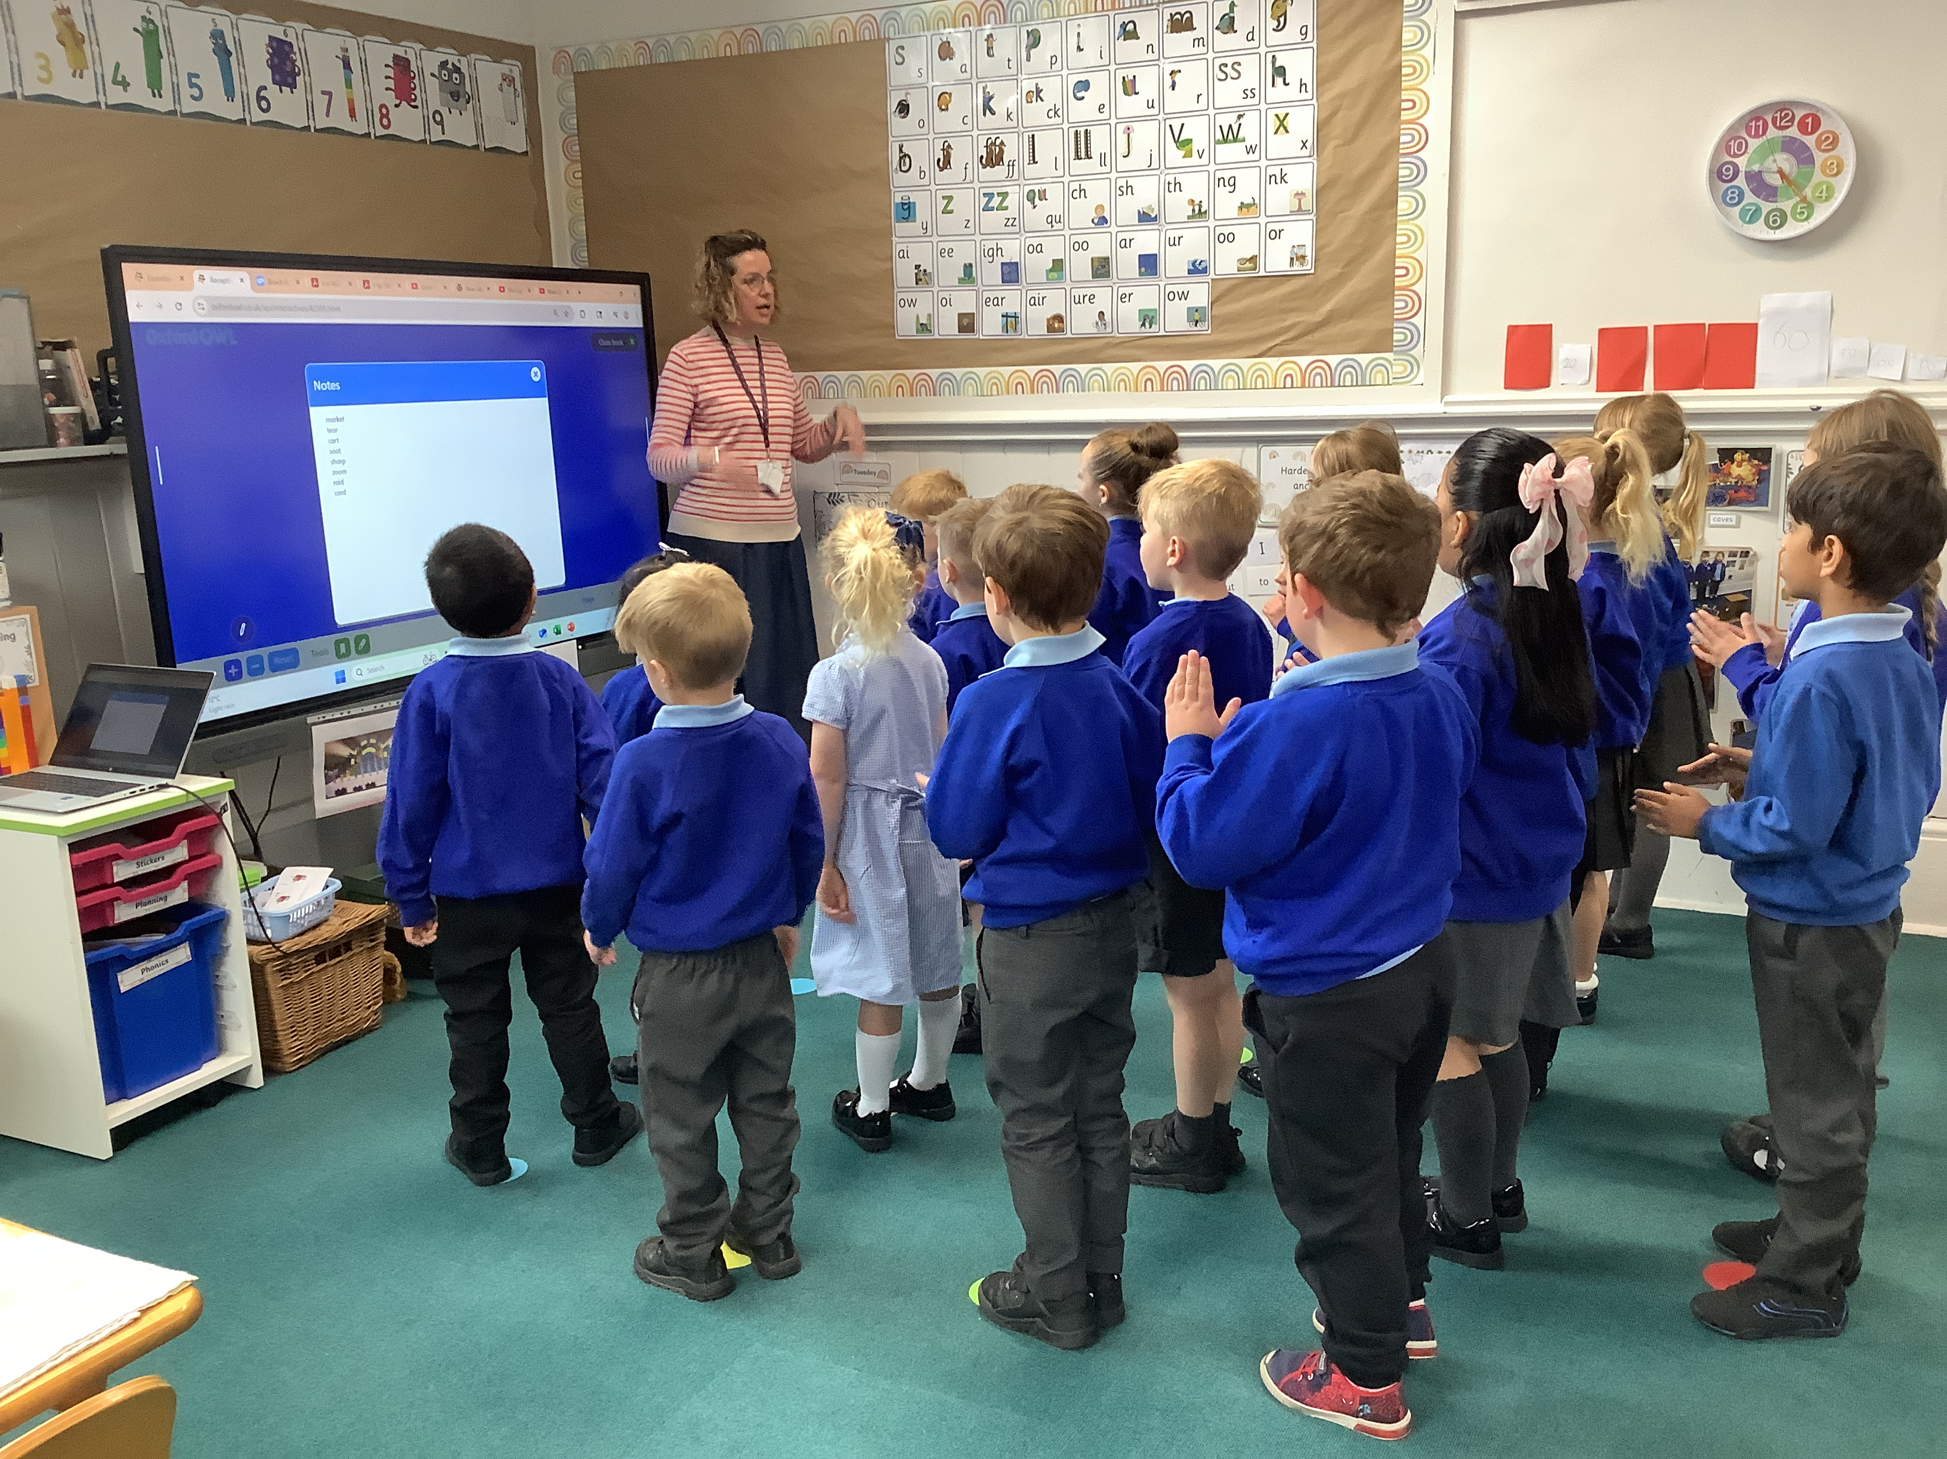
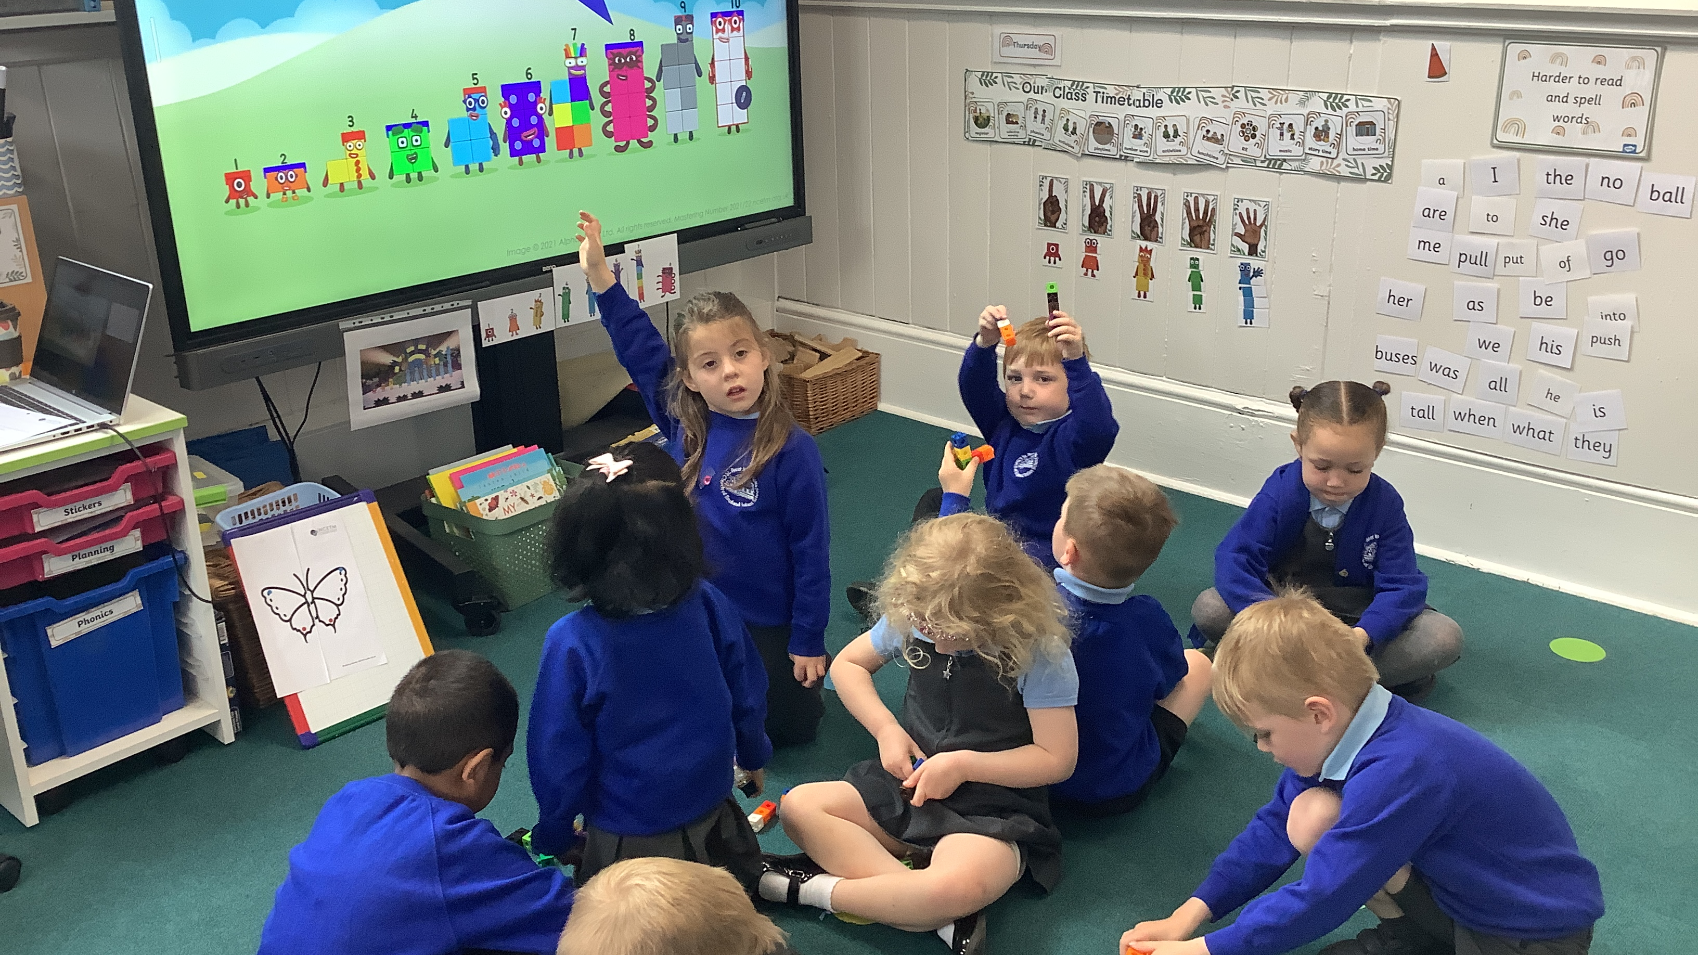
number/phonics

Slide 10
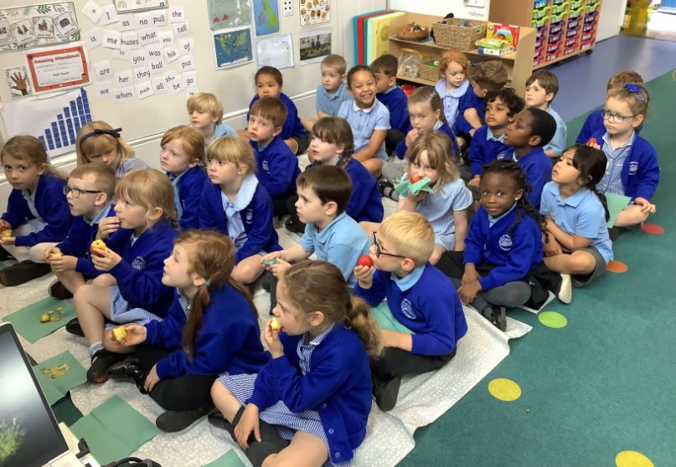
Snack time

Slide 11
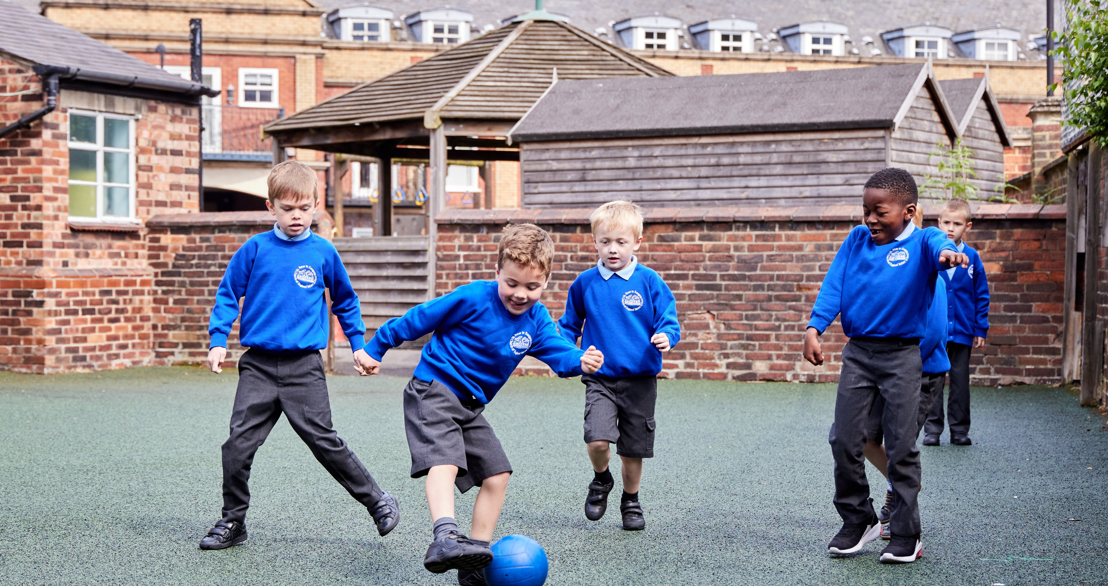
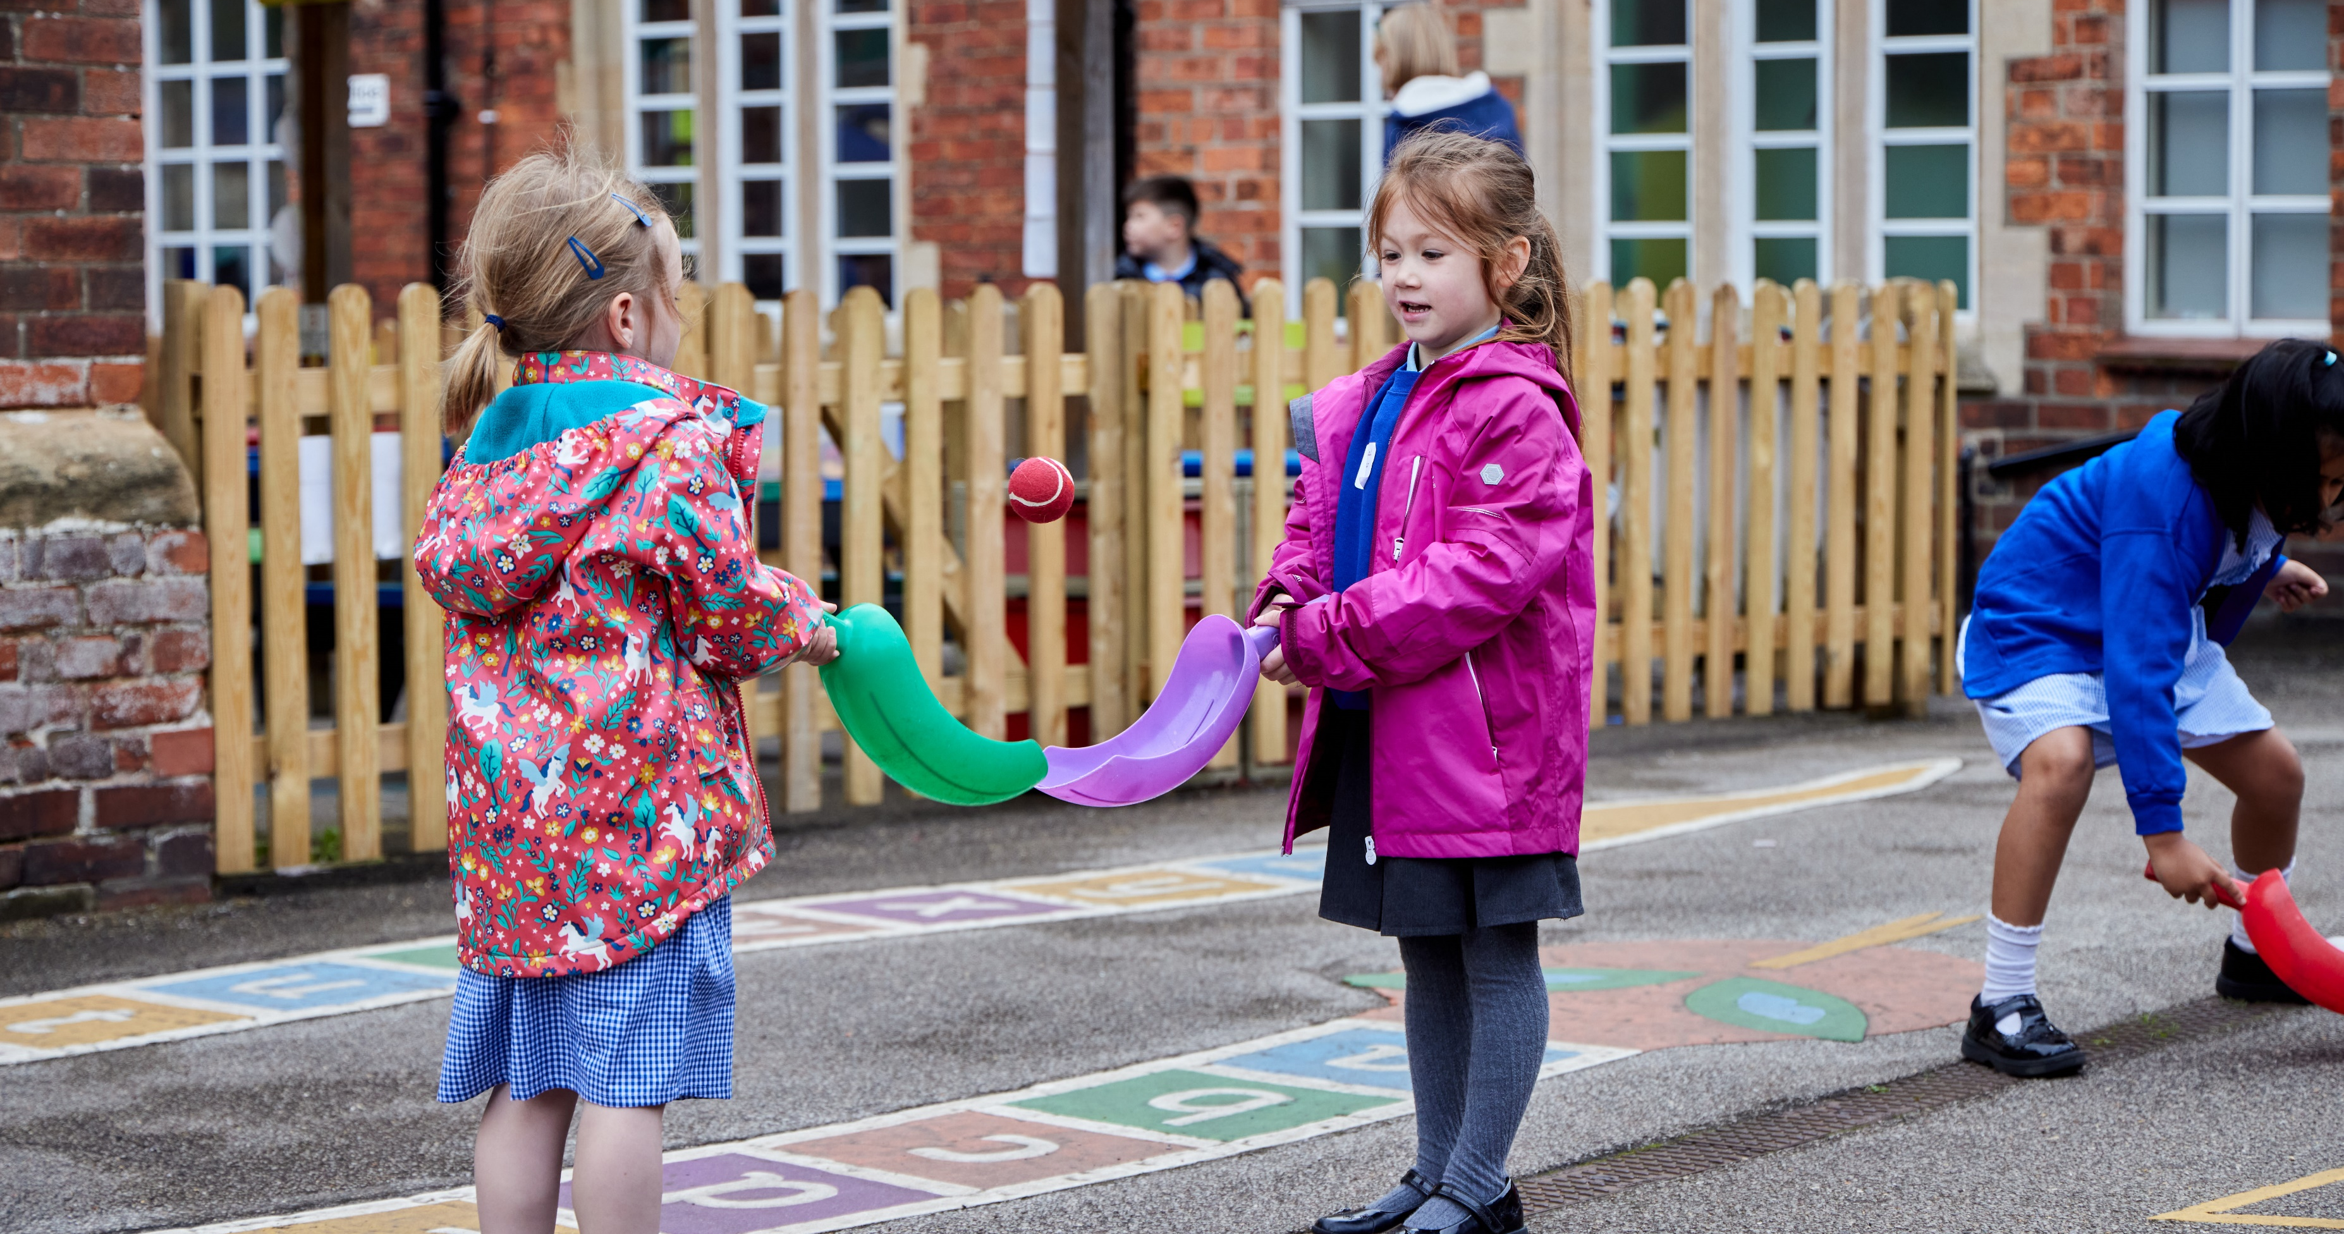

Playtime

Slide 12
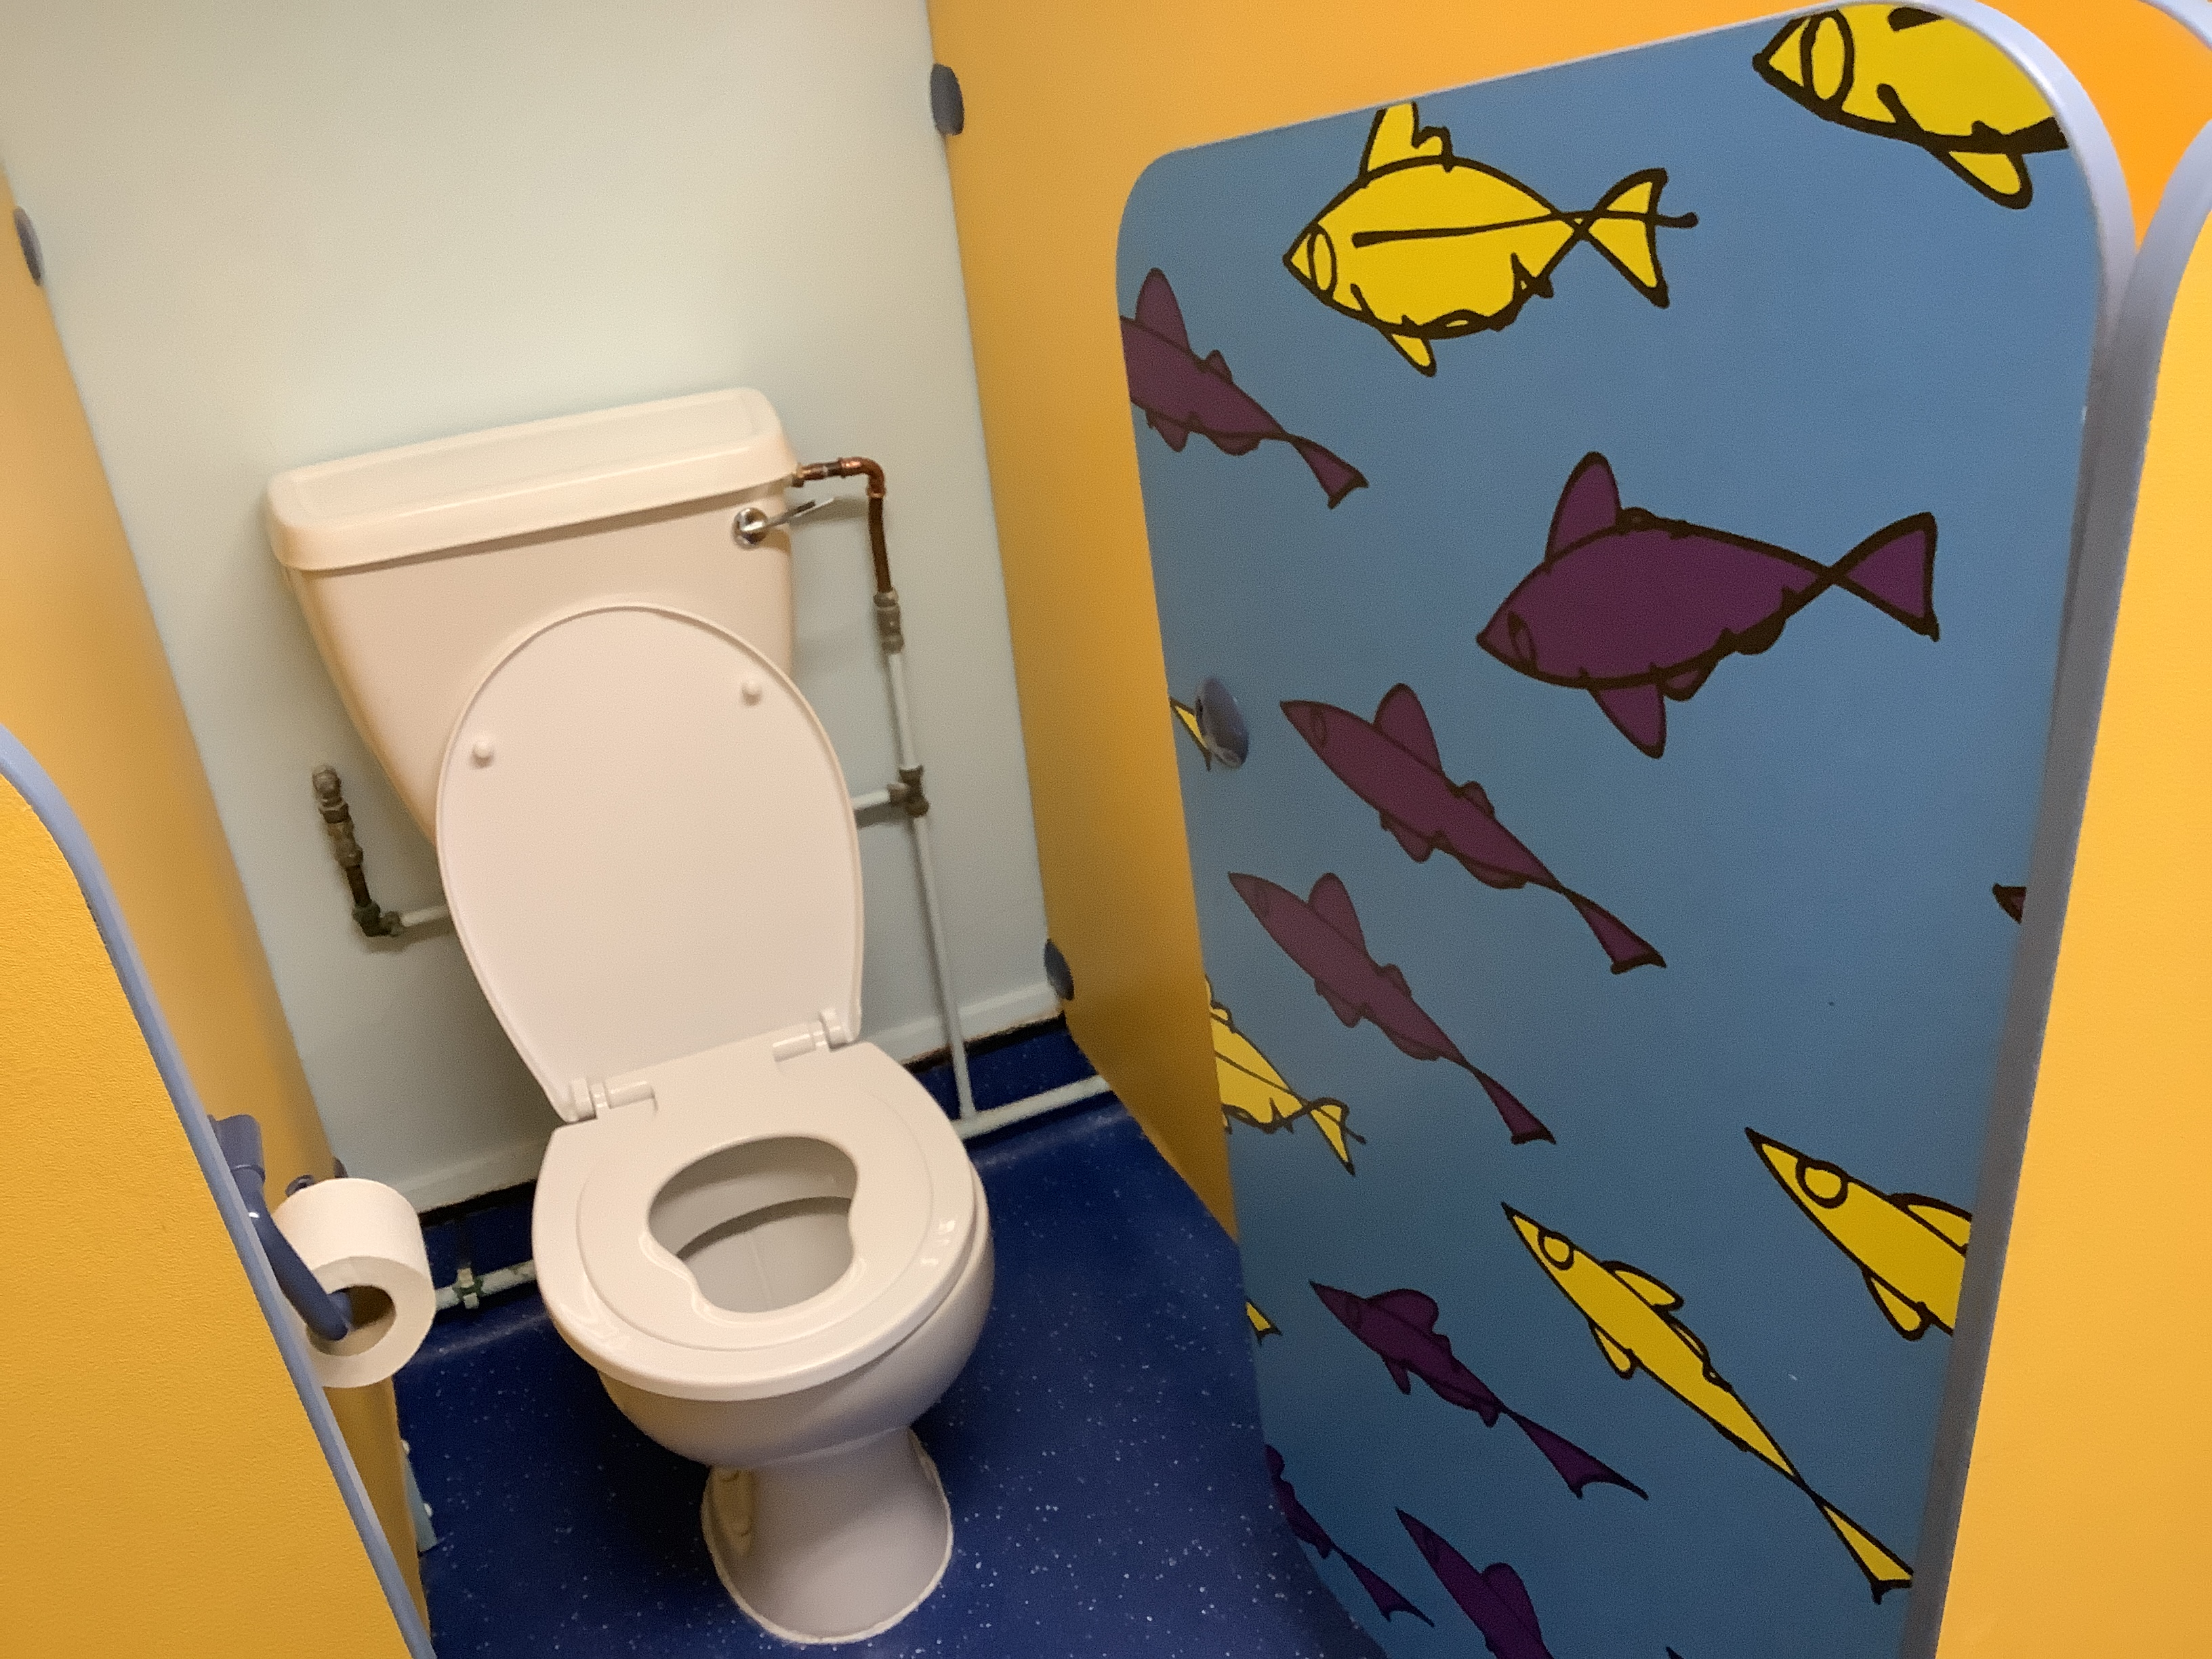
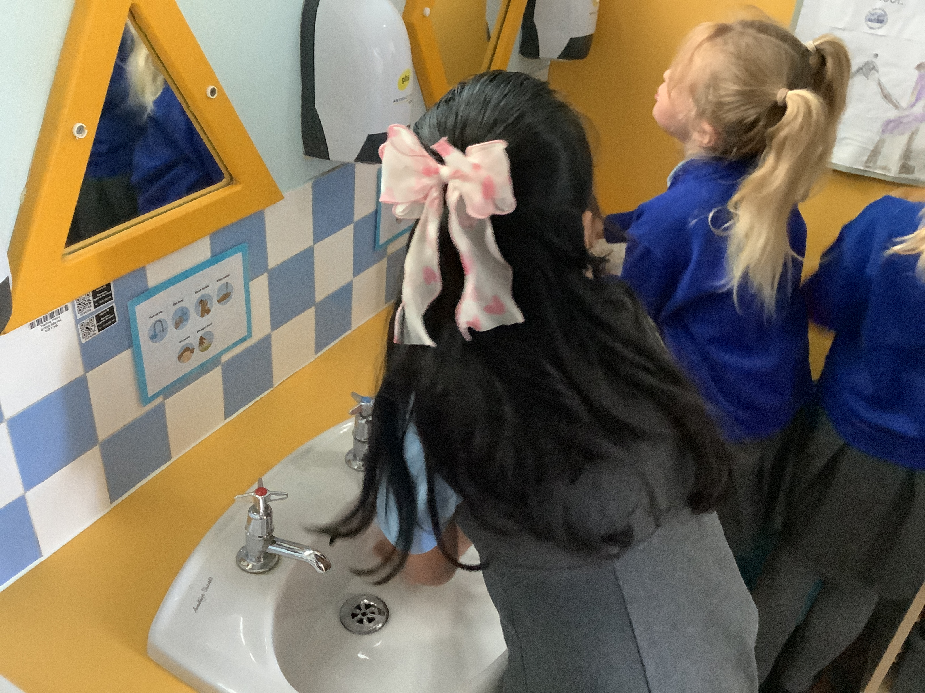
Toilet

Slide 13
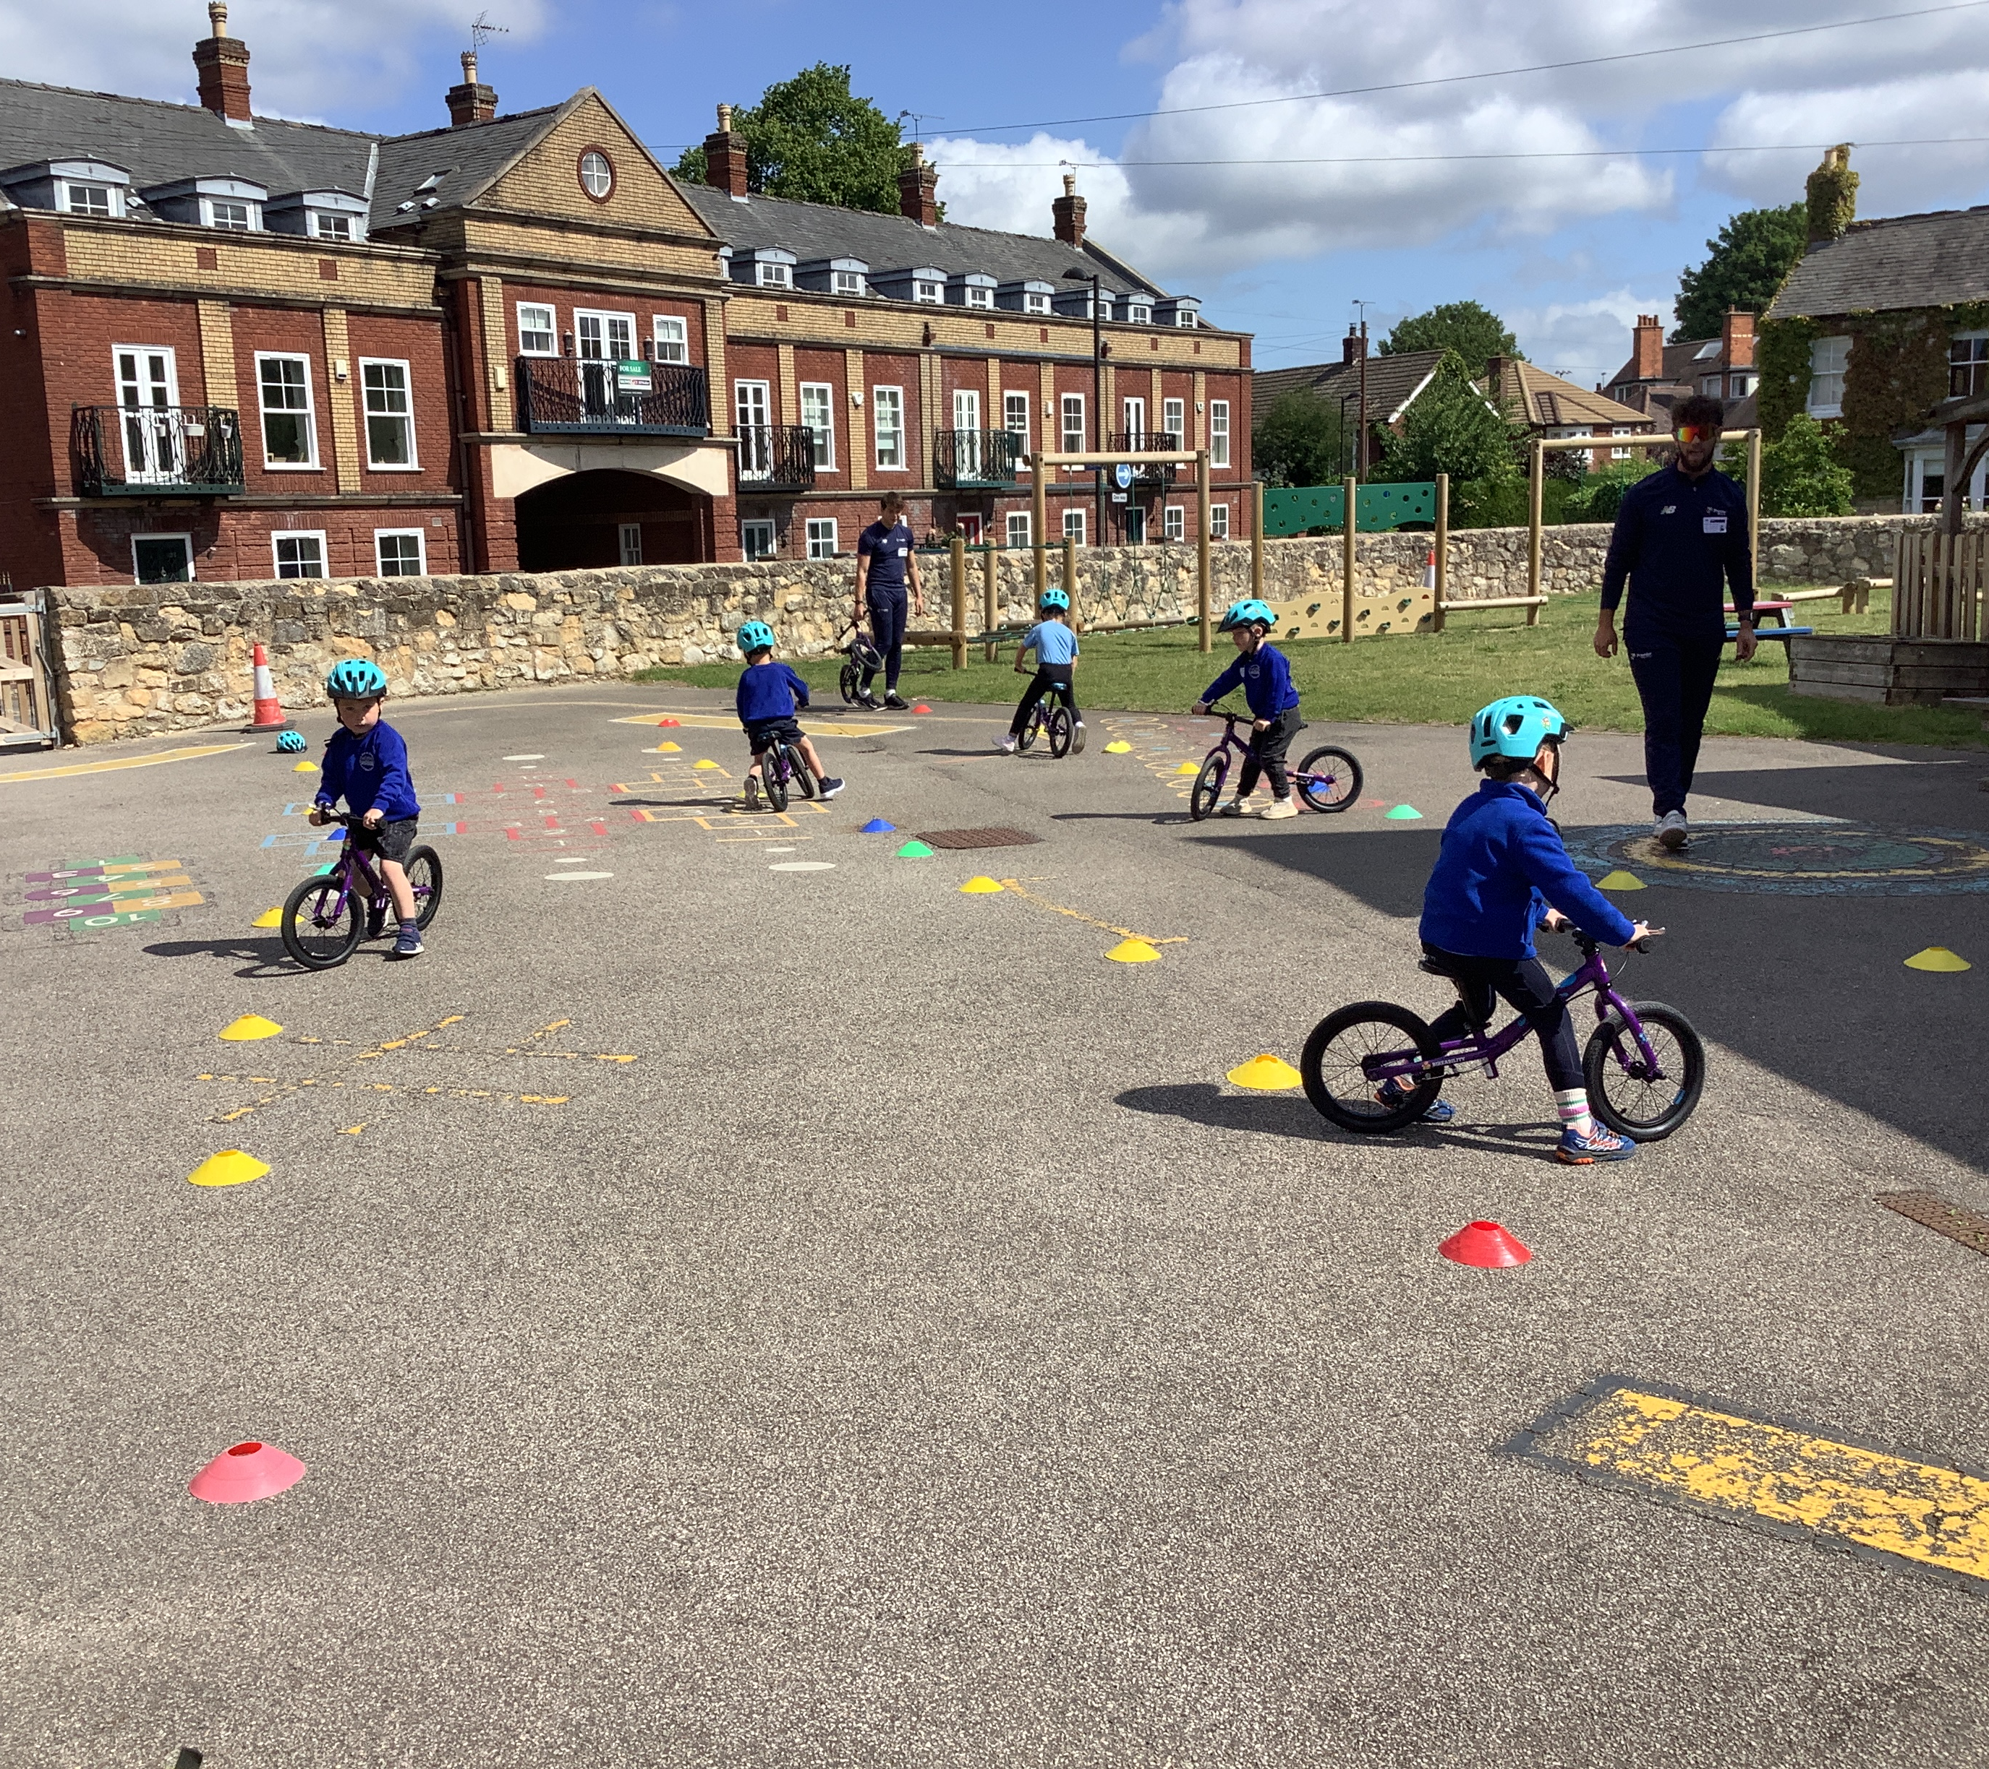
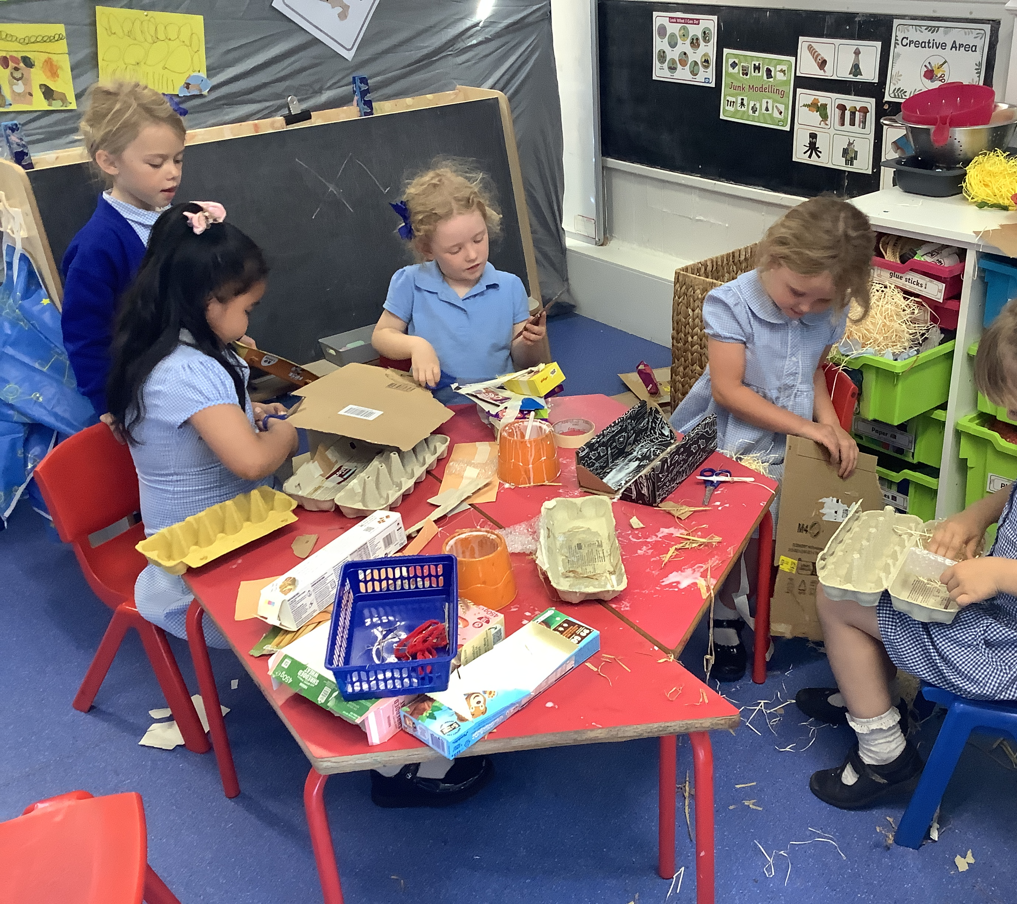
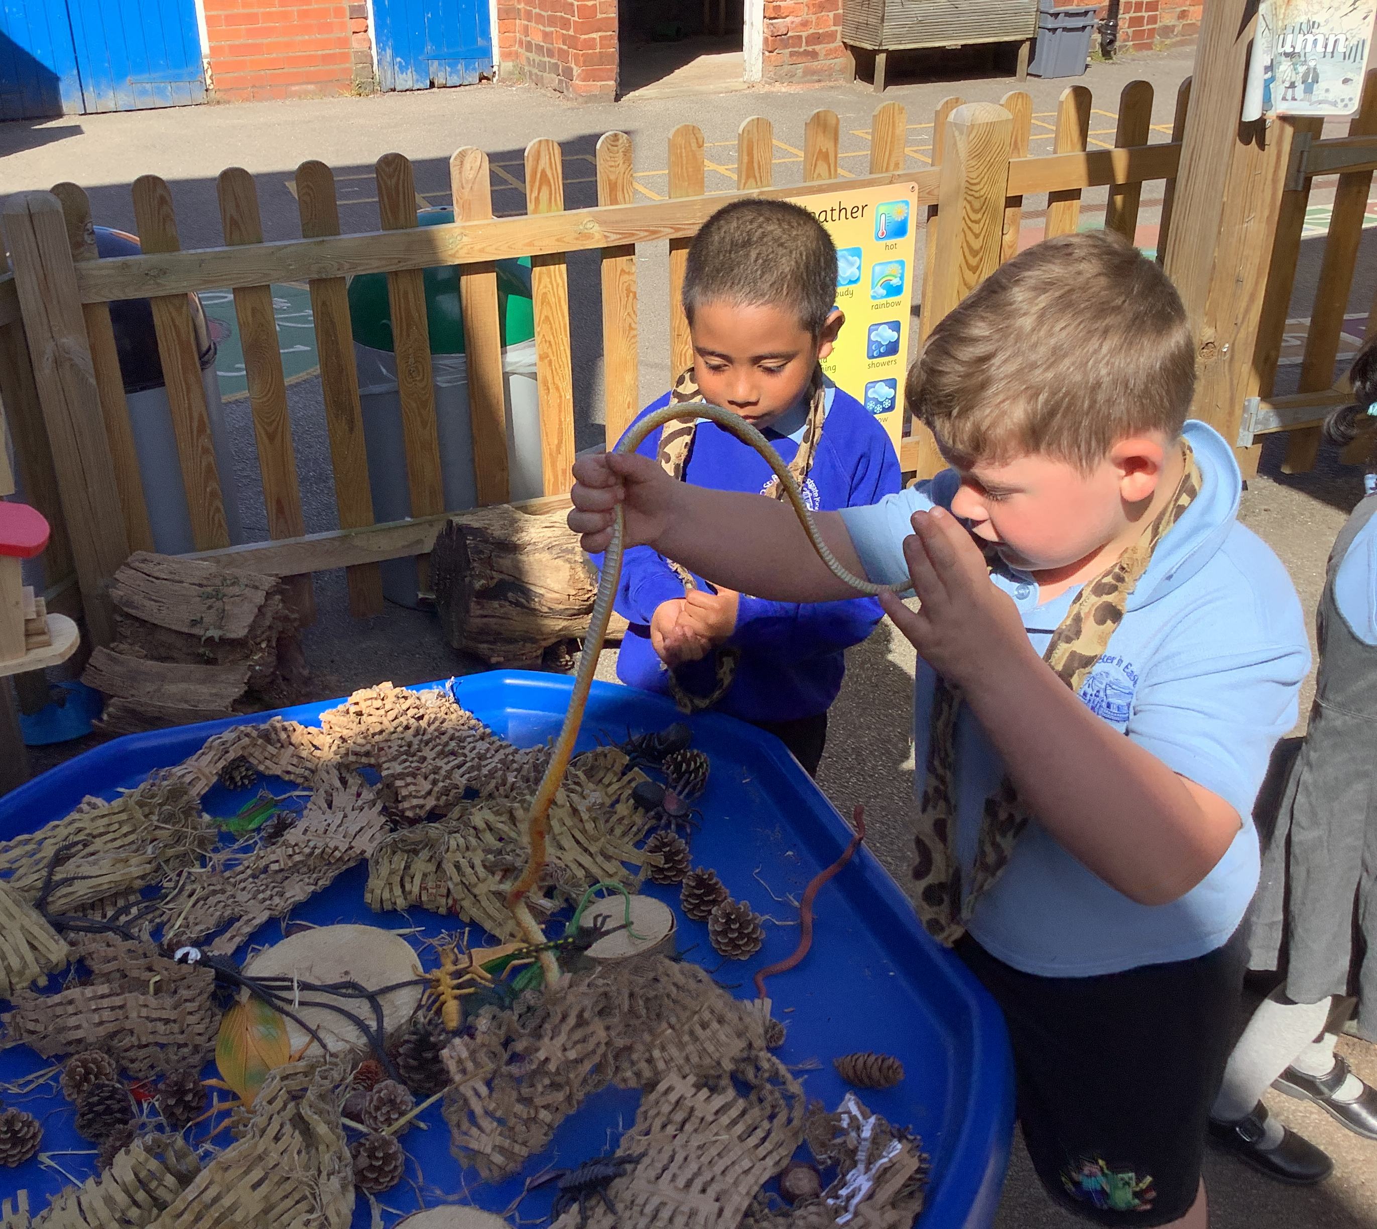
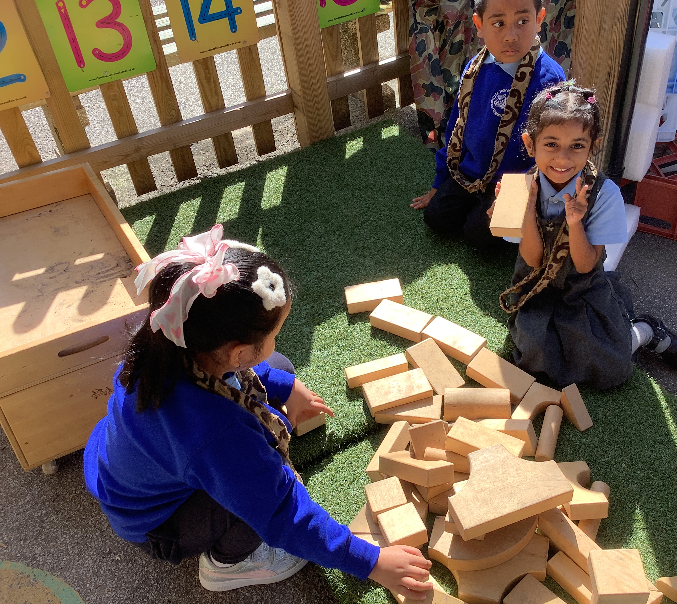
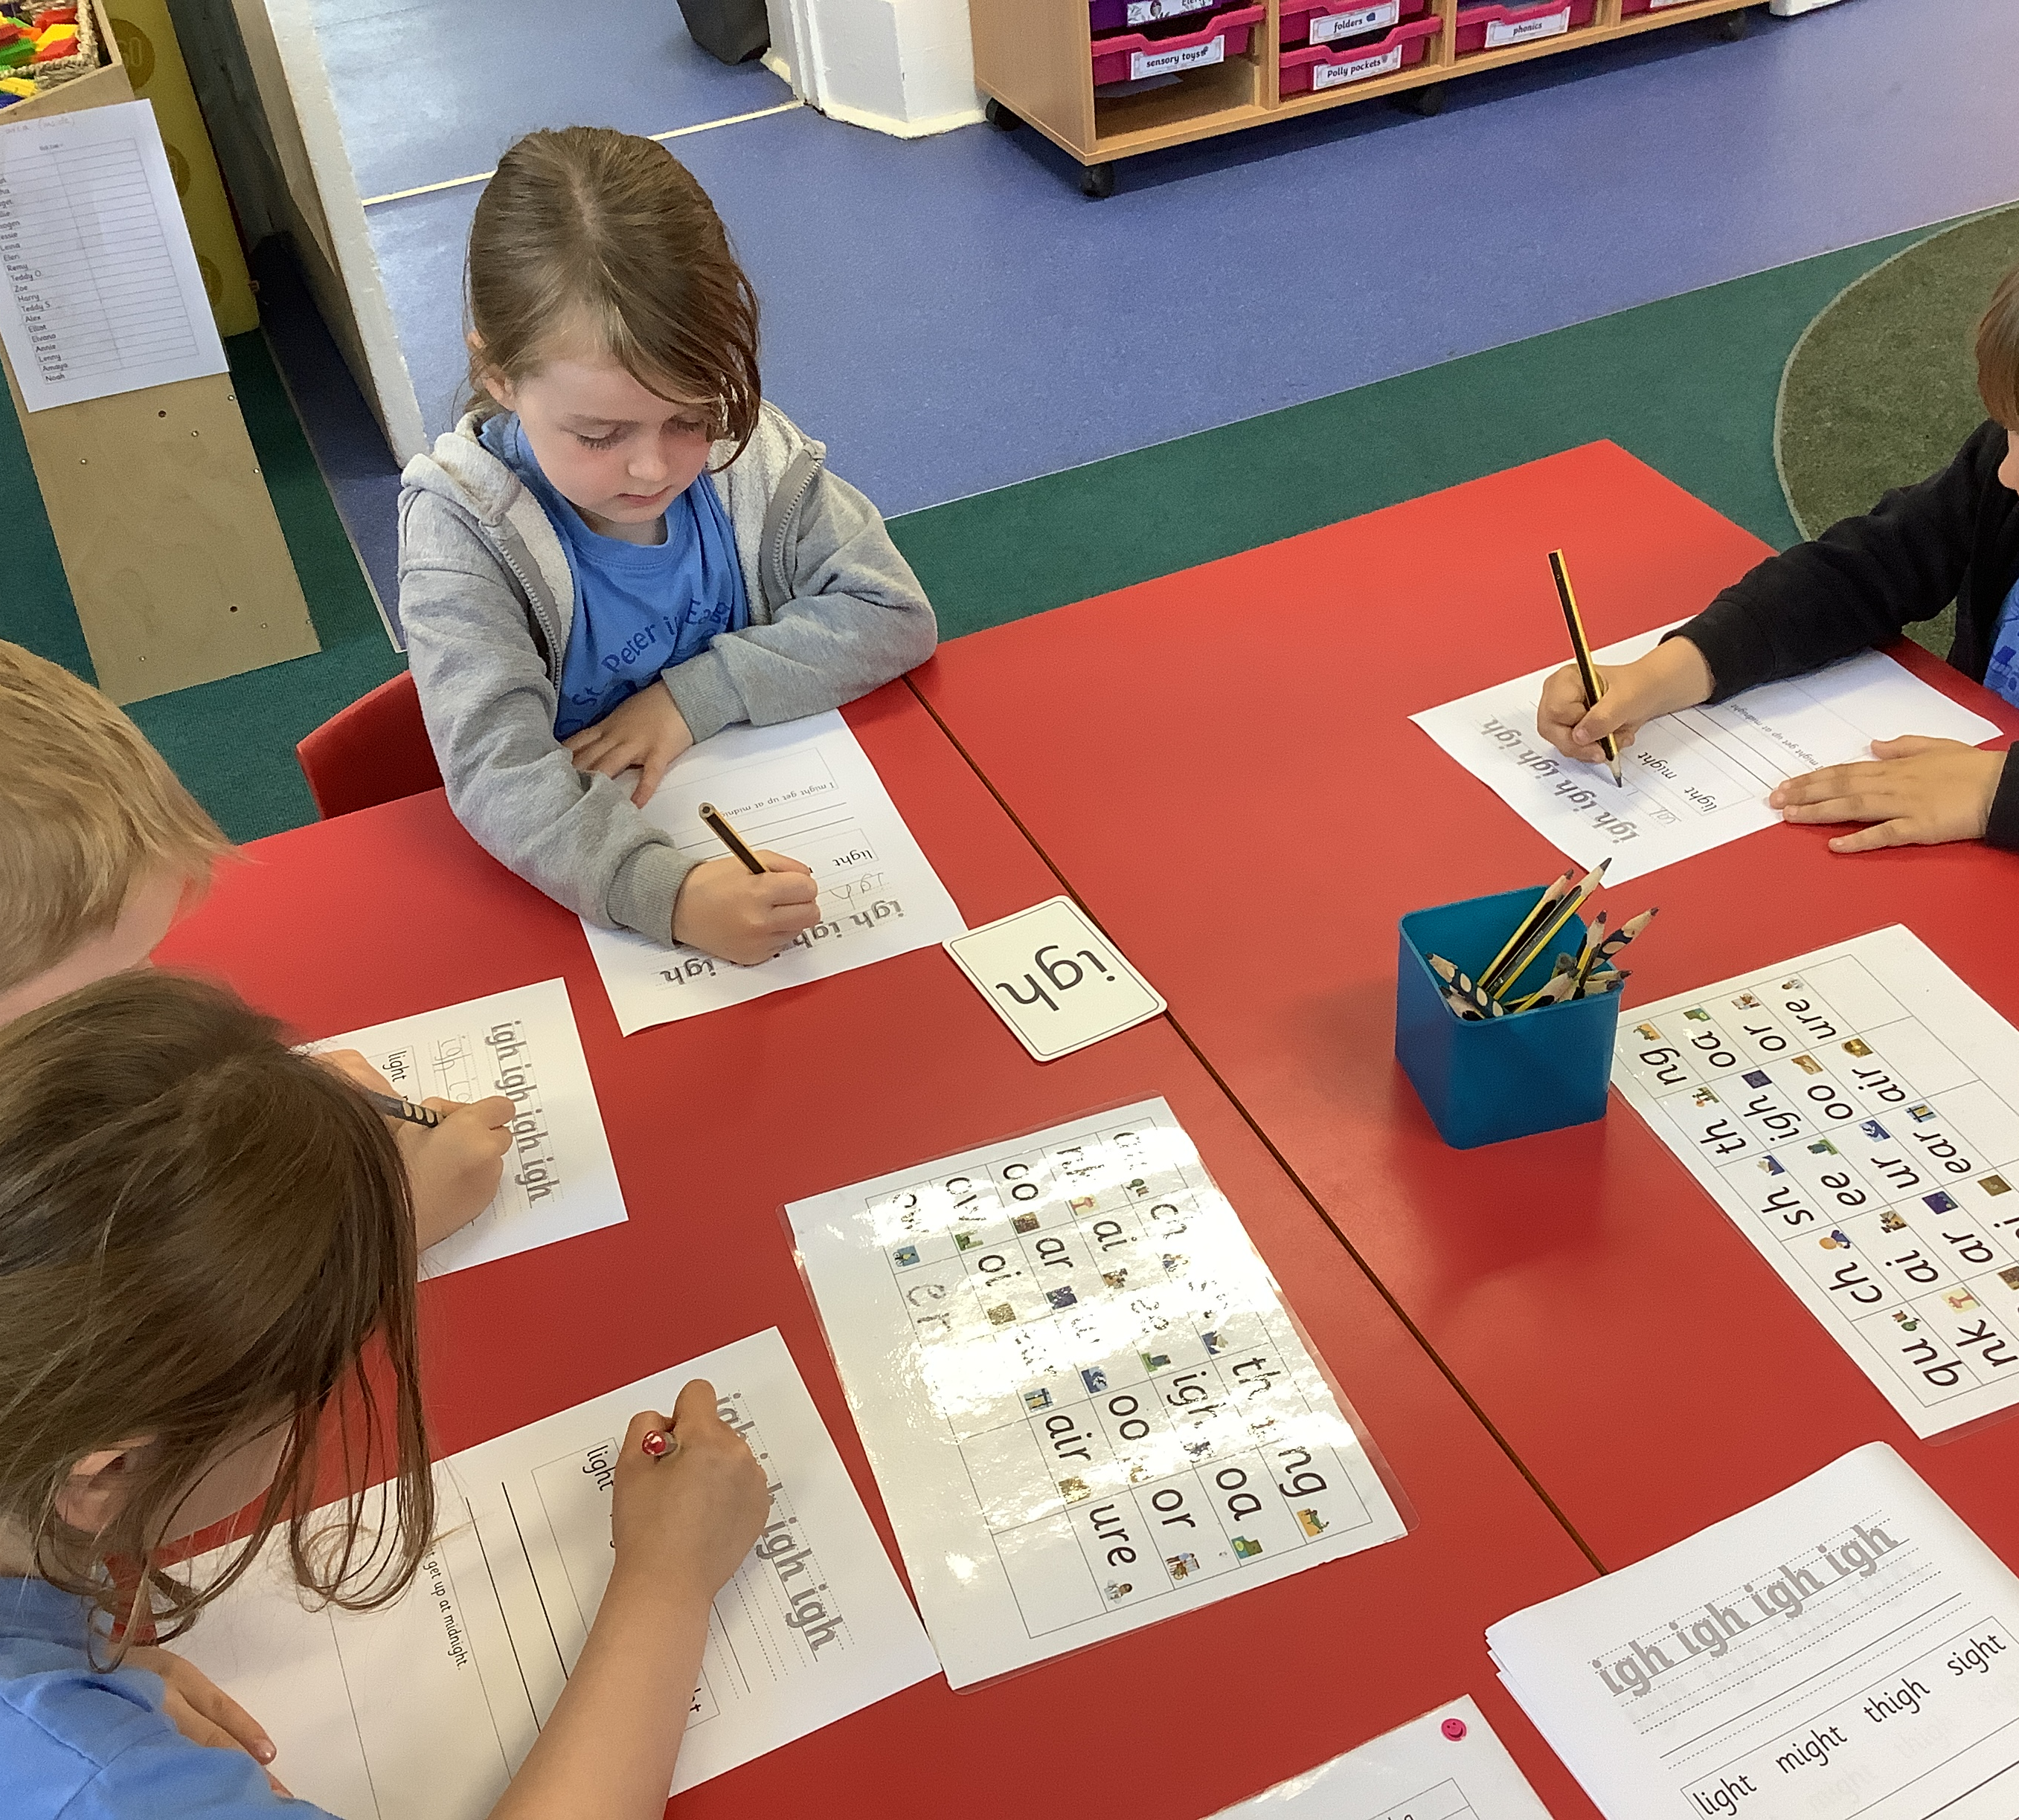
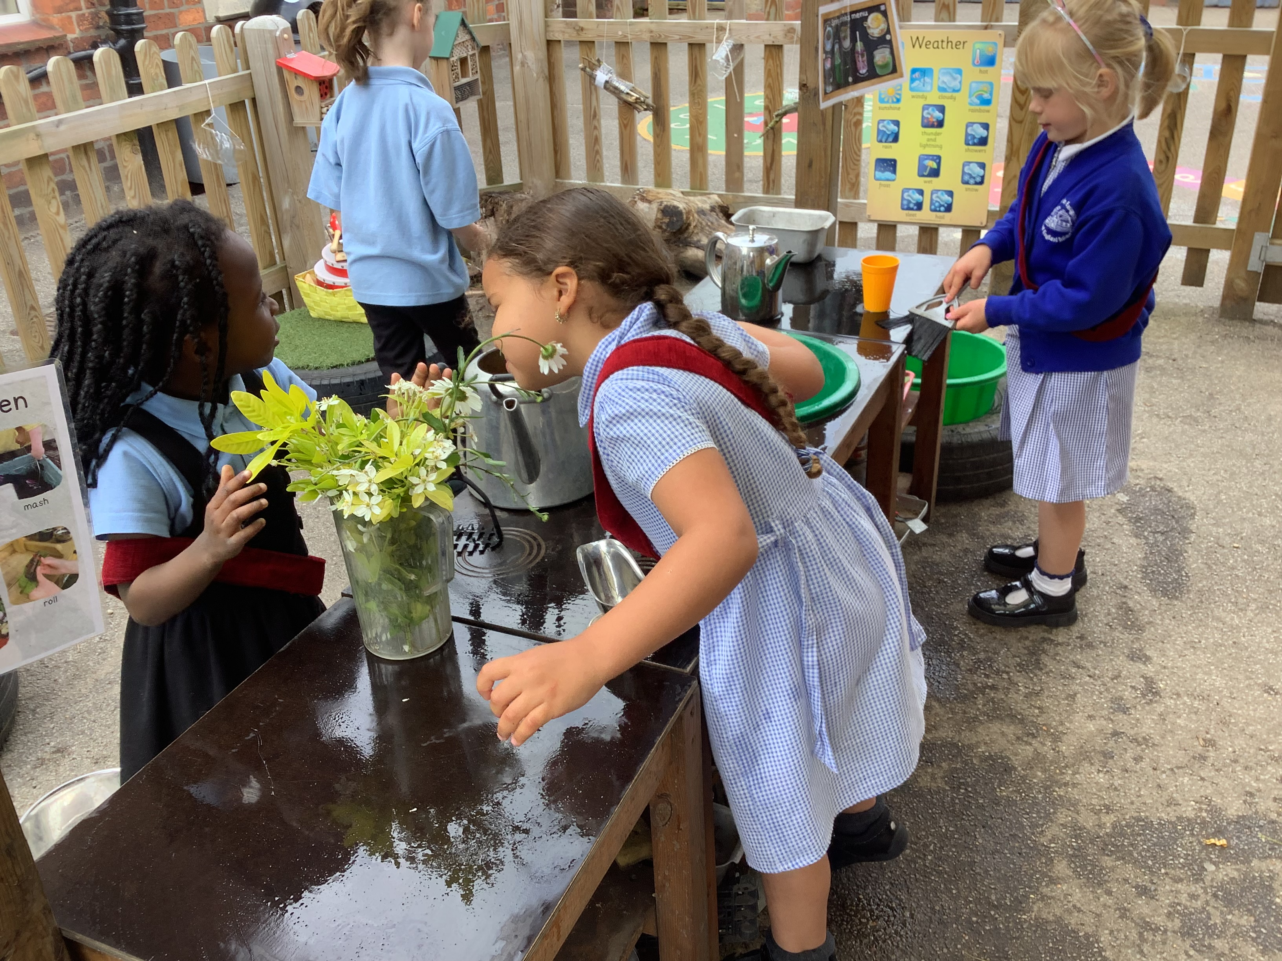
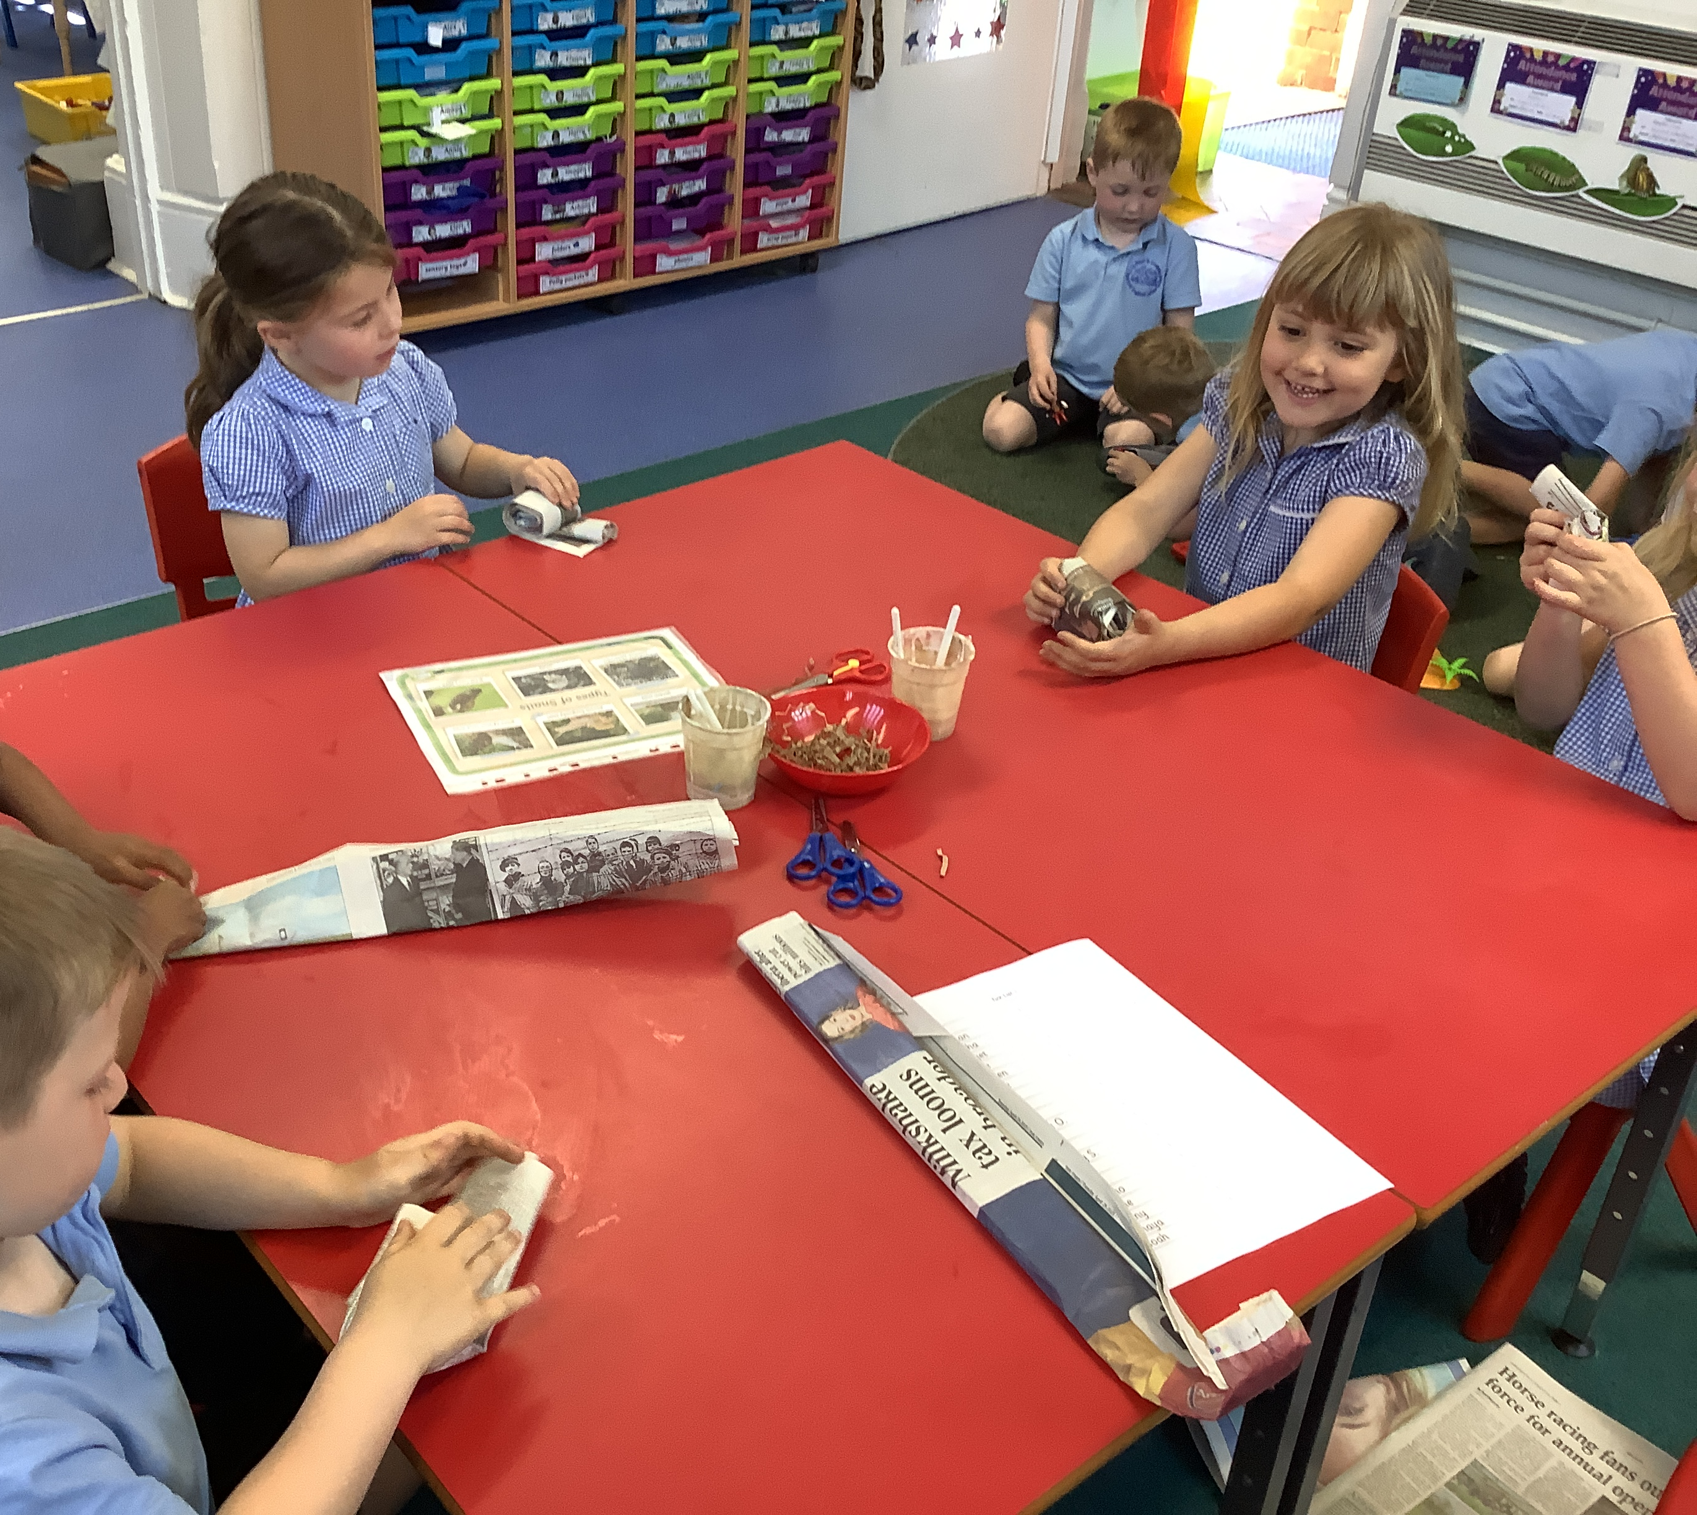
Exploring the learning environment.

Slide 14
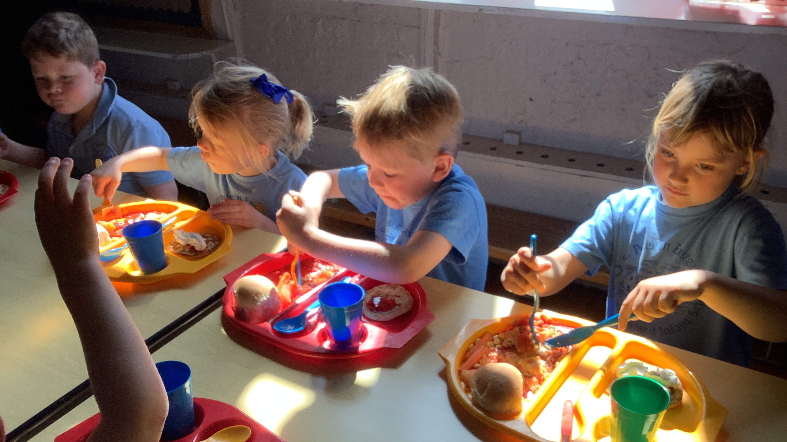
Lunchtime

Slide 15
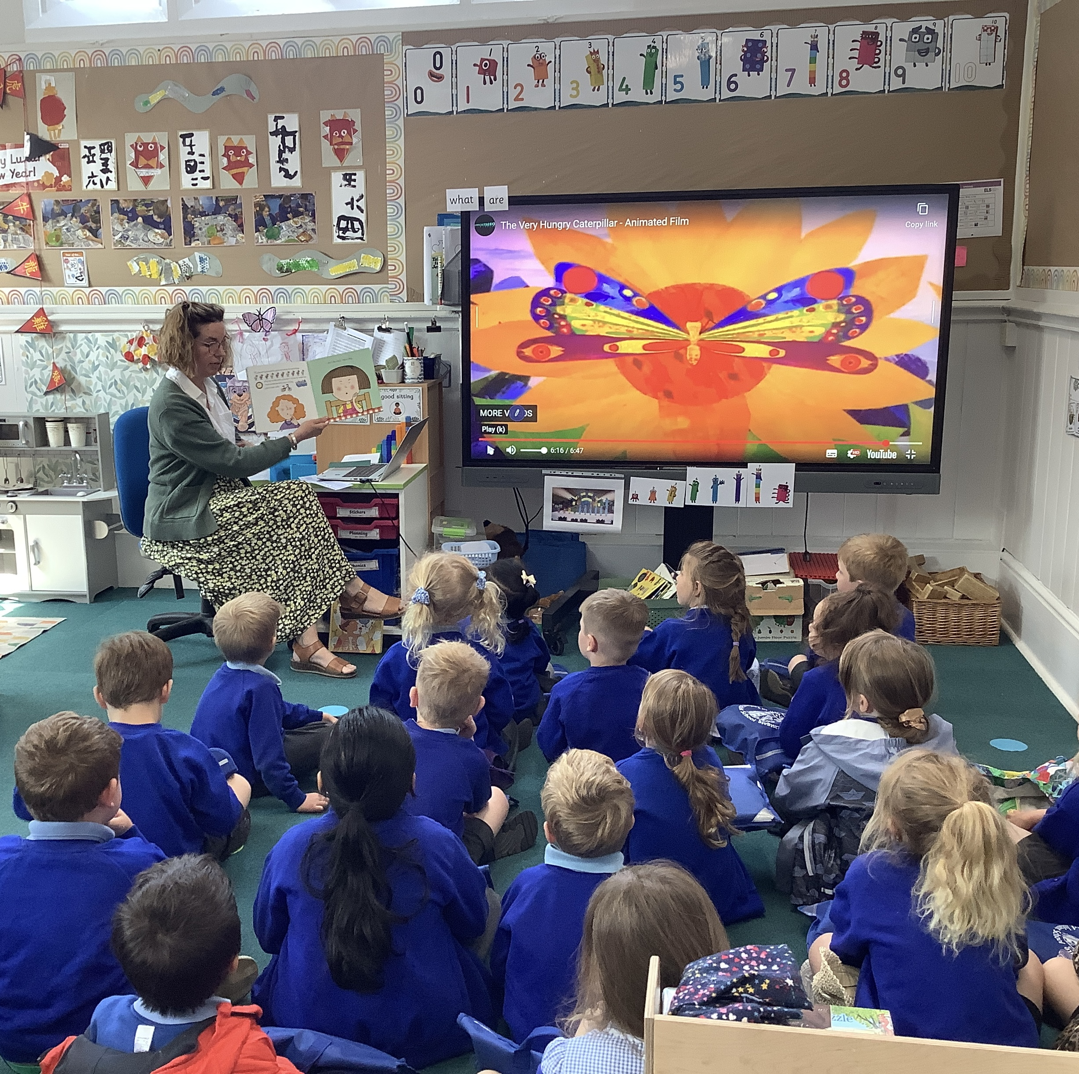
Storytime

Slide 16
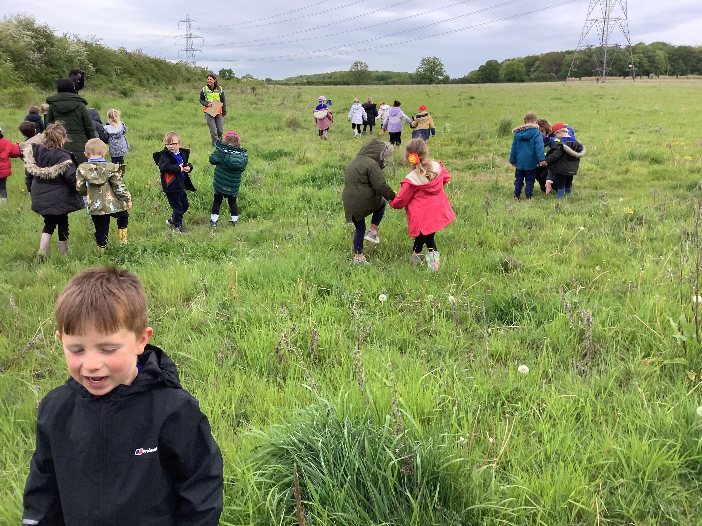
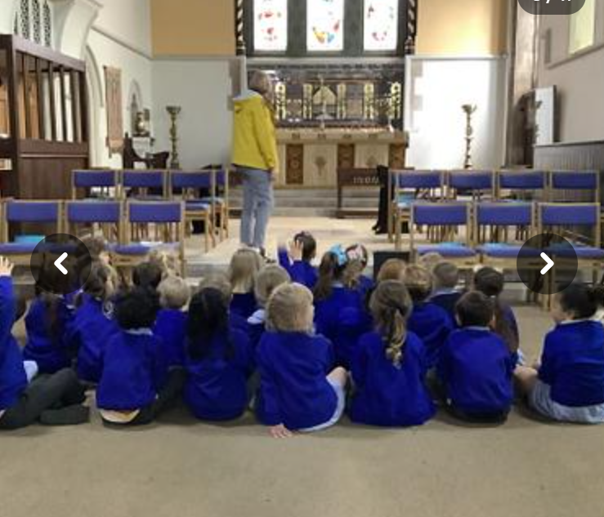
School Trips

Slide 17

Getting ready for school
How can I help?

Slide 18


Slide 19
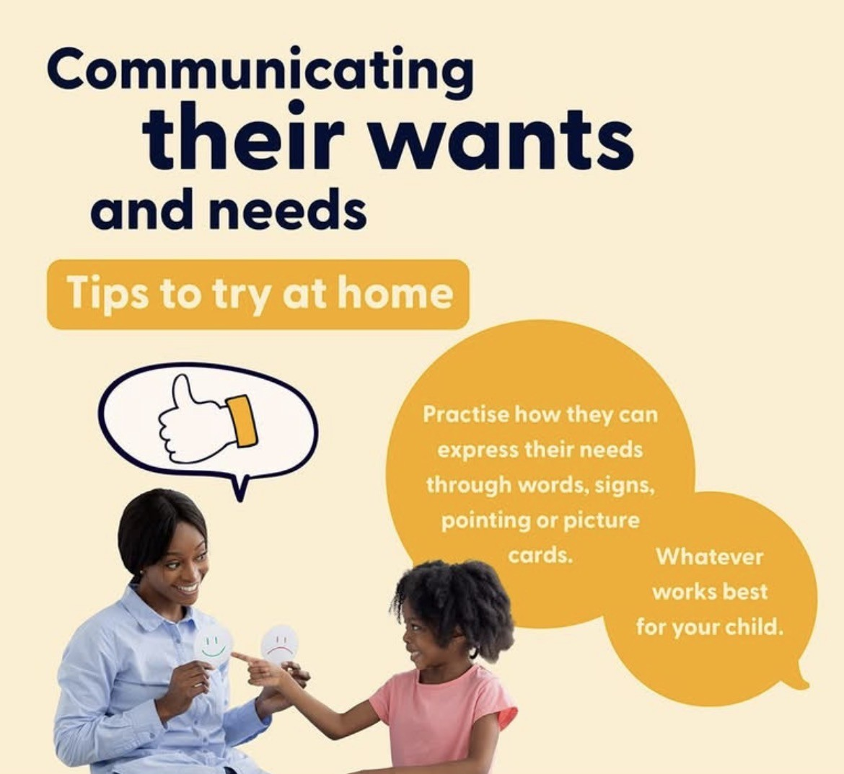
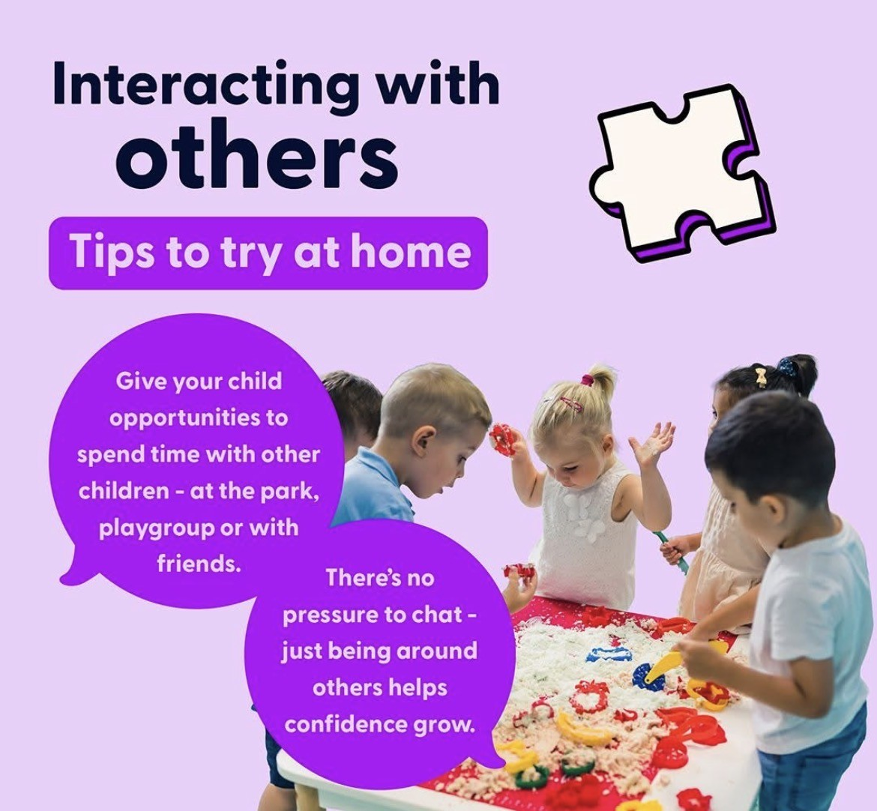

Slide 20
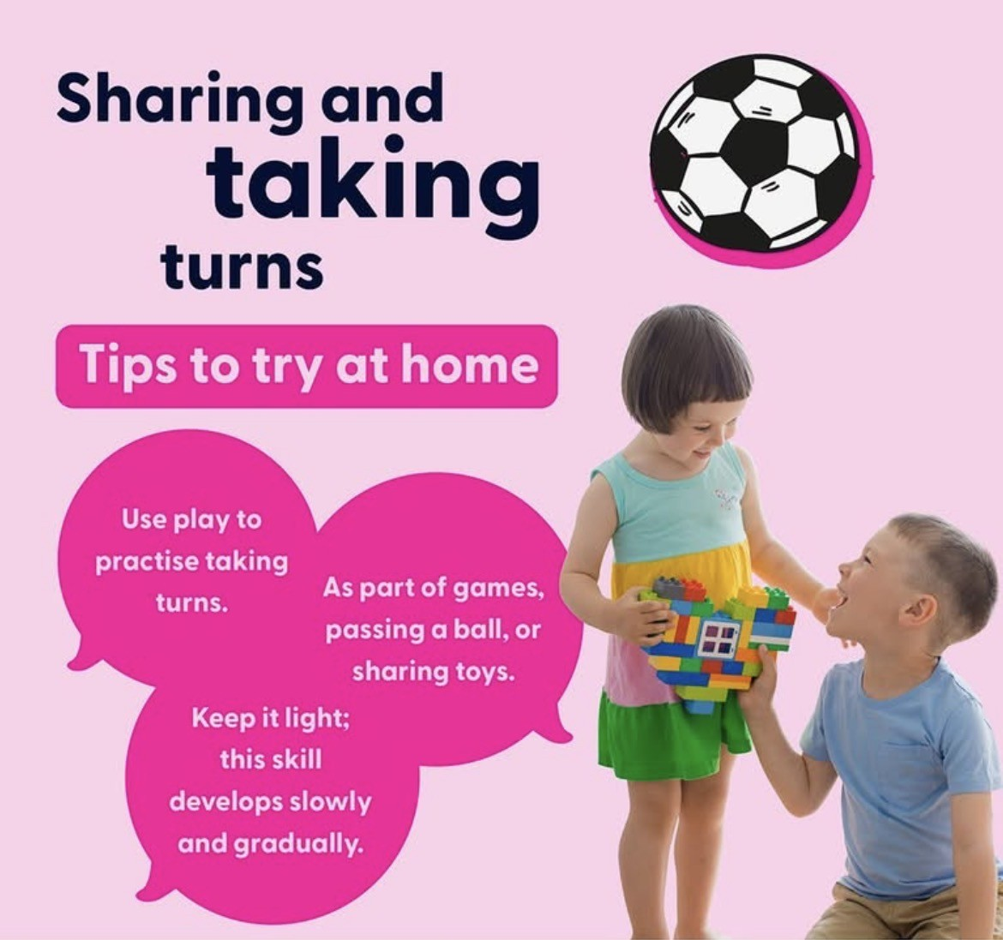


Slide 21


Slide 22


Slide 23
Steps For School Song | @BestStartinLife + @MCGrammarTV 🎤 | Educational Rap Songs for Kids 🎵 – YouTube
Preparing for school - Best Start in Life

Slide 24

Invite to St Peter’s day event

